Slide 1

Using social media to communicate about science
CAFE ESRs webinar, 28 April 2020
Mark Parrington (mark.parrington@ecmwf.int)
@m_parrington

Slide 2
Summary
Quick overview of CAMS products
My experience of communicating CAMS products
  Moving from traditional to NRT communication
  Social media informing news media
  Recent examples
Science by social media
Thoughts on best practices
Monitoring, tools and resources

Slide 3
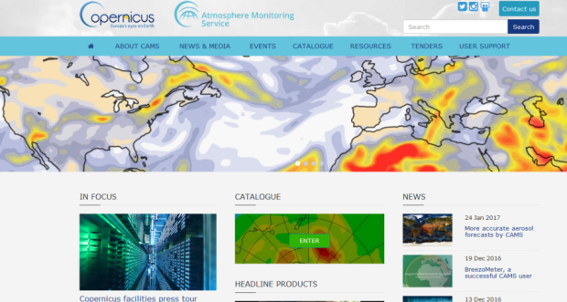
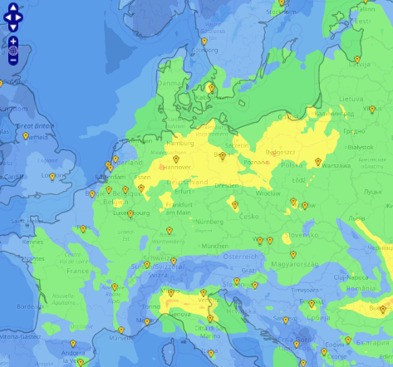
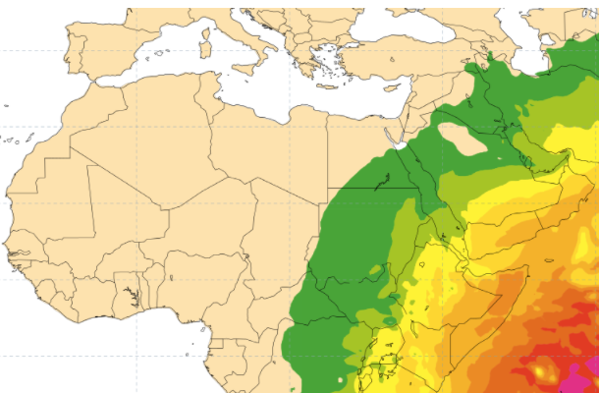
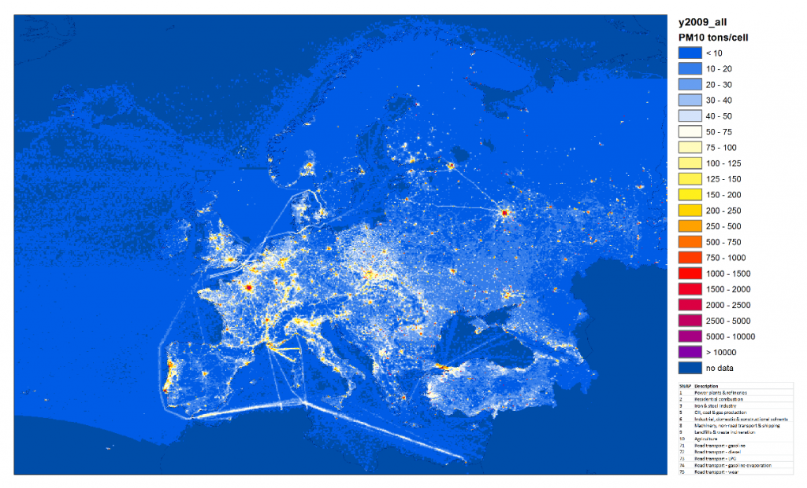
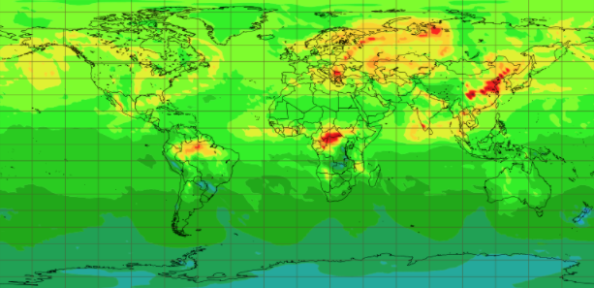
CAMS: COPERNICUS ATMOSPHERE MONITORING SERVICE
European Air Quality
LBCs for regional models
NO₂
http://atmosphere.copernicus.eu
Ozone layer
Solar radiation and UV index
Emissions and surface fluxes
Global analyses, forecasts and reanalyses
Notes:
Here there are some few example of the provided products and it's important to underlying that there are value added information based on satellite data.

Slide 4
Where it all began
Atmospheric composition (& meteorology ) is highly interdisciplinary and effective science communication requires breadth of knowledge and experience.
PhD on satellite observations of ozone in the UTLS
10 years postdoctoral experience
  Numerical modelling and assimilating satellite observations of atmospheric composition in the stratosphere and troposphere
  Aircraft measurements of atmospheric chemistry related to wildfire emissions
6 years “operational” experience
  Atmospheric composition assimilation
  Maintaining Global Fire Assimilation System, and routinely monitoring wildfires worldwide
  Using social media for user engagement and promoting CAMS products
  Monitoring/evaluation of CAMS forecasts

Slide 5
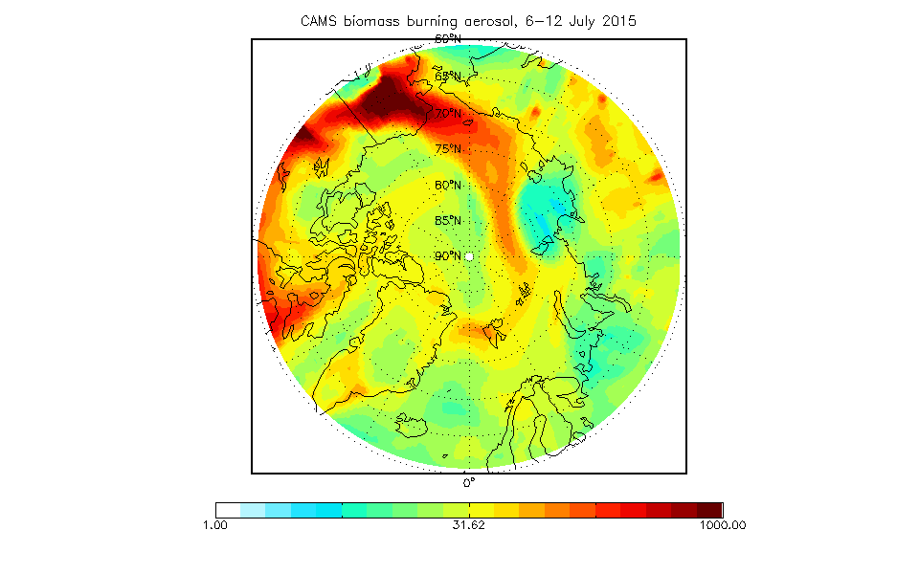
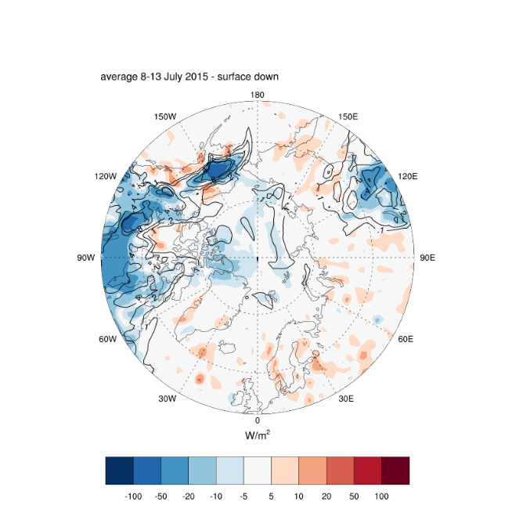
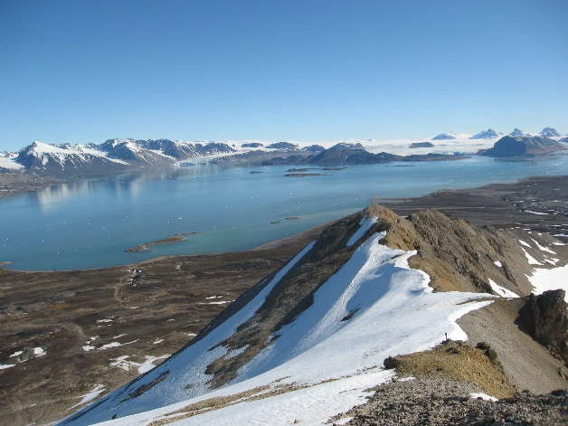
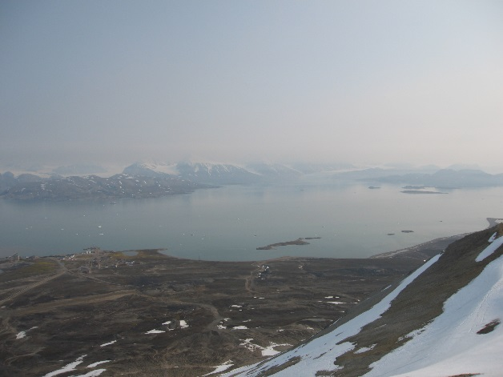
1st case study: Smoke transport to the Arctic, July 2015
Smoke from wildfires in Alaska transported across eastern Arctic Ocean starting 6 July 2015.
Observed as haze at Zeppelin Observatory on Spitsbergen 10 July.
ECMWF Autumn newsletter article by M. Parrington, A. Bozzo, S. Remy and I. Tsonovsky.
Photos courtesy of Per Erik Hanevold (Norwegian Polar Institute)

Slide 6
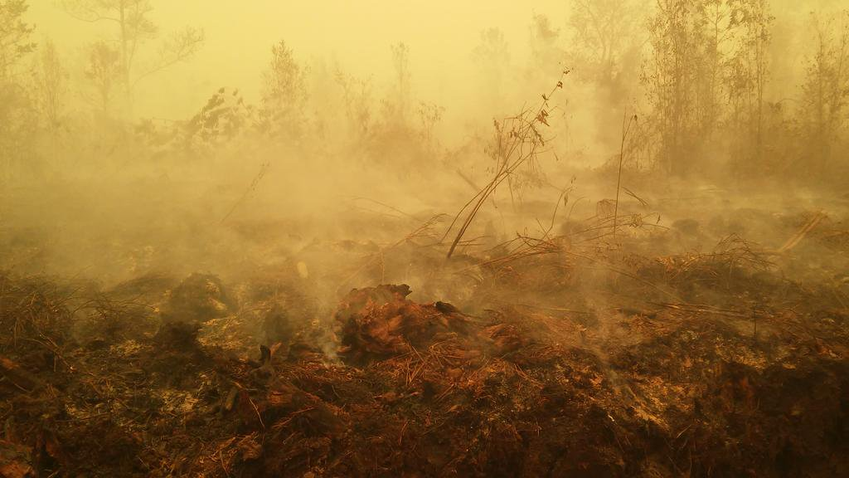
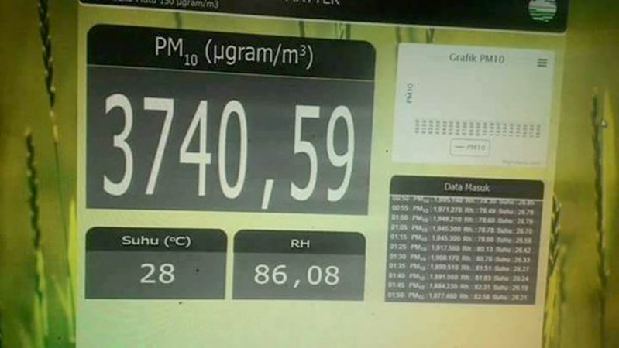
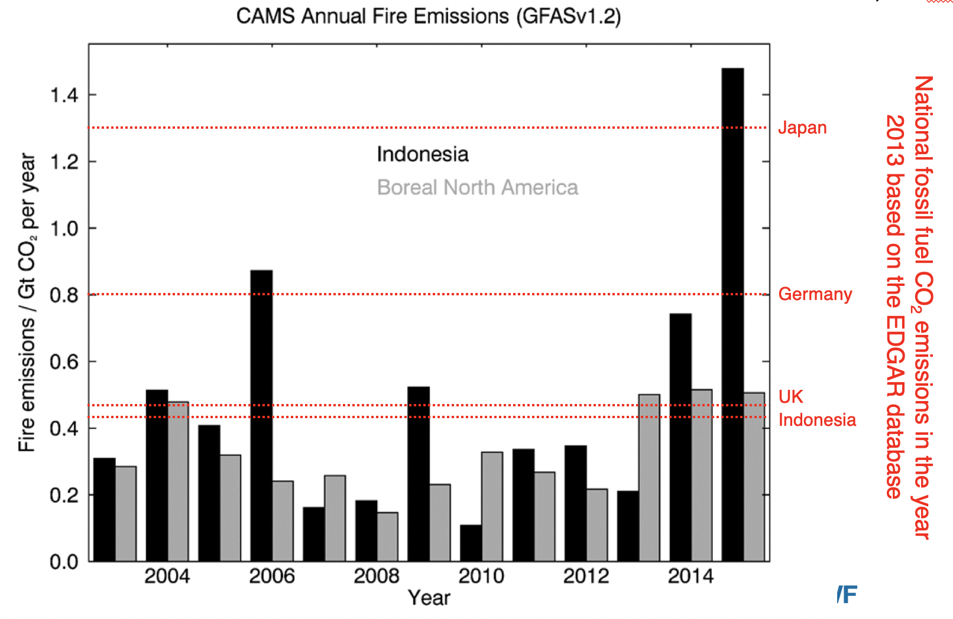
2nd case study: Indonesia fires in 2015
Source: David Gaveau (CIFOR)
Organic matter aerosol optical depth
Carbon monoxide

Slide 7
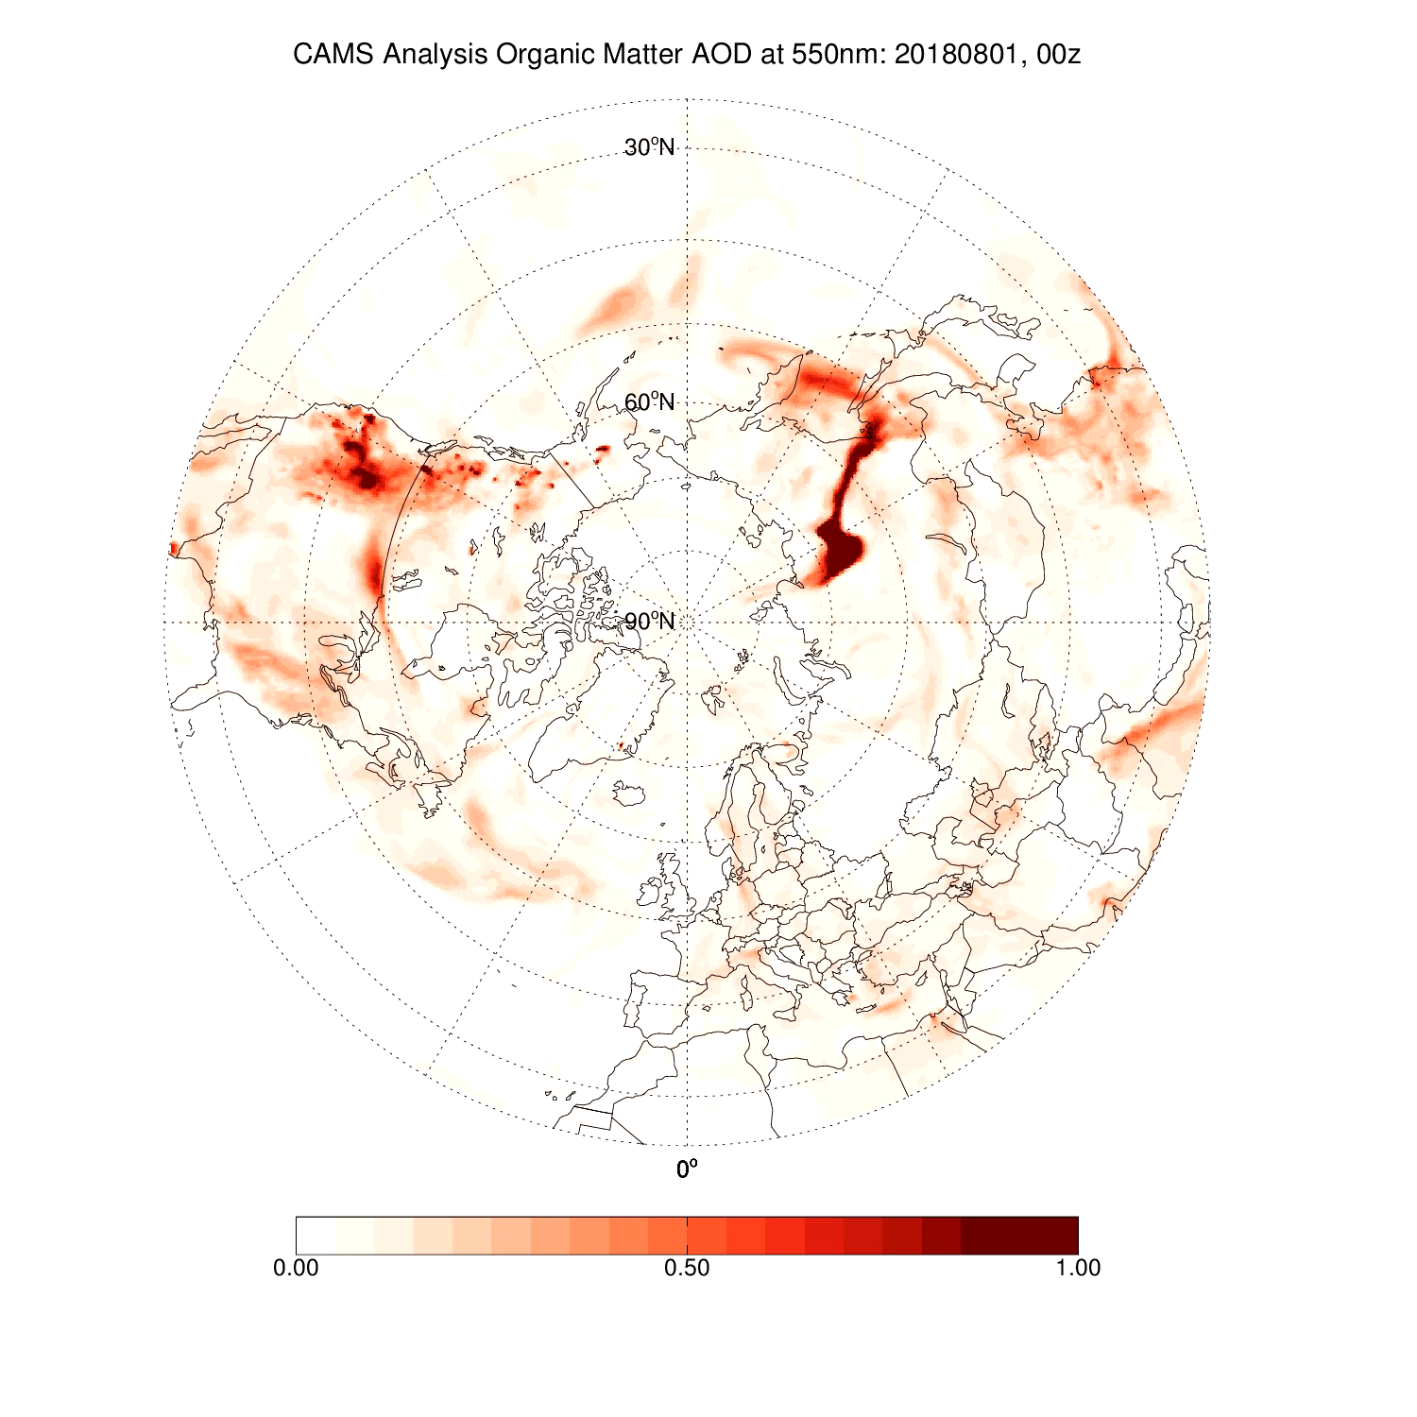
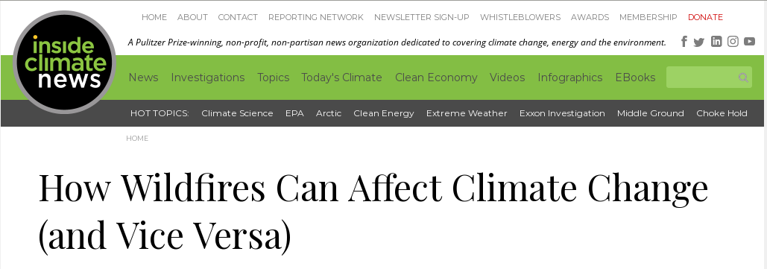
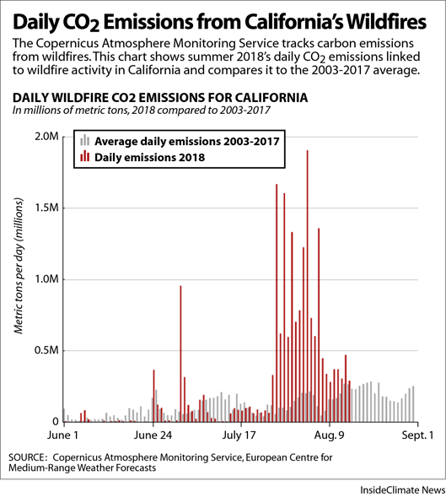
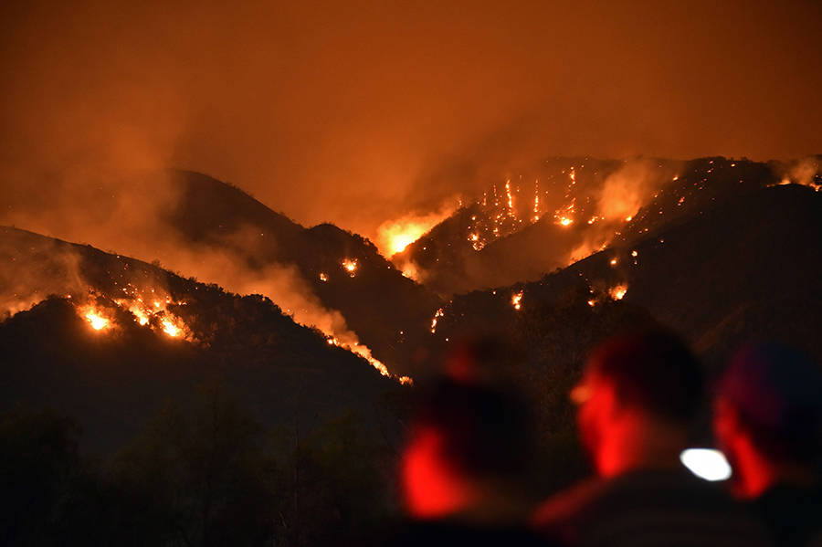
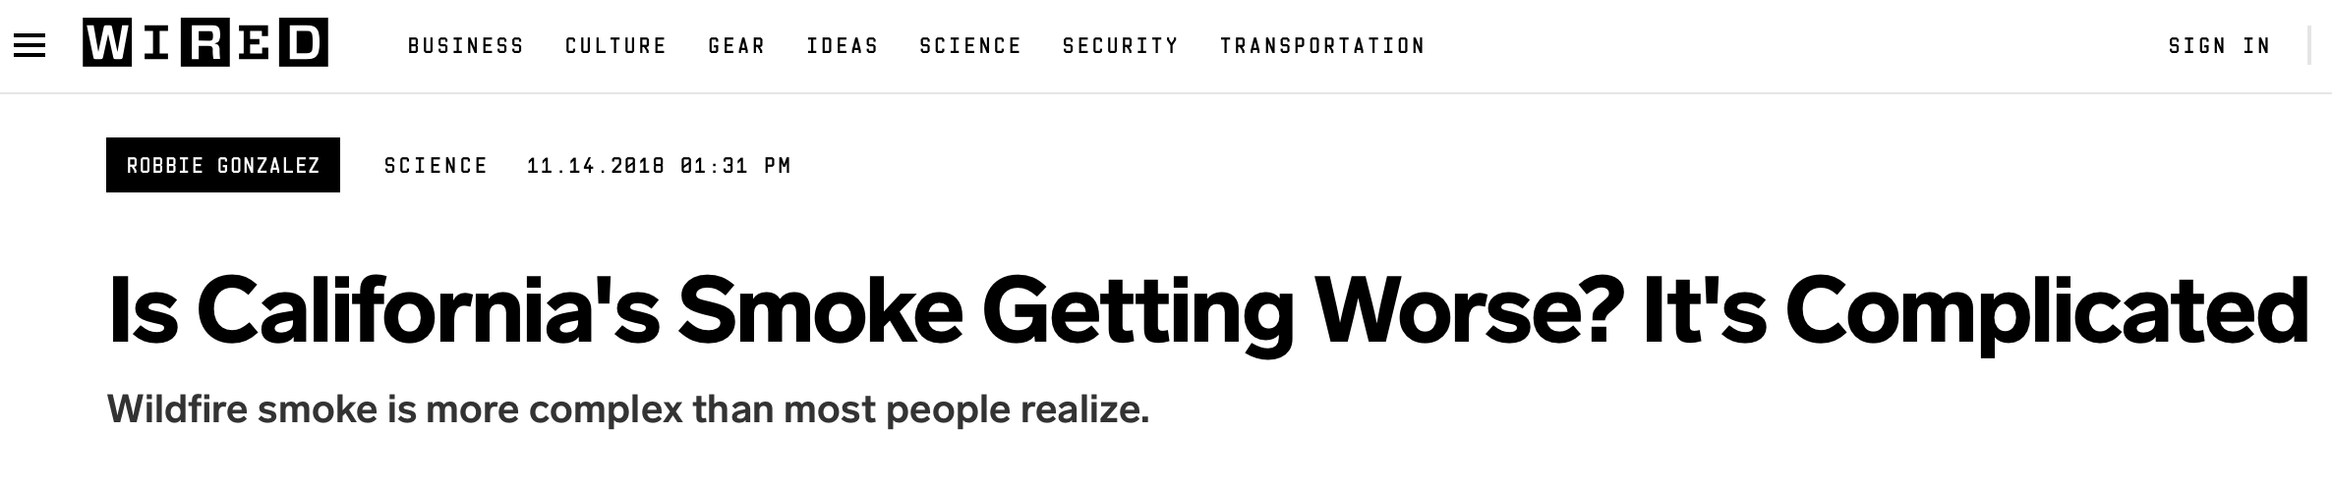
Media interest: summer 2018
Smoke pollution regularly reached the Arctic from large wildfires in Siberia.
Smoke pollution from intense wildfires between California and British Columbia covered large parts of North America and reached as far as Europe.
CAMS monitoring of these fires featured in news articles by El Pais, Euronews, Earther, InsideClimate, The Guardian and WIRED.
https://www.wired.com/story/is-californias-smoke-getting-worse-its-complicated/
https://insideclimatenews.org/news/23082018/extreme-wildfires-climate-change-global-warming-air-pollution-fire-management-black-carbon-co2

Slide 8
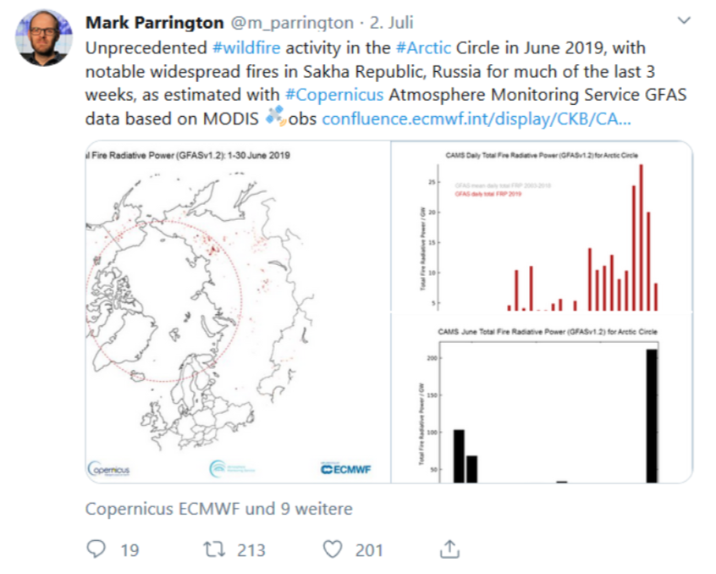
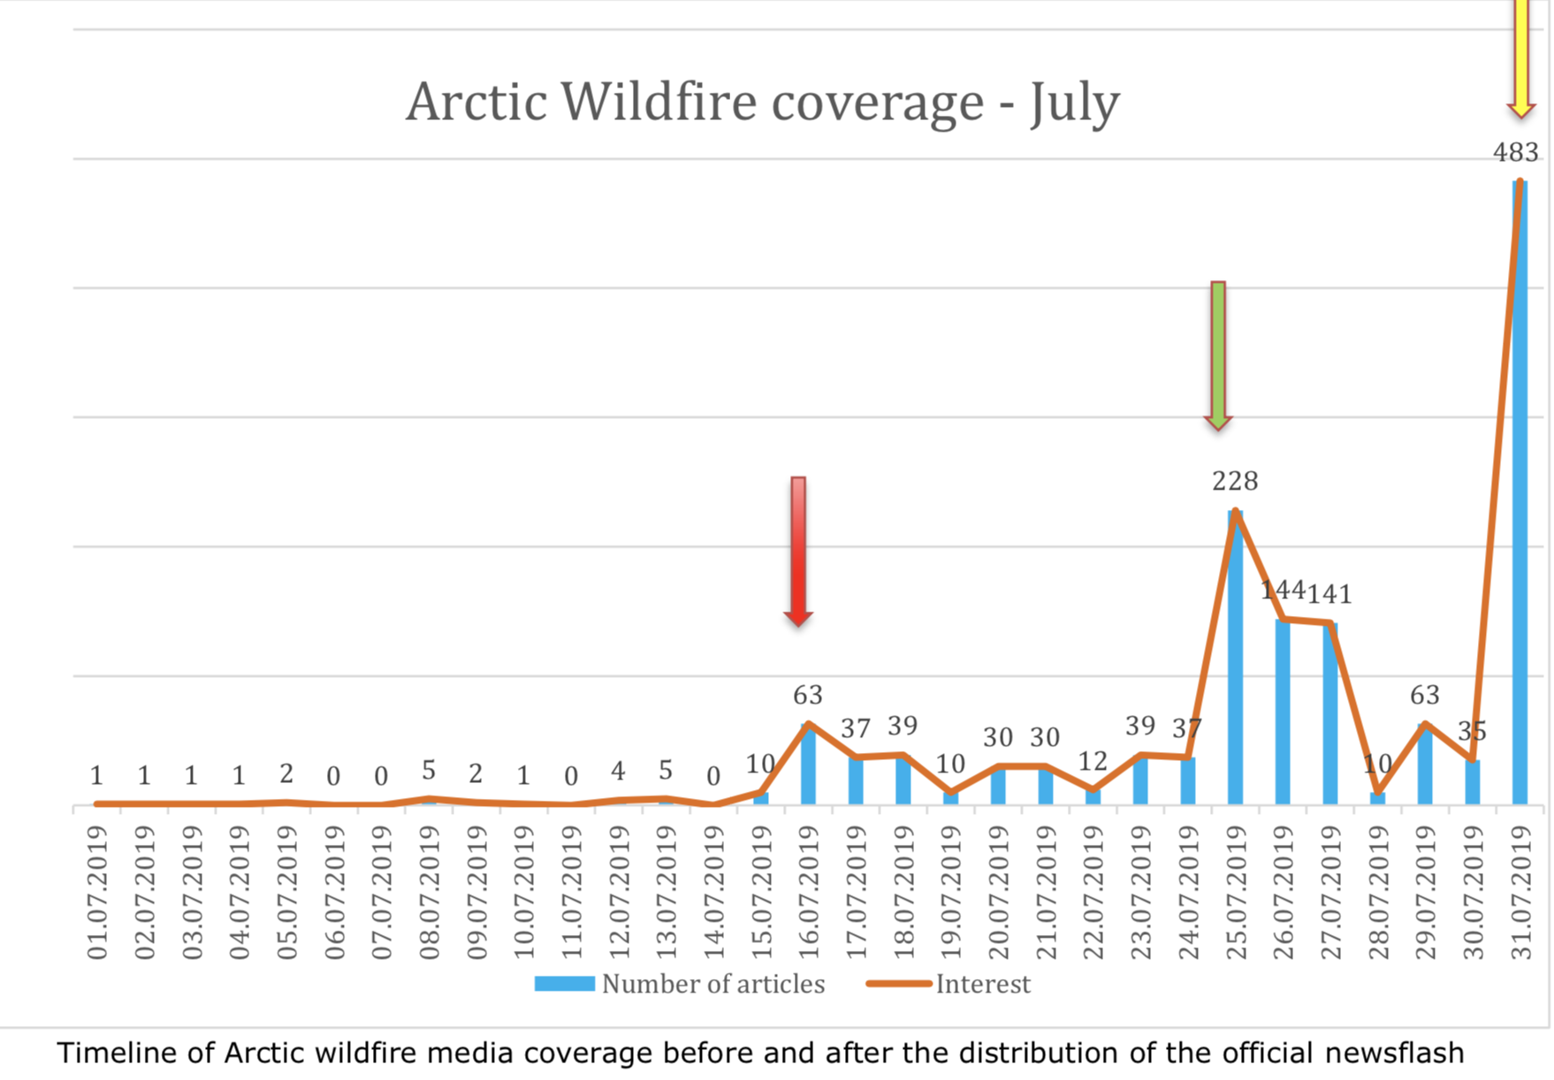
Growing media interest: Arctic wildfires summer 2019
Coverage: 1434 pieces of coverage worldwide in 87 countries
Quality of coverage: major international key broadcasters and publications: CNN, Washington Post, BBC, Zeit
Media inquiries and interviews: 32
Visibility of CAMS increased.

Slide 9
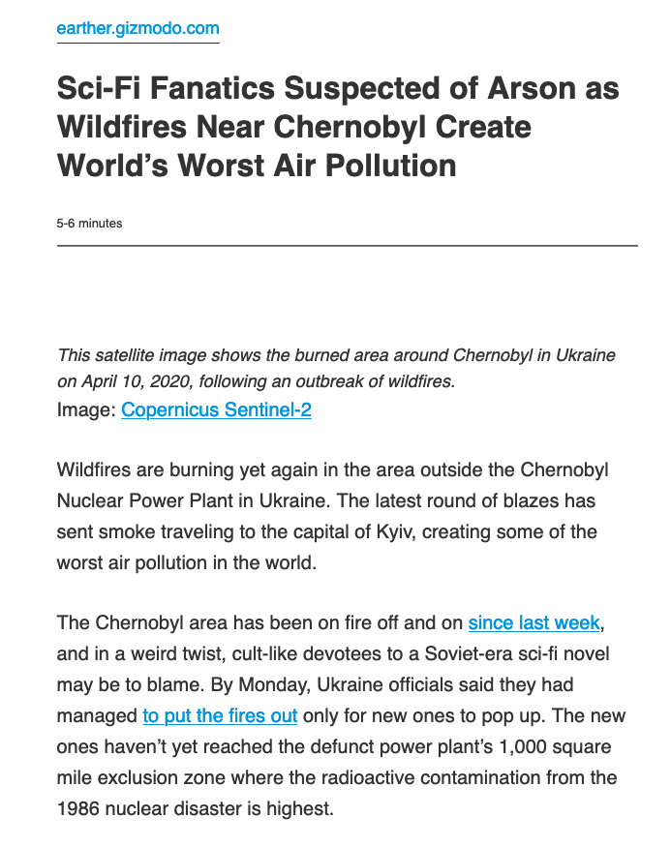
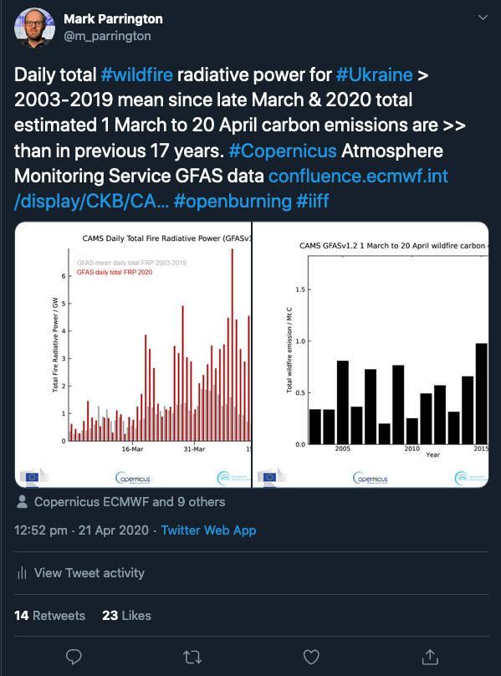
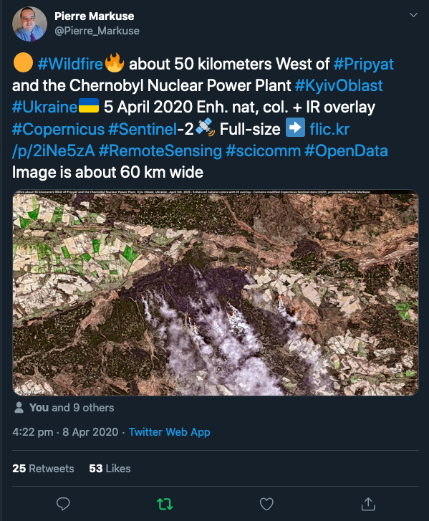
Chernobyl fires
General communication, based on satellite/remote sensing, via social media
Accessible by anybody, quick communication can link to journalists and local experts

Slide 10
Science by Social Media
Social media does not replace peer review or published research
It is a valuable resource for quickly finding, and sharing, scientific information with a diverse audience
Don’t be afraid to tag or tweet at other experts or organizations
  ”Science on the fly”
  Raises your profile, and that of your research, with other scientists/communicators
  Engages with interested parties in your field and related fields
  Builds collaborative networks and creates opportunities
Retweet related or interesting content
  Always read/watch any content first and make sure you are comfortable passing it on

Slide 11
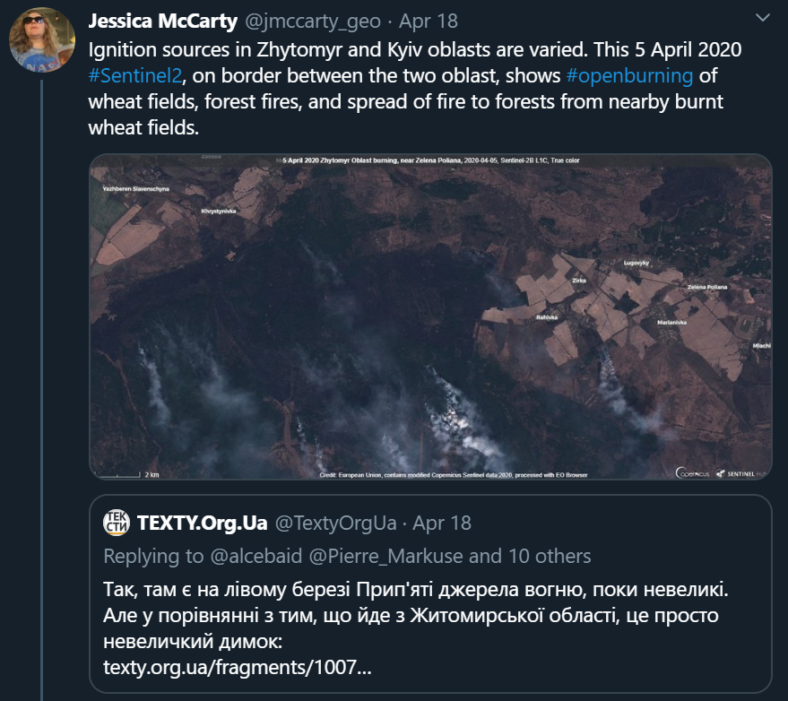
Best practices
Social media is an excellent tool for providing and finding information on wildfires and smoke
Factual, data-driven messages
  Provide context
  Link to actual on-the-ground information or other experts
  Trustworthy for social media users and journalists
Elevate regional and local expertise
  Locations reported in local media (Chernobyl fires, April 2020)
  Official communication channels and emergency response
Engage/share information with local experts as much as possible

Slide 12
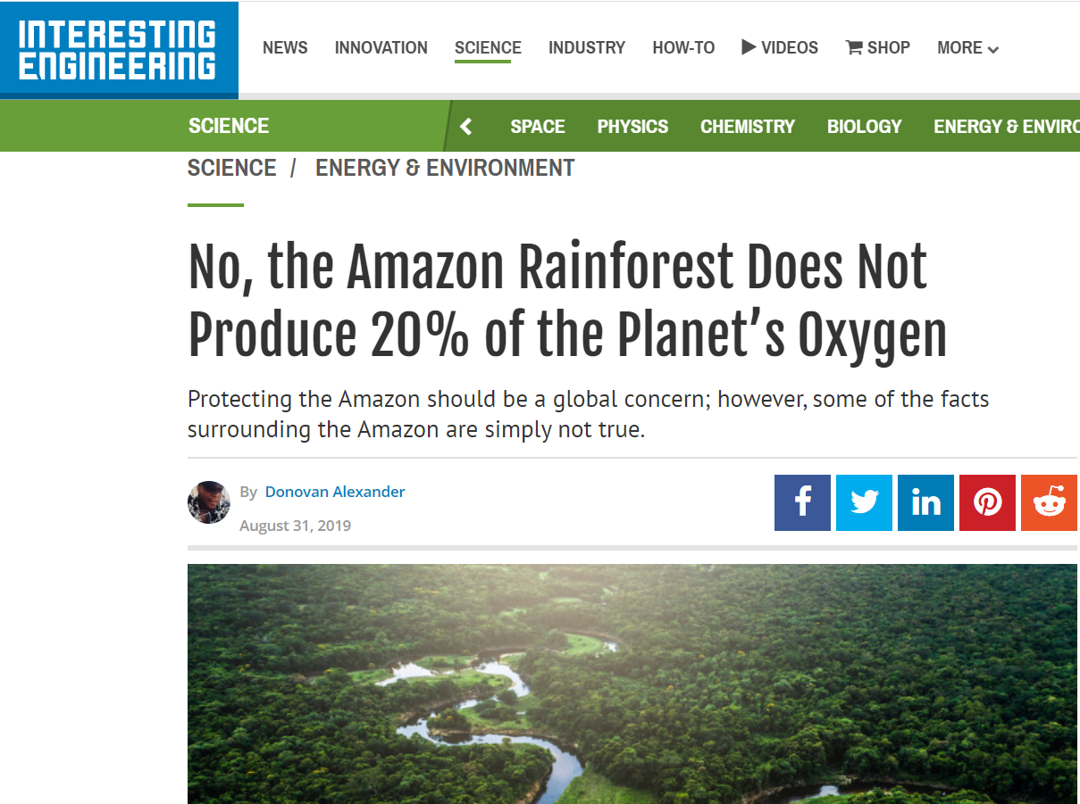
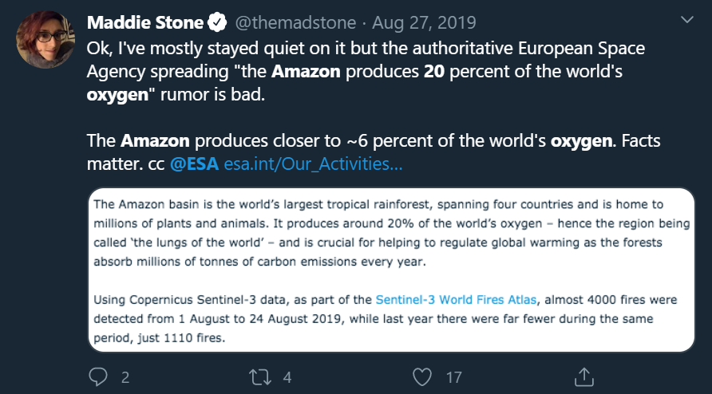
And if you are wrong…
Admit it, correct it, but don’t delete it.
  Screenshots are forever.

Slide 13
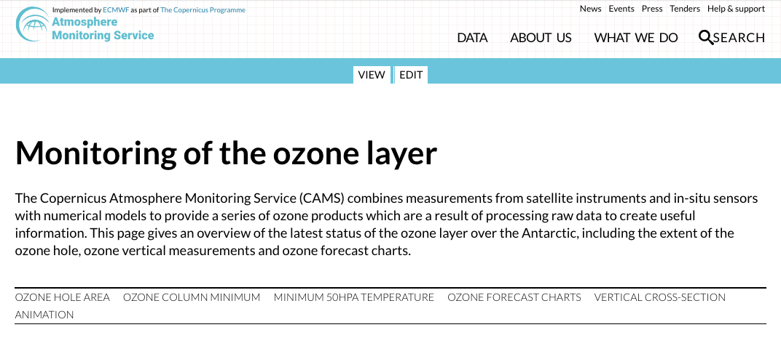
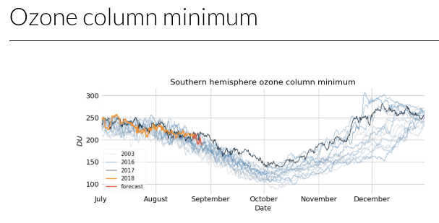
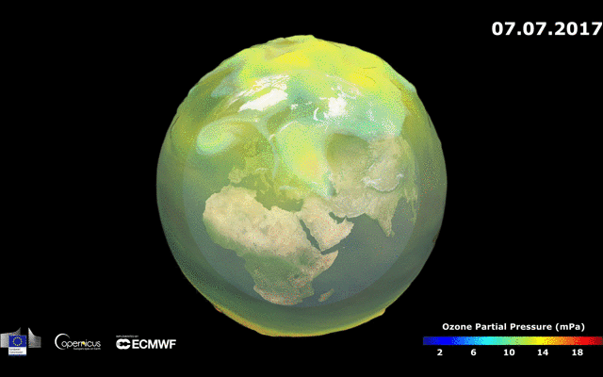
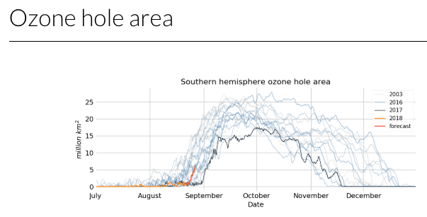
Targetted monitoring/communication: Ozone layer
INTERNATIONAL DAY FOR THE PRESERVATION OF THE OZONE LAYER
KEEP COOL AND CARRY ON: MONTREAL PROTOCOL – 16 SEPTEMBER 2018
Having highest quality data is not enough
Put current ozone hole in the longer term context
Explanatory animation to explain what to look for

Slide 14
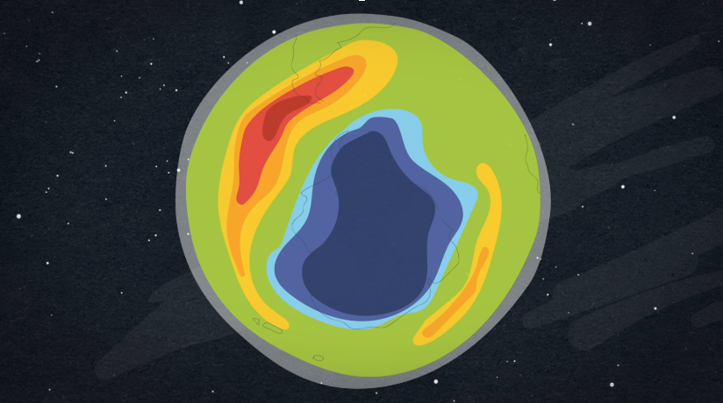

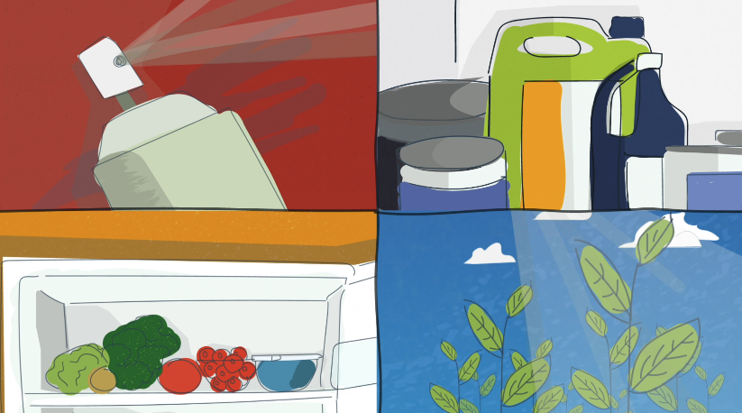
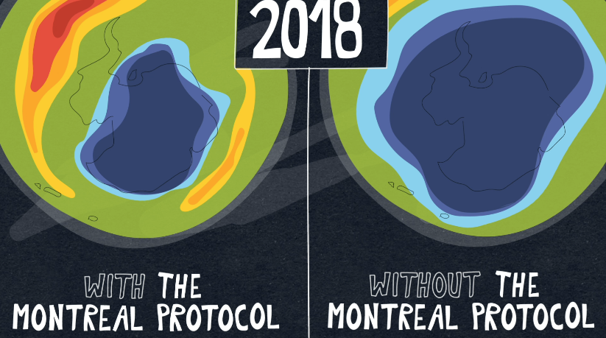


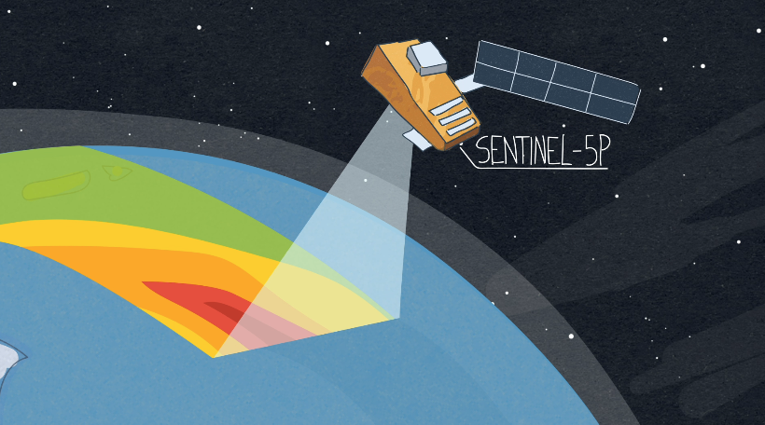
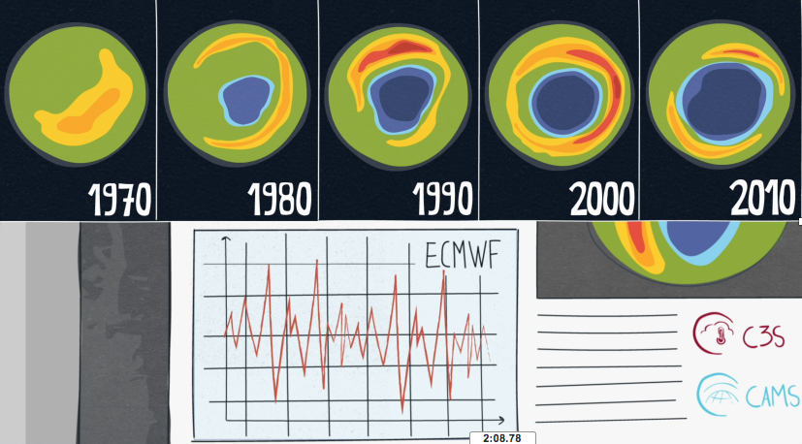
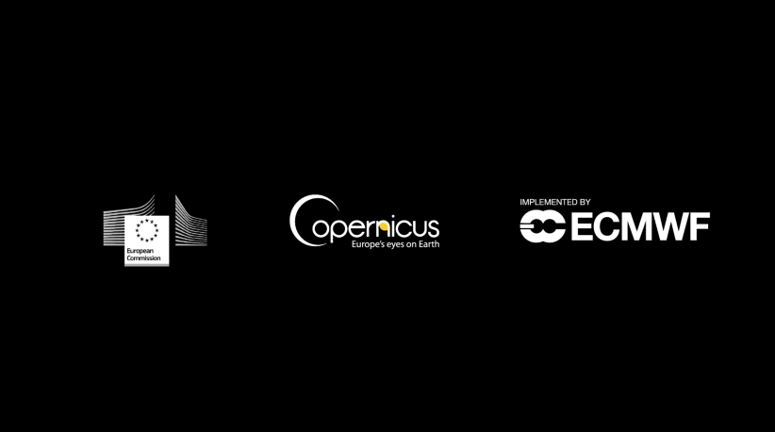
EDUCATIONAL VIDEOS

Slide 15
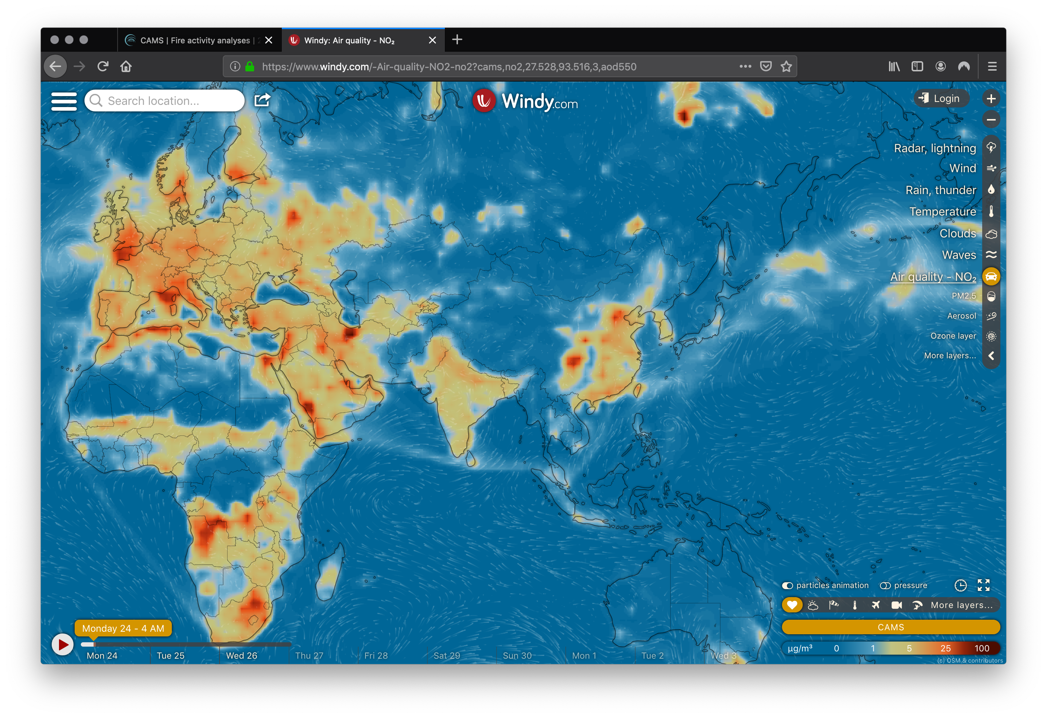
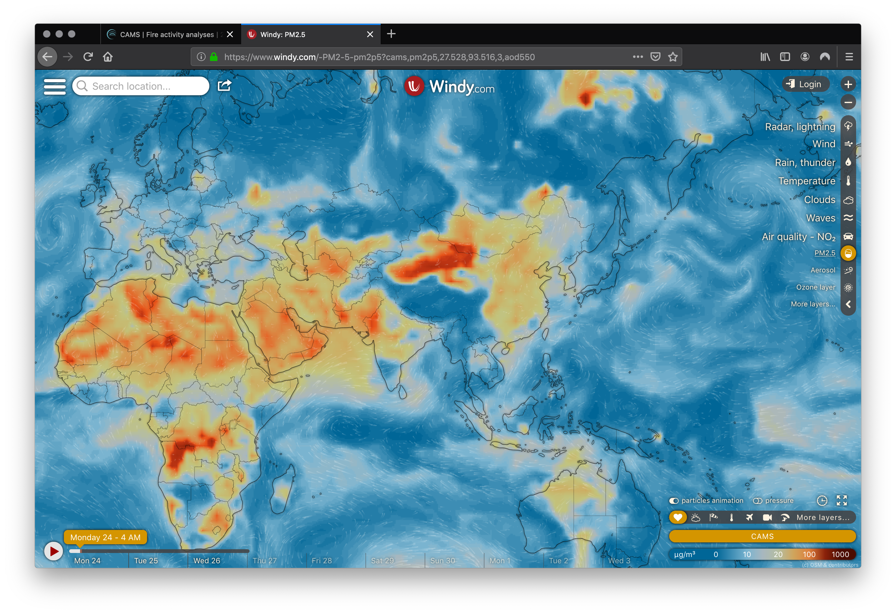
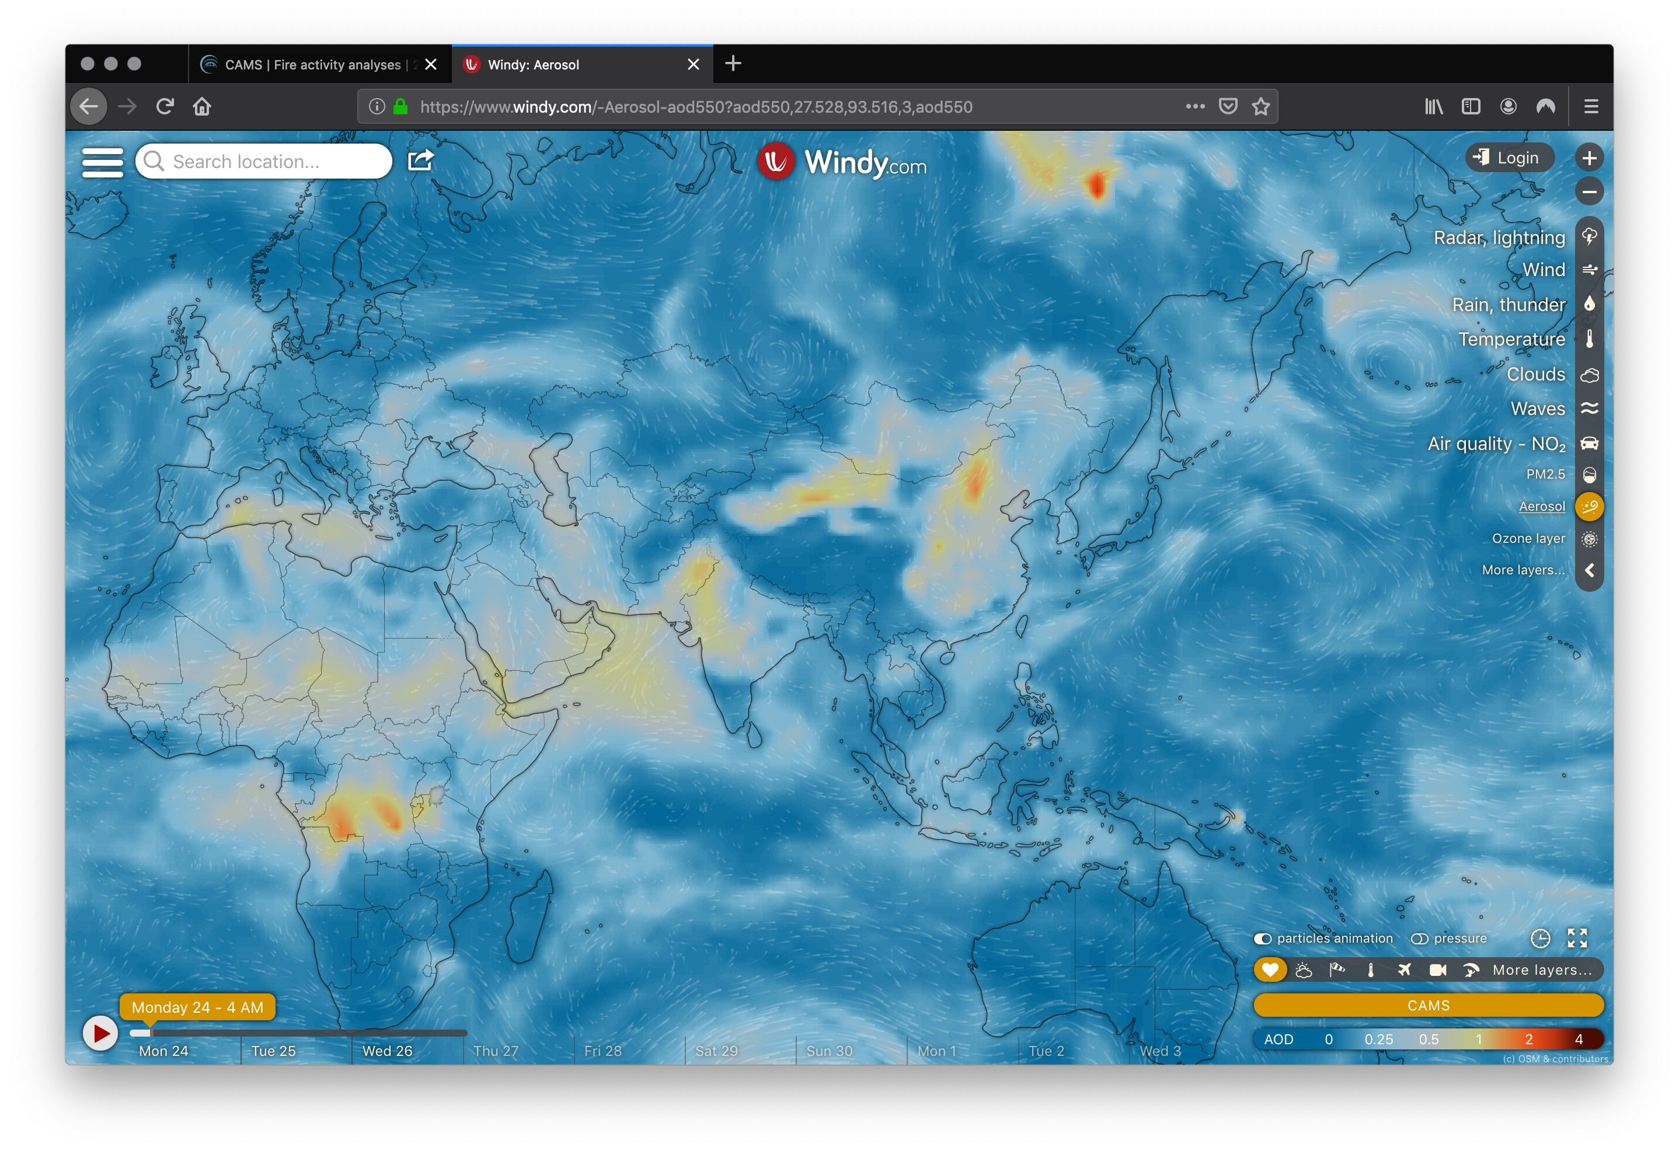
Visualizing CAMS forecasts on Windy.com
NO2
PM2.5
Latest CAMS 5-day global forecasts and fire emissions visualized via website and mobile app of windy.com
AOD

Slide 16
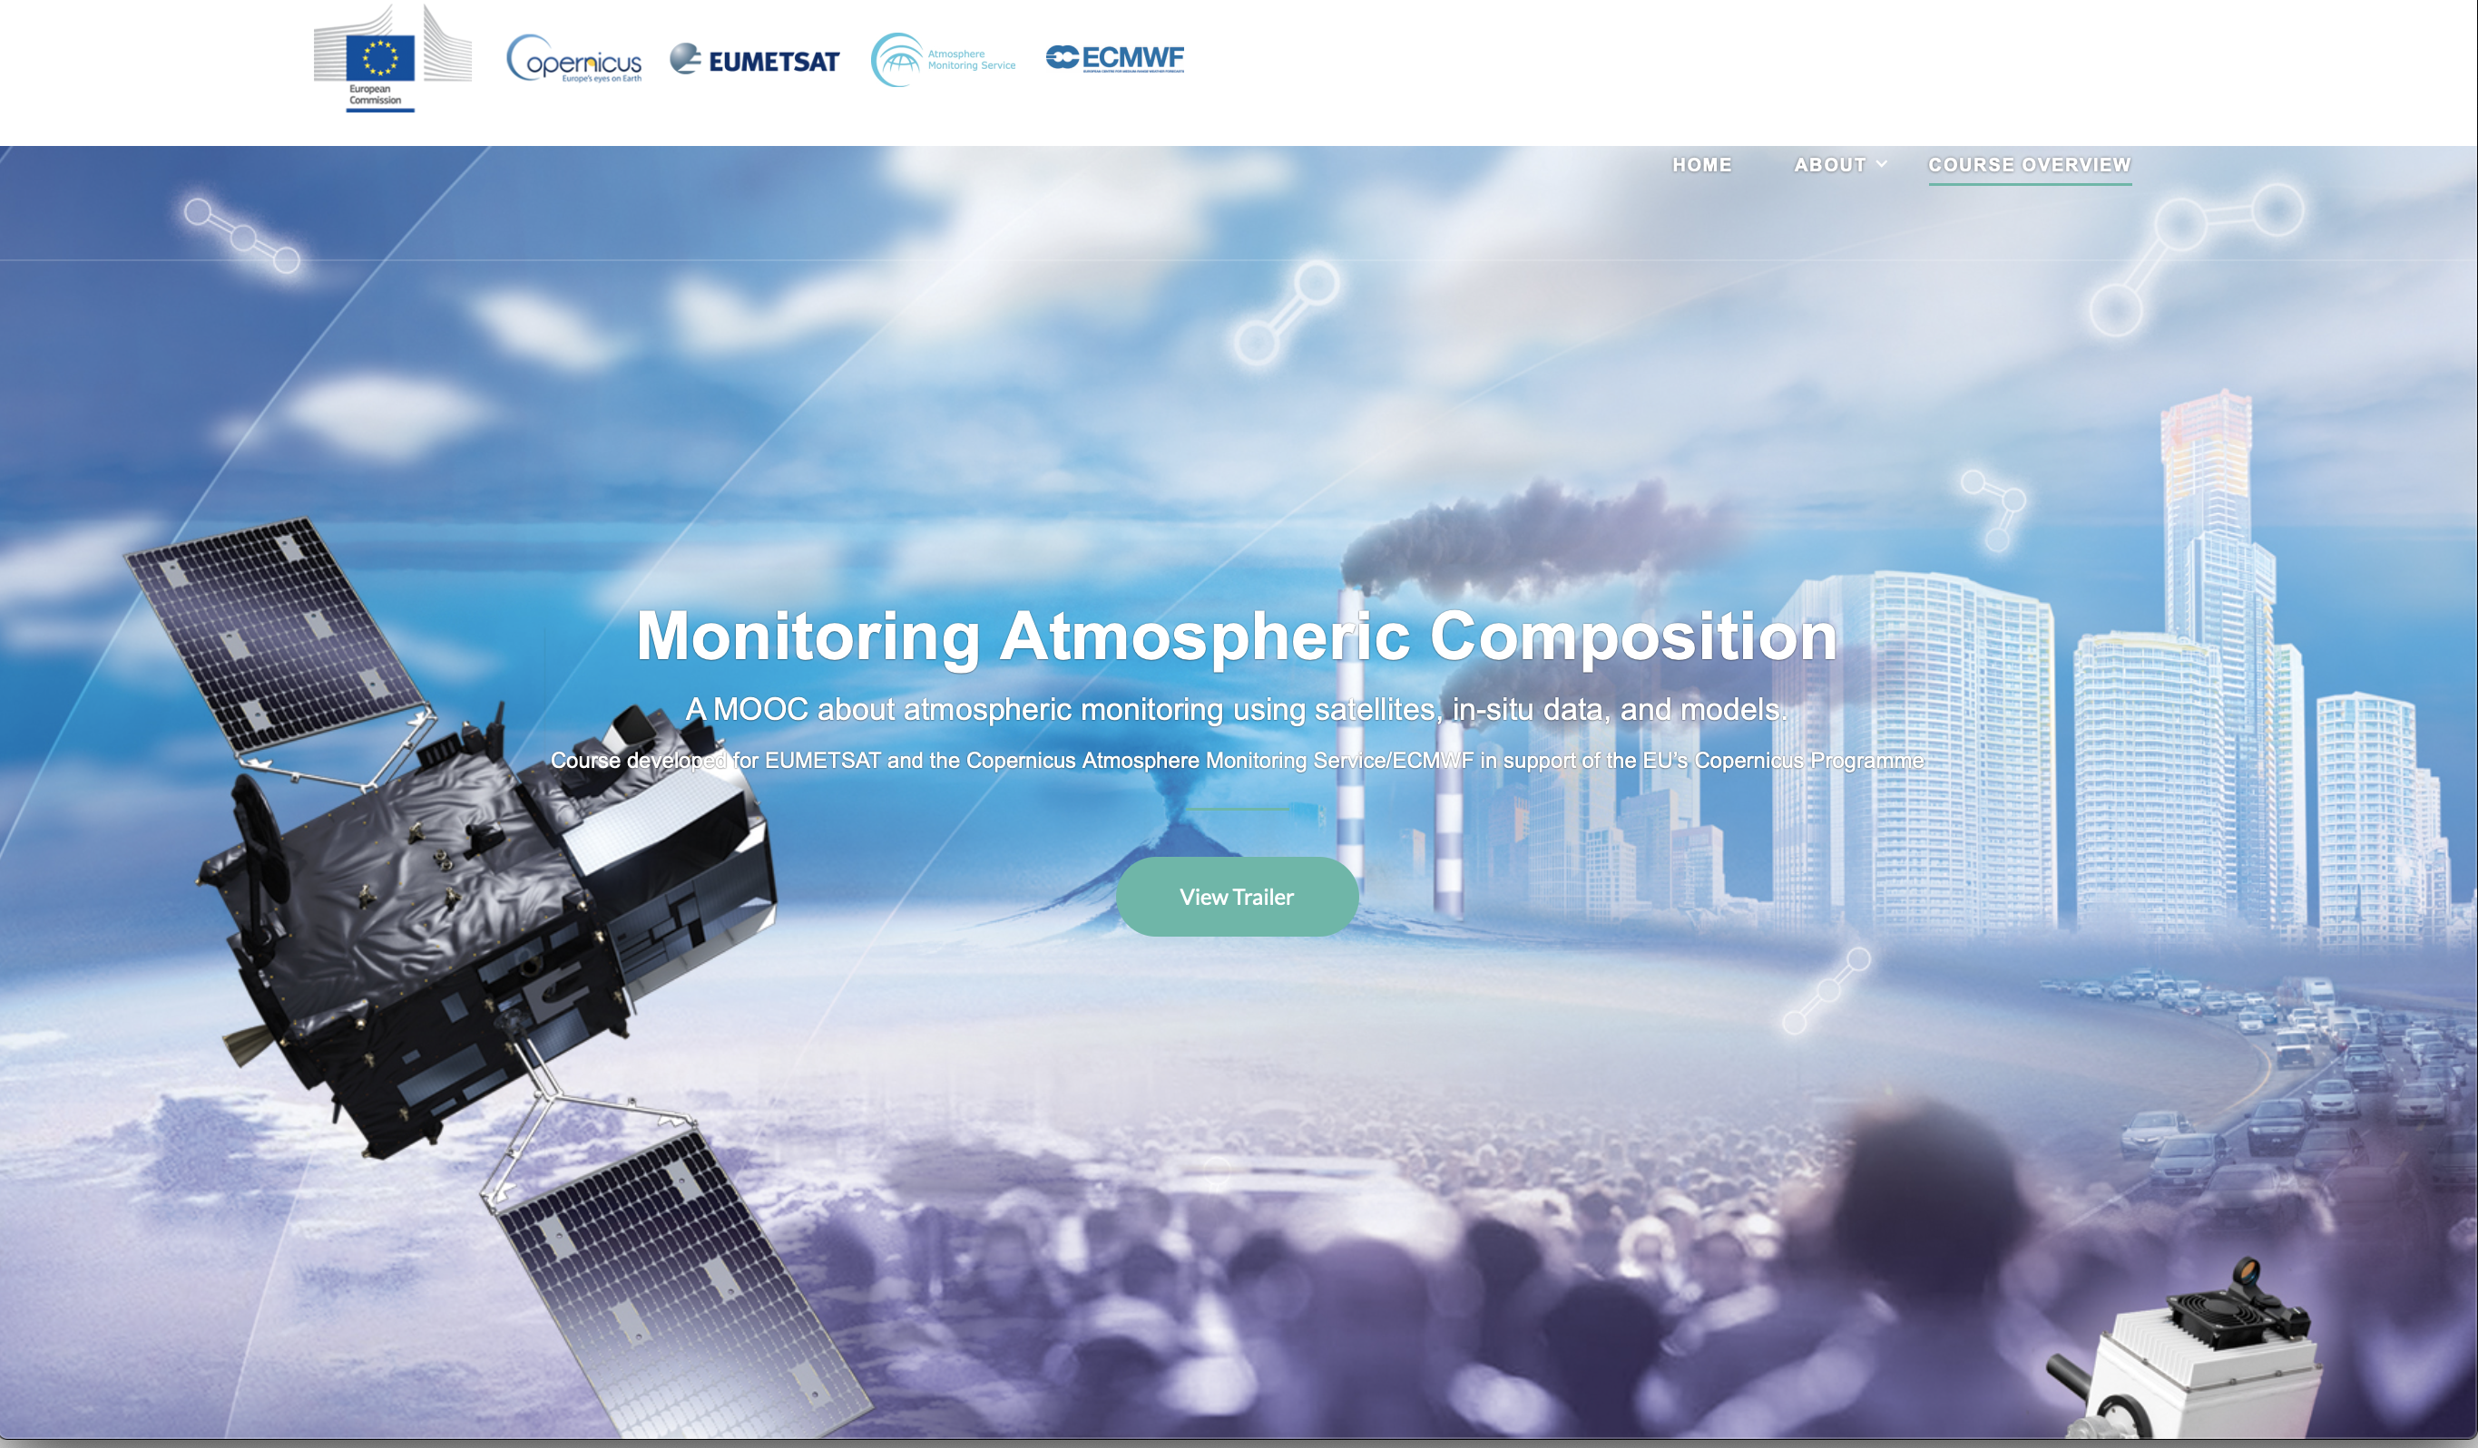
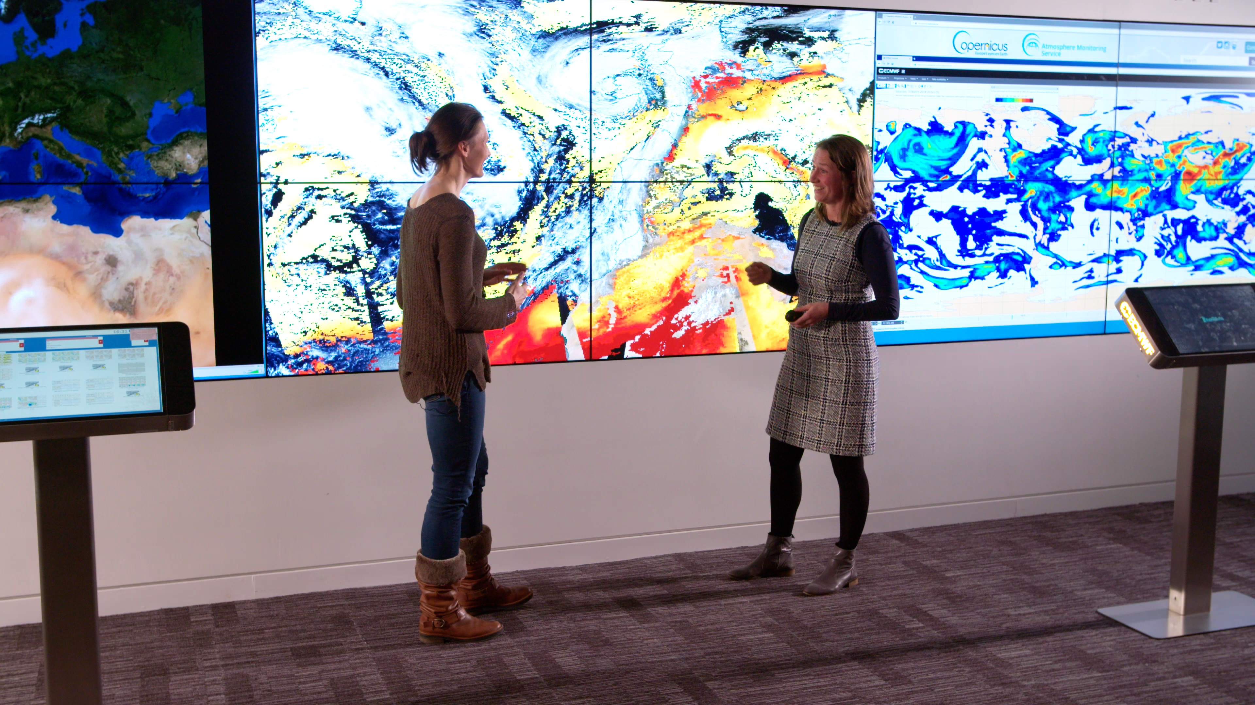
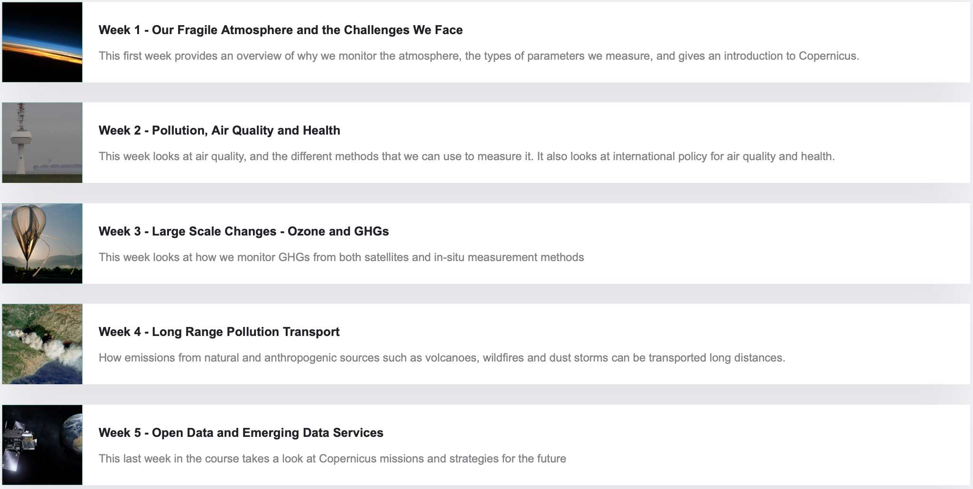
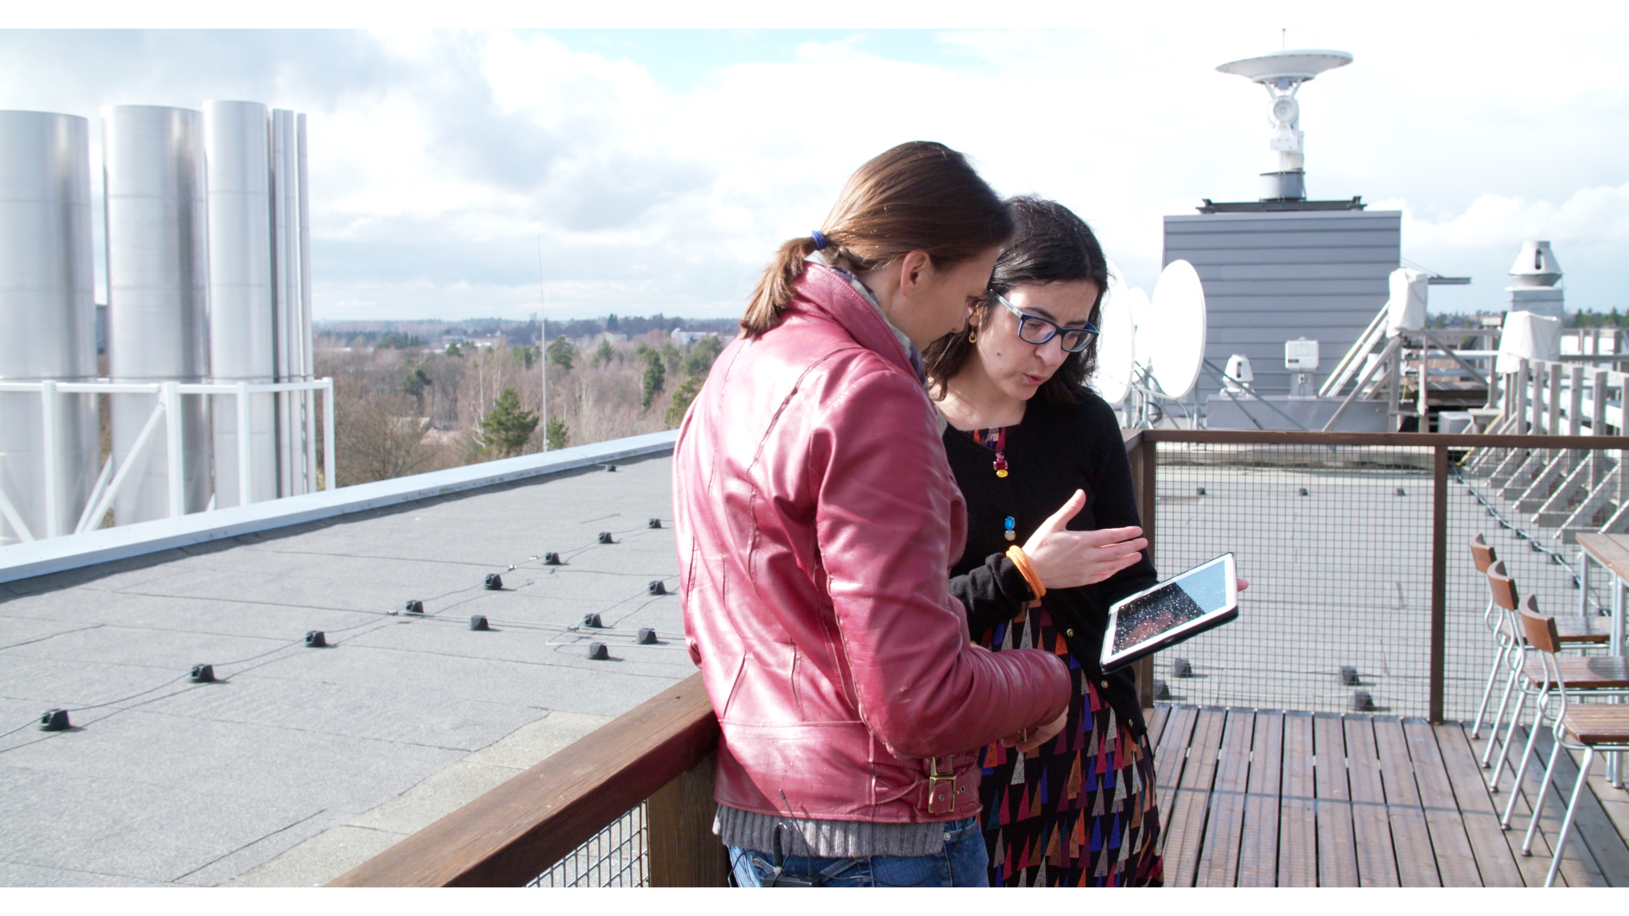
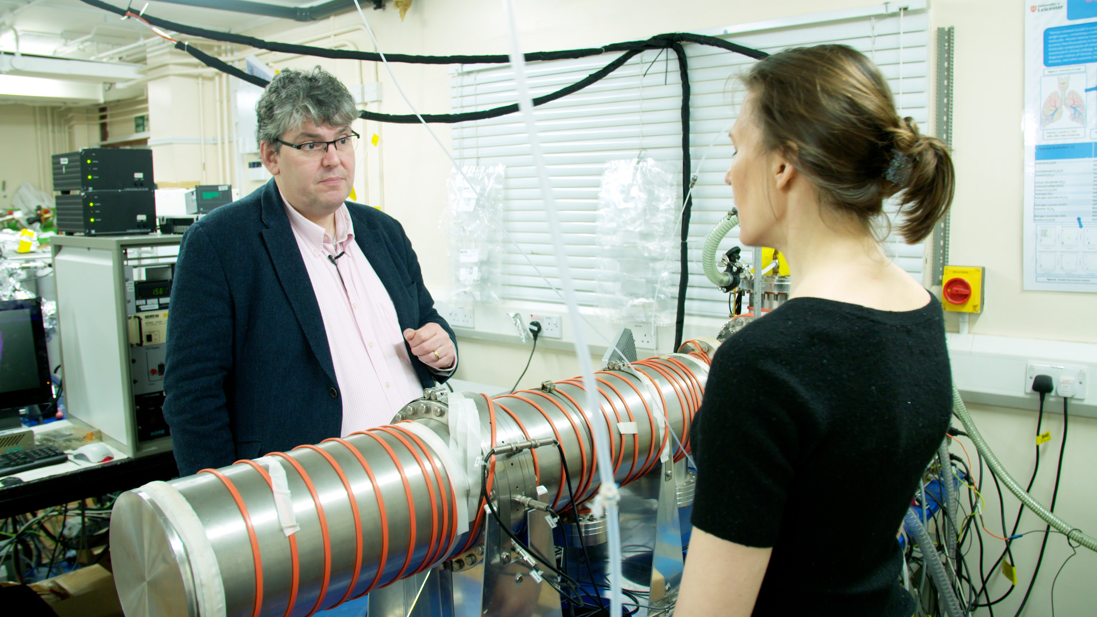
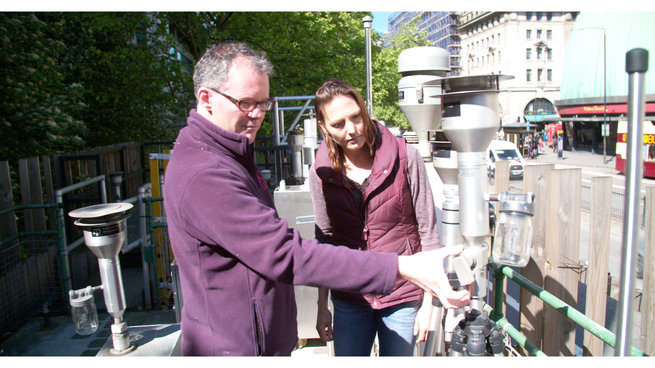
THE ATMOSPHERE MOOC
https://www.atmospheremooc.org/course-overview
#AtmosphereMOOC

