Slide 1



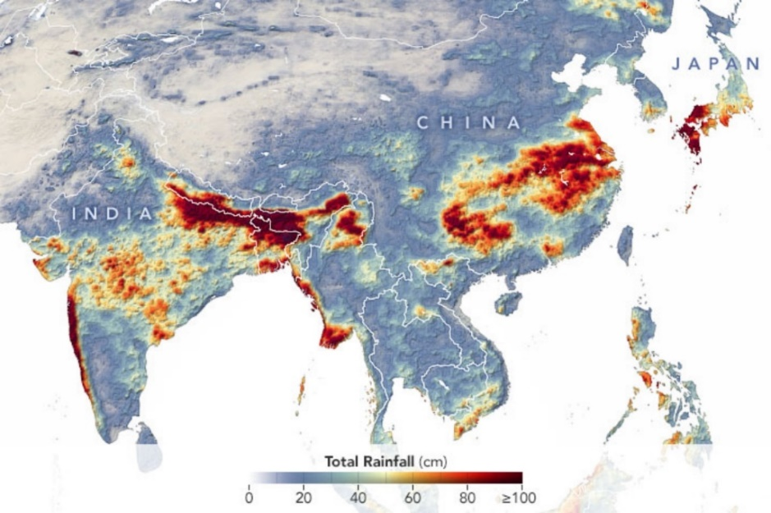
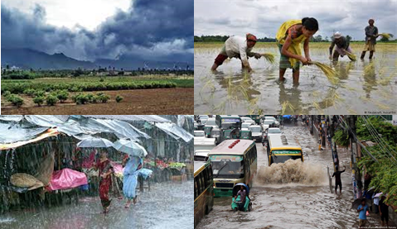
Spatial Synchronization Patterns of Extreme Rainfall Events in the Asian Summer Monsoon Region
shraddha.gupta@pik-potsdam.de
@ShraddhaGupta28
Shraddha Gupta, Zhen Su, Niklas Boers, Jürgen Kurths, Norbert Marwan, and Florian Pappenberger

Slide 2
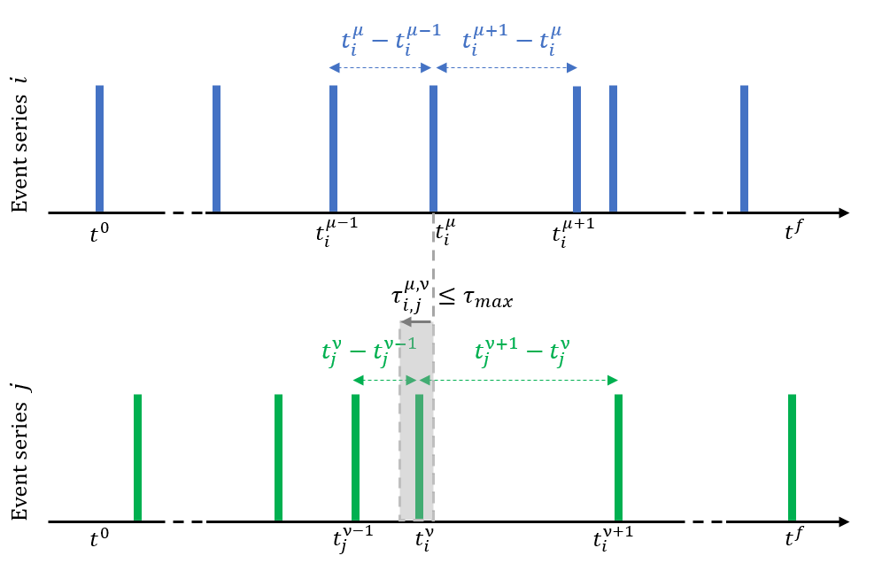
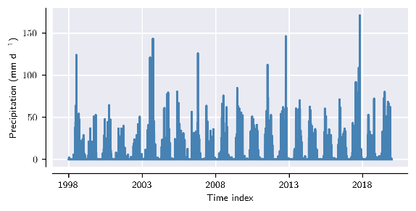
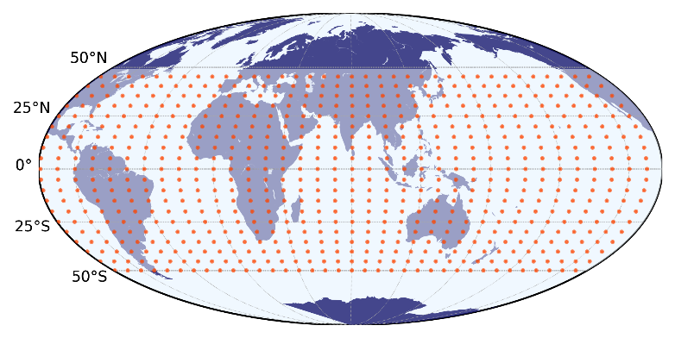
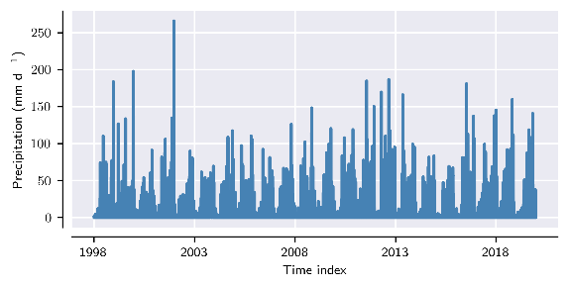
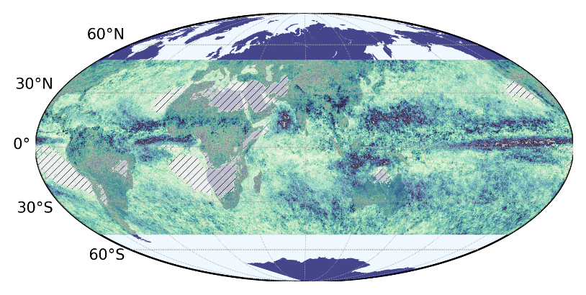
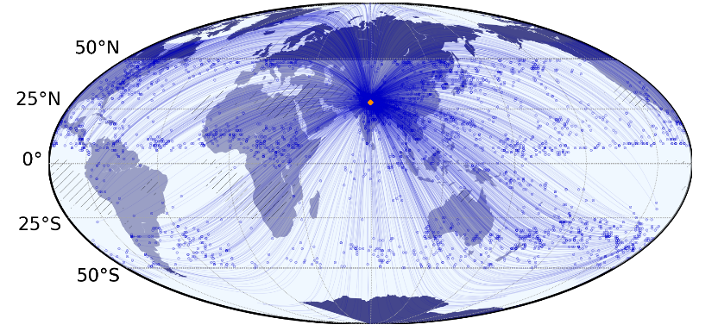




Climate Network Reconstruction – Extreme Precipitation
Precipitation
Extreme Precipitation
Climate Dataset: Nodes/ Grid points
$$X_{i}\left(t\right)$$
Compute similarity
– Event synchronization.
$$t$$
$$X_{j}\left(t\right)$$
$$t$$
Counts number of “synchronized“ events, c(i|j)
Thresholding – significant links
Quantify topology
Network Measure:
Degree: No. of connections of one node with other nodes.
Dataset – TRMM 3B42 V7, daily total precipitation (1998-2019), 0.25°x0.25° spatial res., Jun-Jul-Aug
Events > 90th perc. of wet days for each location.

Slide 3
Precipitation Networks – ISM-EASM Interaction
Gupta et al. (2022), Int. J. Climatol., 1-16

Slide 4
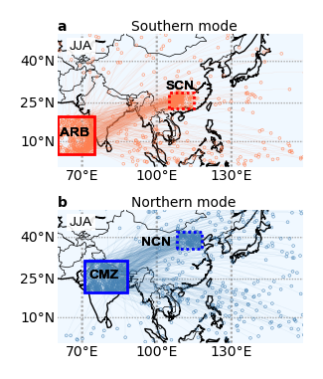
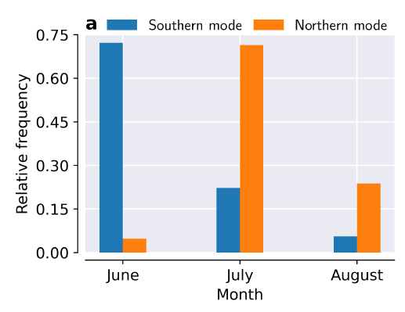
Precipitation Networks – ISM-EASM Interaction
We identify two dominant synchronization pathways between ISM and EASM
  Southern Mode: Arabian Sea and South-western part of India with Southern China (Yangtze river basin – Meiyu rainfall)
  Northern Mode: Northern and Central part of India with Northern China (Beijing, Tianjin etc., near the Yellow River)
The month-wise distribution of days with high Extreme Rainfall Events synchronization
  Southern Mode: June
  Northern Mode: July
Gupta et al. (2022), Int. J. Climatol., 1-16

Slide 5
Atmospheric Circulations – ISM-EASM Interaction
(Day 0)
(Day 0)
Identification of specific times (Day 0) of high rainfall synchronization for each mode.
Compute composites of associated large-scale atmospheric circulation (Wind, GPH, etc.) and moisture transport patterns from ERA5.
Southern mode: Onset conditions of monsoon, convergence of low-level winds, movement of +WPSH causes ARB →SCN synchronization.
Northern mode: A-C-A in upper level, Bonin High over Japan leads to dry spells, high in the upper level while low in the lower levels (CMZ and NCN) leads to enhanced synchronous rainfall over CMZ and NCN.
C
A
A
Bonin High
Bonin High
+WPSH
C
+WPSH
L
L
Bonin High
C
+WPSH
+WPSH
Gupta et al. (2022), Int. J. Climatol., 1-16

Slide 6
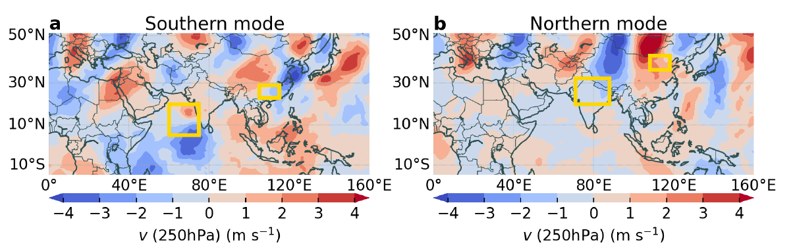
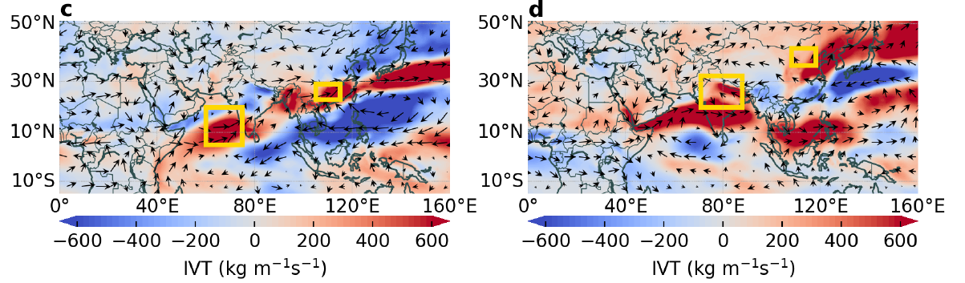
Atmospheric Circulations – ISM-EASM Interaction
(Day 0)
(Day 0)
Identification of specific times (Day )0 of high rainfall synchronization for each mode.
Compute composites of associated large-scale atmospheric circulation (Wind, GPH, etc.) and moisture transport patterns from ERA5.
Southern mode: Upper-level waves coming from North Africa, higher wave numbers (k=7,11), Moisture Corridor established in ~14 days
Northern mode: Silk Road Pattern (k=5,8), local recycling of moisture from the respective Indian and Pacific Ocean sources.
Silk Road pattern
k=5
k=7
Gupta et al. (2022), Int. J. Climatol., 1-16
(Day 0-14)
(Day 0-14)

Slide 7
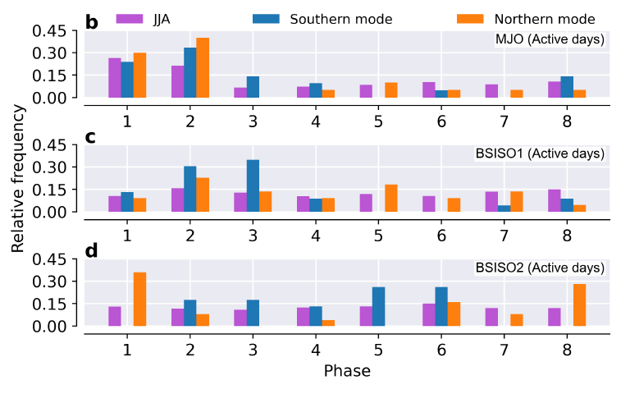
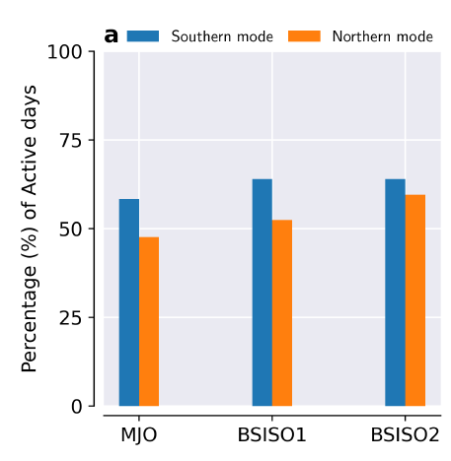
Intraseasonal Oscillations – ISM-EASM Interaction
Q: Does the Intraseasonal Oscillations cause the northward propagation of the synchronization mode between ISM and EASM ?
Classify the days when high synchronization occurs for each mode according to active/inactive MJO, BSISO.
Extreme rainfall events over the Asian monsoon region are favoured by certain phases of the lower frequency mode (MJO, BSISO1), while
The higher frequency mode (BSISO2) may support the switch between the two interaction modes.
~40% of days of high rainfall synchronization are inactive in BSISO/MJO.
Gupta et al. (2022), Int. J. Climatol., 1-16

Slide 8
Conclusion – ISM-EASM Interaction
Complex network approach sheds light on the intricate relationship between the different components of Asian Summer Monsoon.
Identification of two modes of interaction between Indian and East Asian Summer Monsoon.
Southern mode of synchronization occurs in June while Northern mode peaks in July.
Southern mode: Mainly associated with convergence of Somalian Jet with easterly winds in the lower boundary of the Western North Pacific Subtropical High (Onset of ISM and Meiyu over Yangtze).
Northern mode: Associated with Silk Road Teleconnection.
Particular phases of MJO and BSISO are associated with enhanced rainfall synchronization between ISM and EASM.
Further References:
Gupta, S., Su, Z., Boers, N., et al. Interconnection between the Indian and the East Asian Summer Monsoon: spatial synchronization patterns of extreme rainfall events, Int. J. of Climatol., 1-16 (2022).
Boers, N., Goswami, B., Rheinwalt, A., et al. Complex networks reveal global pattern of extreme-rainfall teleconnections. Nature, 566, 373–377 (2019).
Preethi, B., Mujumdar, M., Kripalani, R. H. , et al. Recent trends and tele-connections among South and East Asian summer monsoons in a warming environment. Clim Dyn 48, 2489–2505 (2017).
Liu, Y., Liang, P. and Sun, Y. The Asian summer monsoon: characteristics, variability, teleconnections and projection. Elsevier (2019).
Image Courtesy in Title slide:
NASA/GSFC, GMP/IMERG
https://p.dw.com/p/3M1TF
https://p.dw.com/p/3rx9l
https://en.wikipedia.org/wiki/Monsoon
https://www.tripsavvy.com/traveling-during-the-monsoon-season-1458706

