Slide 1
Copernicus Climate Change Service
Carlo Buontempo
C3S, ECMWF
Notes:
It is so wonderful to see you all in person again. I missed it so much. Whilst the managed to keep in touch with one another and ensure the running of the services we missed the opportunity to meet and discuss face to face. For some of us, such as Sam Burgess or Francesca Somma, it will be the first time to see you all together. Welcome! I really look forward to this couple of days of discussion.
I would also like to remember those who are no longer with us. In particular I would like to pay my respect to Geert Jan Van Oldenbur who passed away last year a few weeks after being nominated as one of the 100s most influential person of the year. A true achievement for a climatologist.

Slide 2
Was this climate change?
212 mm of rain in 3 hours

Slide 3
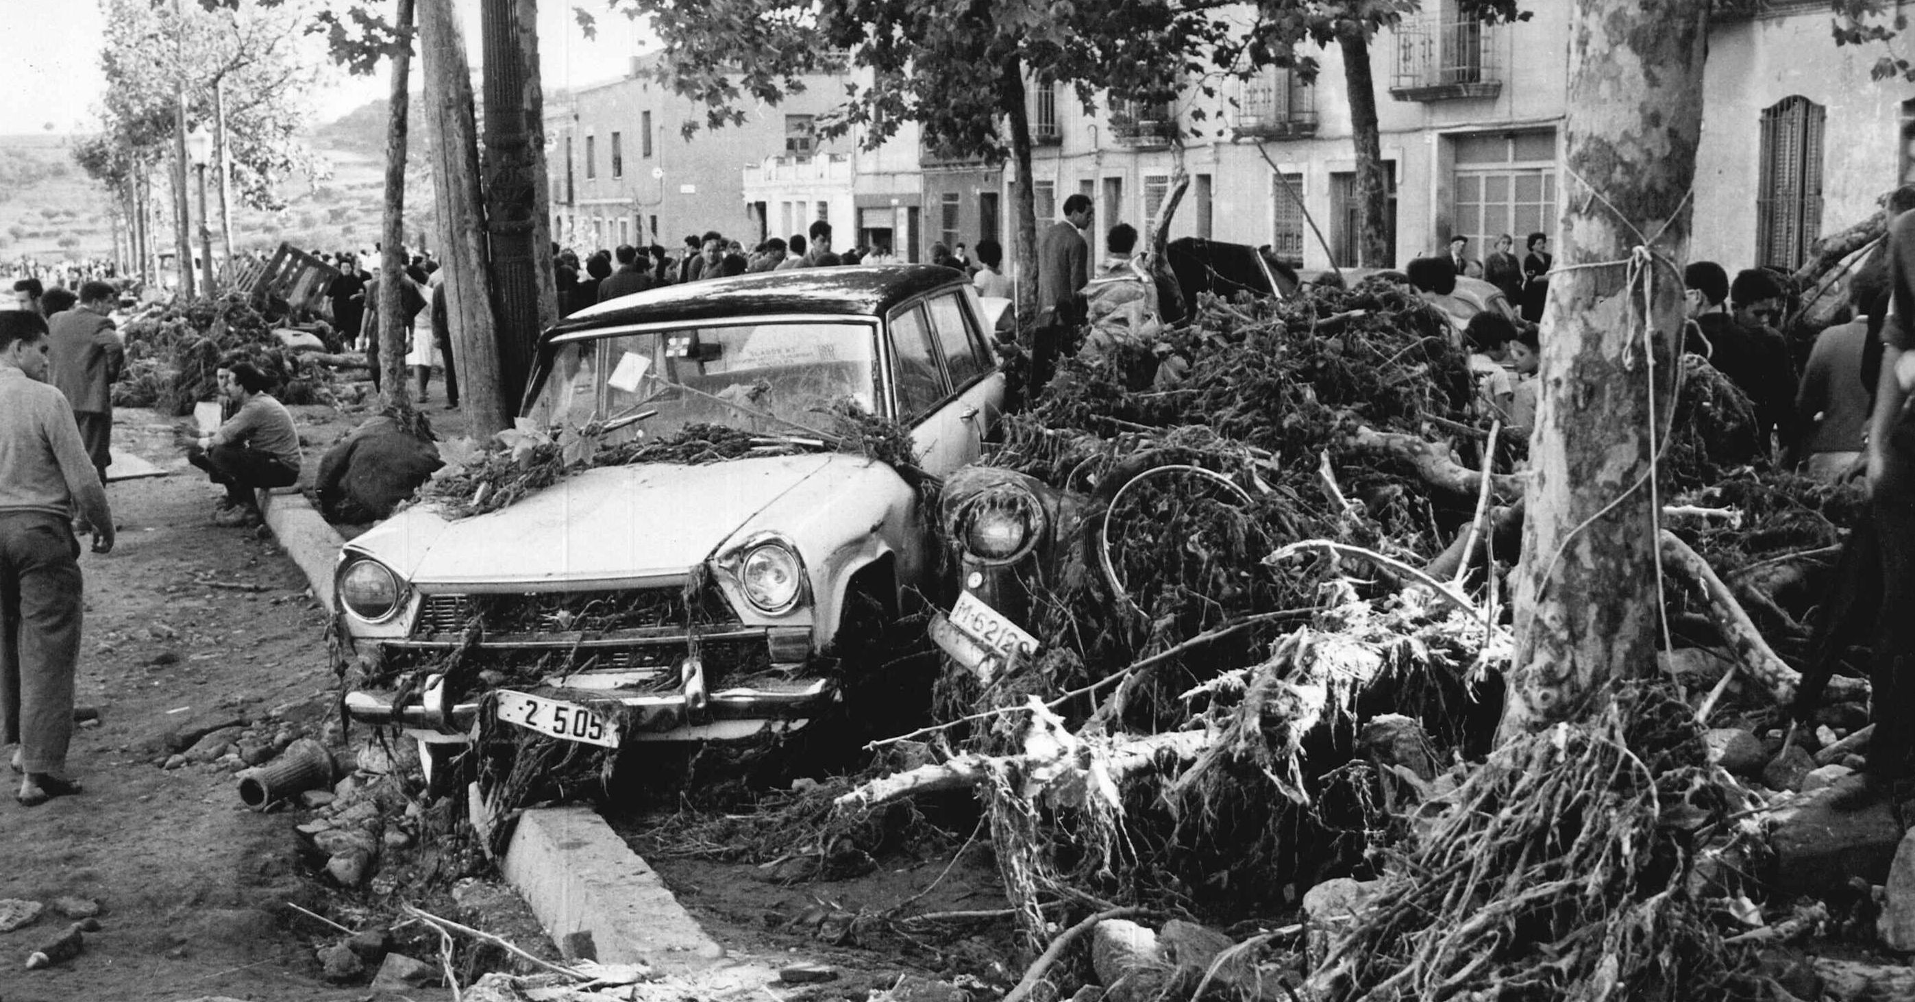
Extremes of the past: September 1962
https://forocoches.com/foro/showthread.php?t=6730327

Slide 4
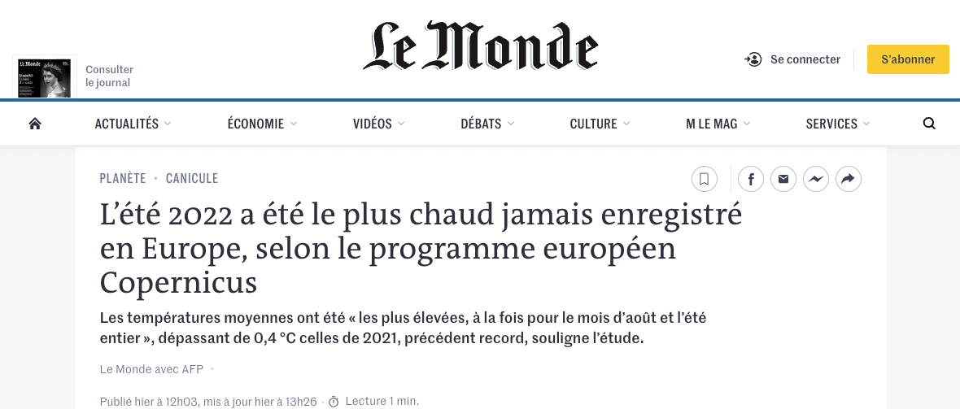
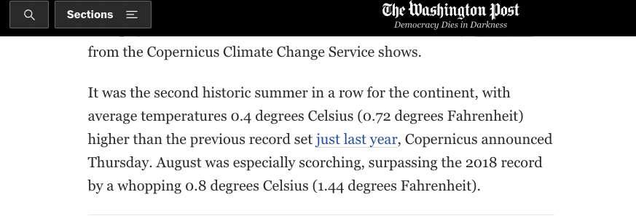
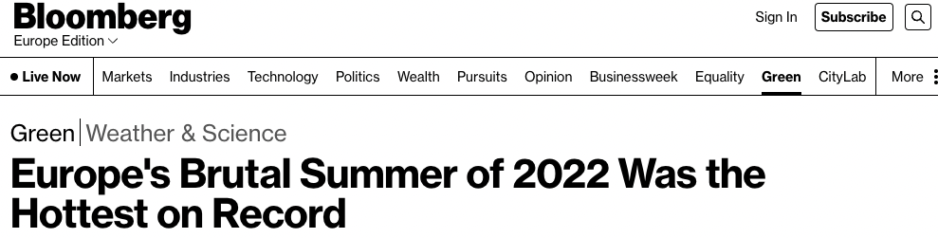

Breaking news
The average temperature over Europe in 2022 was the highest on record for both August and summer (June – August) by substantial margins.
August this year exceed the values recorded in August 2018 by of 0.8°C. The whole summer was 0.4°C warmer than the then record-breaking summer of 2021.
The news was picked-up by all major media outlet all over the world with over 656 clippings in the first four days
Notes:
The hottest summer on record for Europe, the flooding last summer, and the many near misses, are powerful reminder of the fact that climate change is here, and we need to adapt to it.

Slide 5

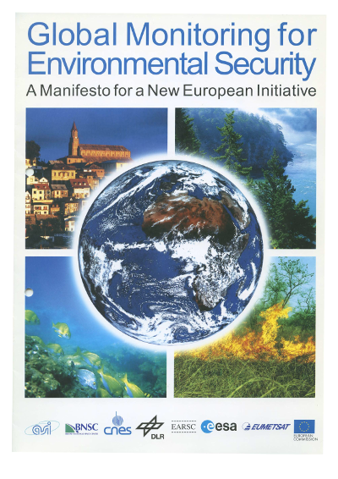
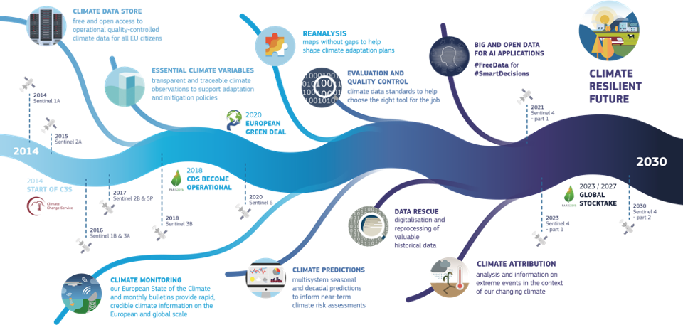
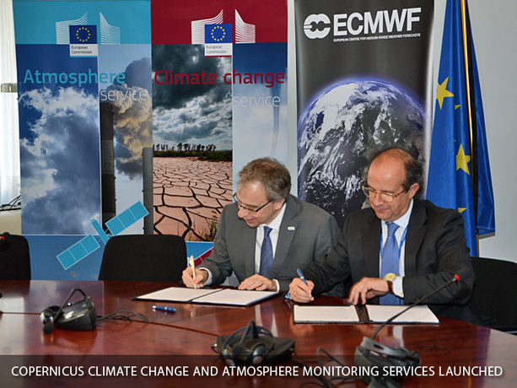
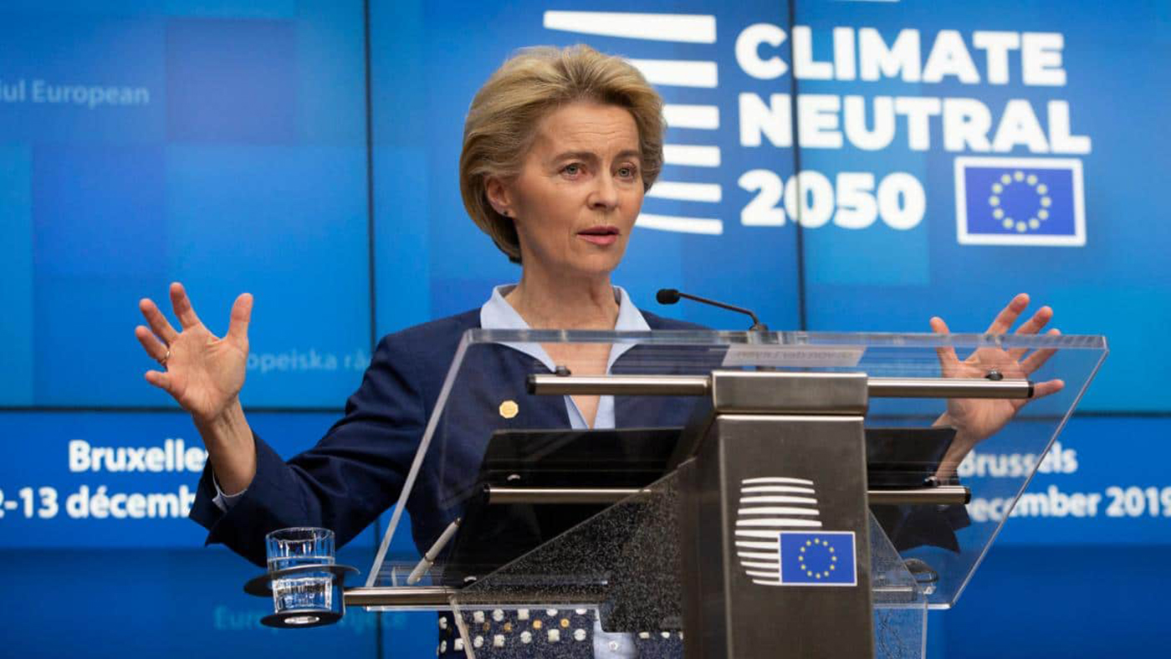
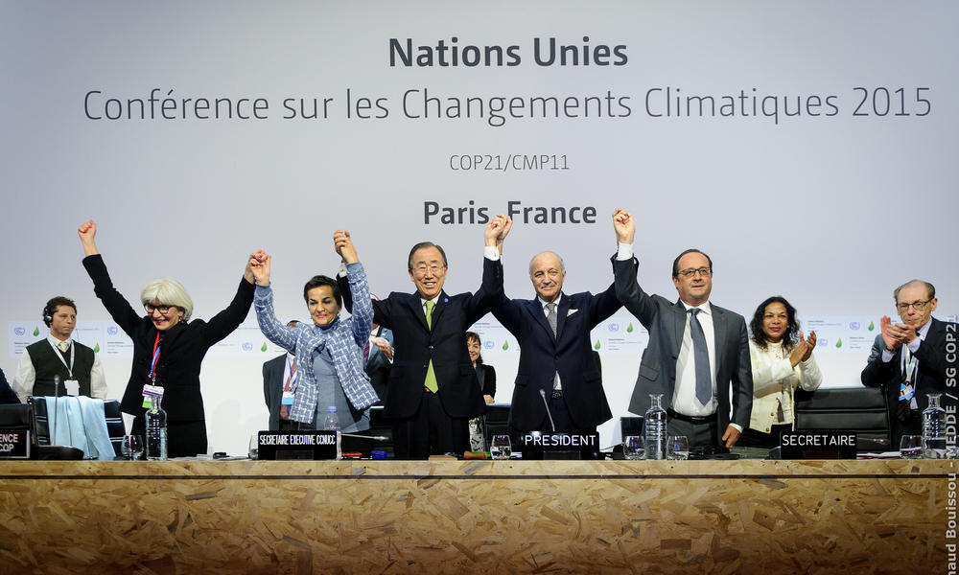
Make a long story short

Slide 6
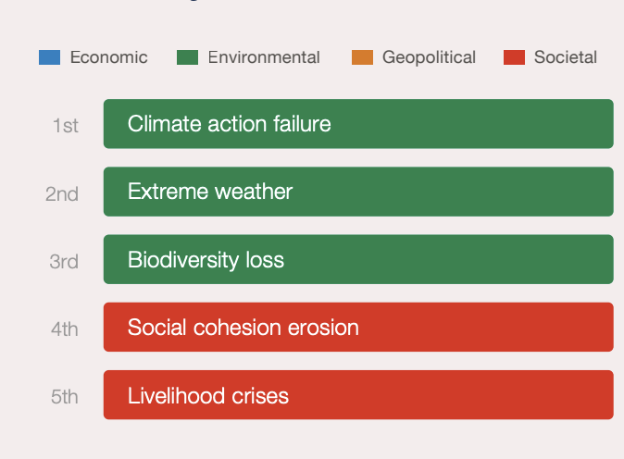
A rapidly changing landscape
World Economic Forum 2022: Global Risks Report: “most severe risks on a global scale over the next 10 years”
There are more climate related disasters now than ever before. Improving our ability to describe then and predict them would equip our society to better manage them.
Notes:
In a recent keynote at EMS I have stressed the importance of trans-disciplinarity of the climate service approach. To crack the climate crisis, we need more than data. The effort of the Mission of Adaptation, for example, shows the importance of investing on communities and bottom-up approaches that put the needs of the people on the ground at the beginning rather than at the end of the design process.

Slide 7
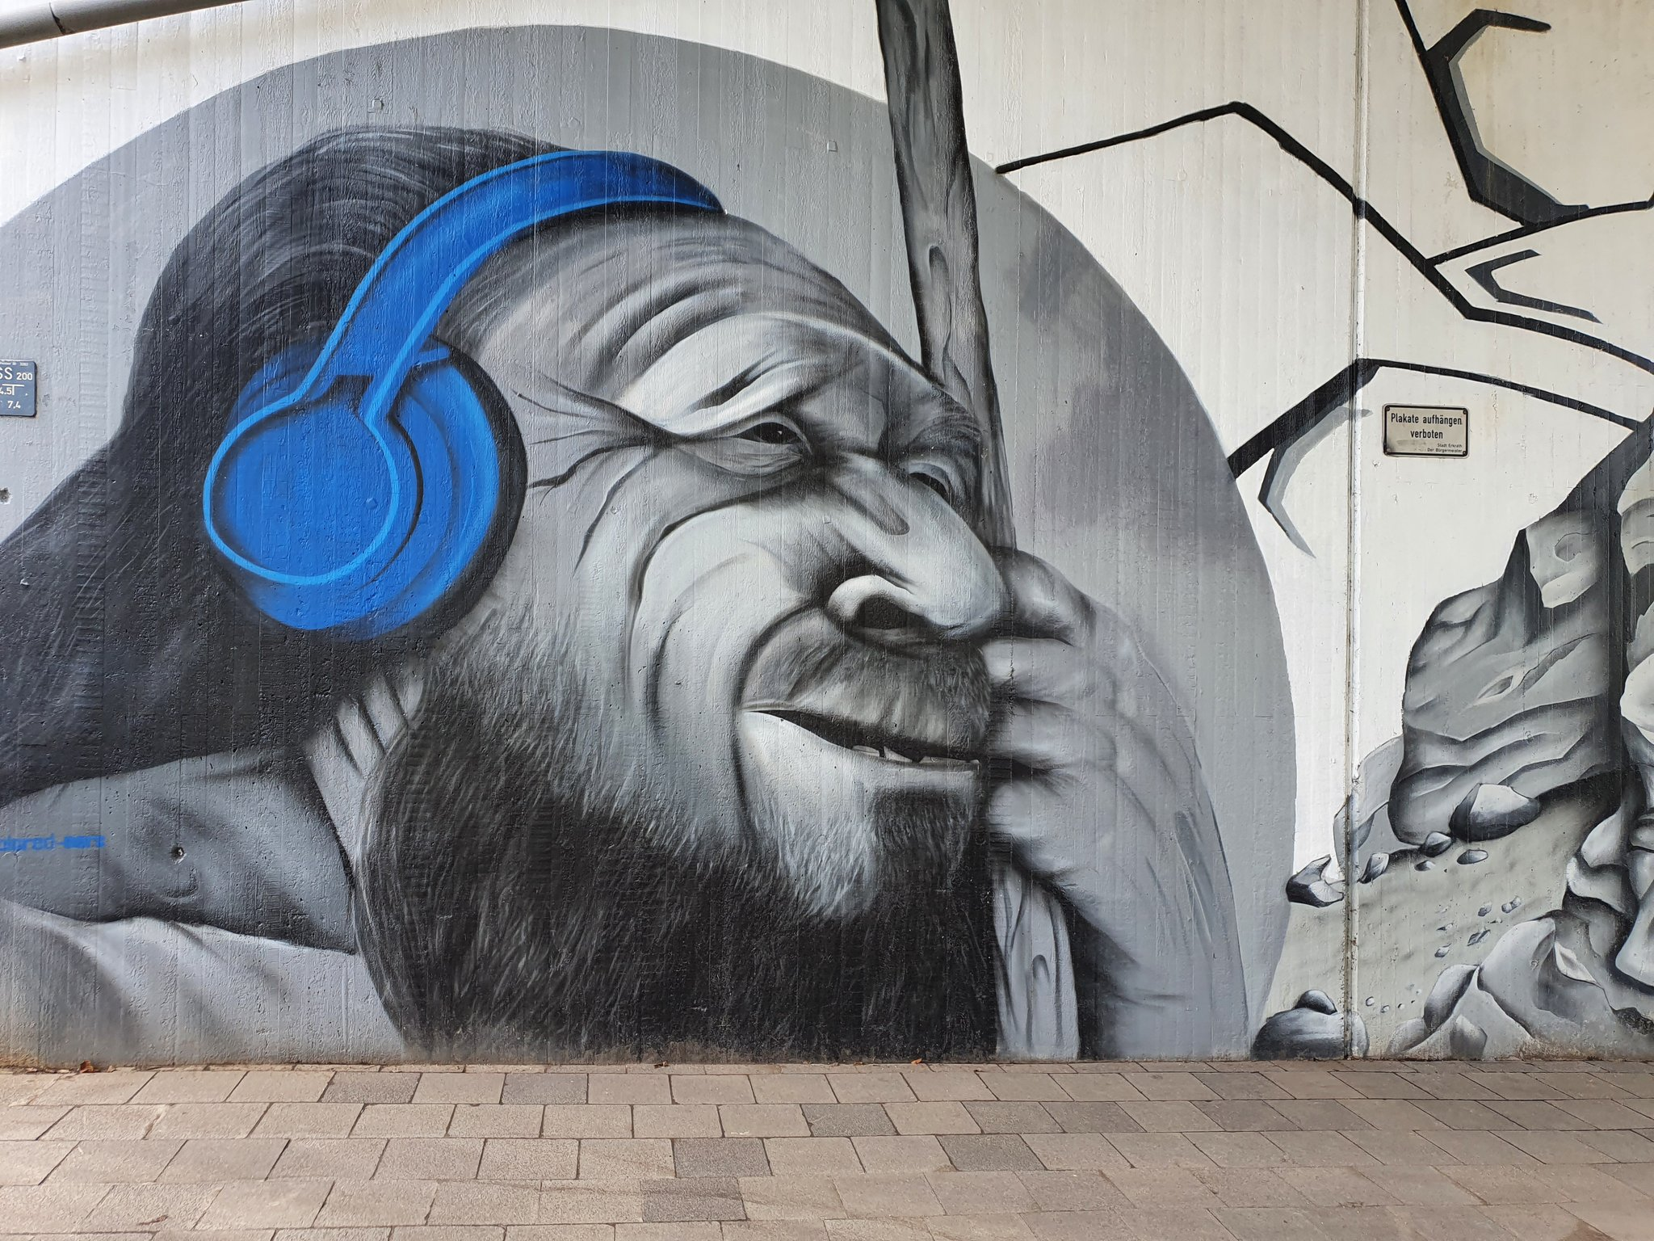
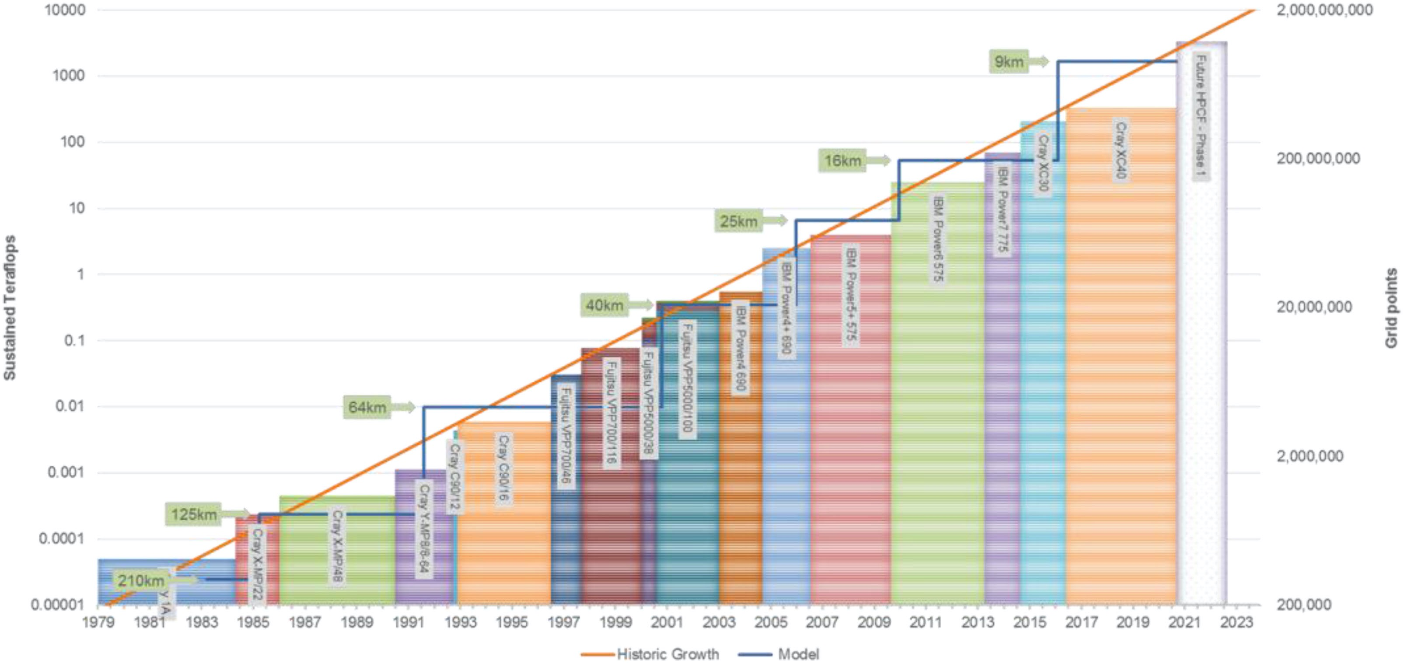
Too big to handle
At the end of 2015, the archive held about 140 PB of data
The current figure is about 400 PB* and growing
A simple example
ERA-I 0.1 Pb, 0.2 GSBU;
ERA5 12 Pb, 10 GSBU;
ERA6 80+ Pb, 30+ GSBU
*If it were music, it could provide a staggering 1.000.000 years of streaming more than our life on the planet as homo sapiens
https://iammdnor.com/2015/08/15/infographic-hpw-large-is-150-petabytes/
Image from: https://twitter.com/GCWeniger/status/1363822745834967043?s=20&t=3izmNInjv_FMKnvgbn-RvA
In 1995, ECMWF archive was growing annually by 14 TB
In 2012, the archive was growing daily by 28 TB
In early 2018, the daily growth was 200 TB
http://htor.inf.ethz.ch/publications/img/schulthess-exascale-climate.pdf

Slide 8
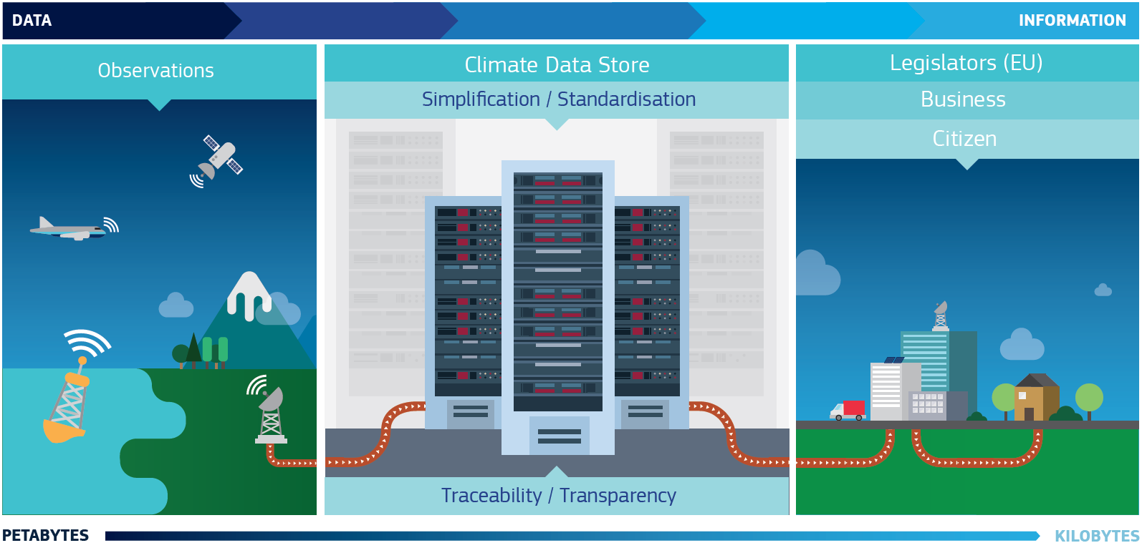
The climate data store
https://cds.climate.copernicus.eu
>150.000 users
Typical download: ˜100 TB /day
Typical number of requests: 500k/day
Notes:
Such an effort though doesn’t work in isolation. Adaptation without reliable and trustworthy data can easily lead to maladaptation and wastage of resources. We need to invest in the generation, curation, processing and distribution of climate data to communities in an open and free manner.
Thanks to work of the team in house and to the effort of the whole community over the last 4 years the service has grown massively. not only in the number of users but also in the quality of the outputs and its uptake but secondary communities. Whilst the academic community still represents an important user of our data, for some data streams the fraction of non-academic users is now very large and keeps growing.
The fact that all of this happened on one of the most challenging backdrops possible (COVID, BREXIT, relocations, HPC move, international political instability …) make the success of the programme all more extraordinary.

Slide 9
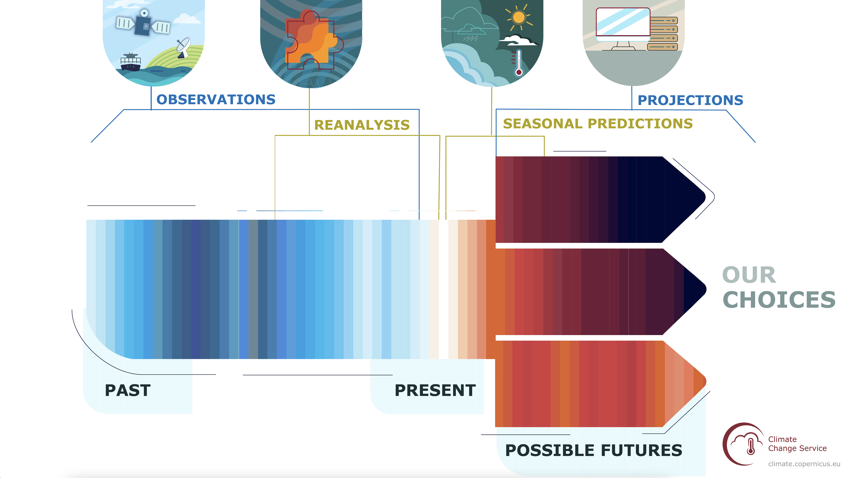
Our portfolio
Inspired by @Ed_Hawkins | @IPCC_CH

Slide 10
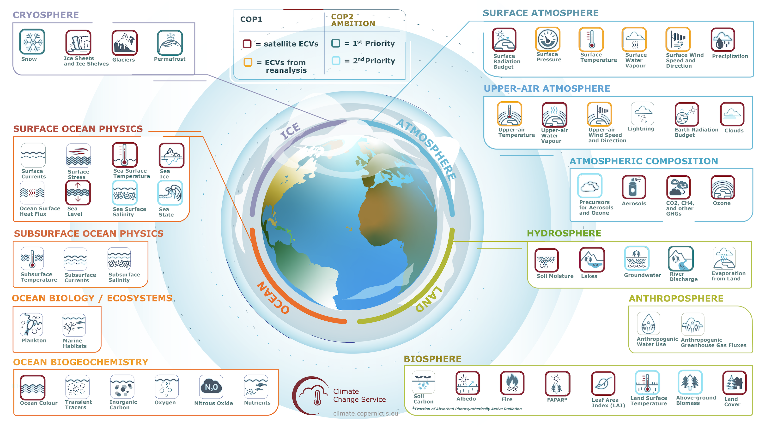
Improving our understanding of the Earth system

Slide 11

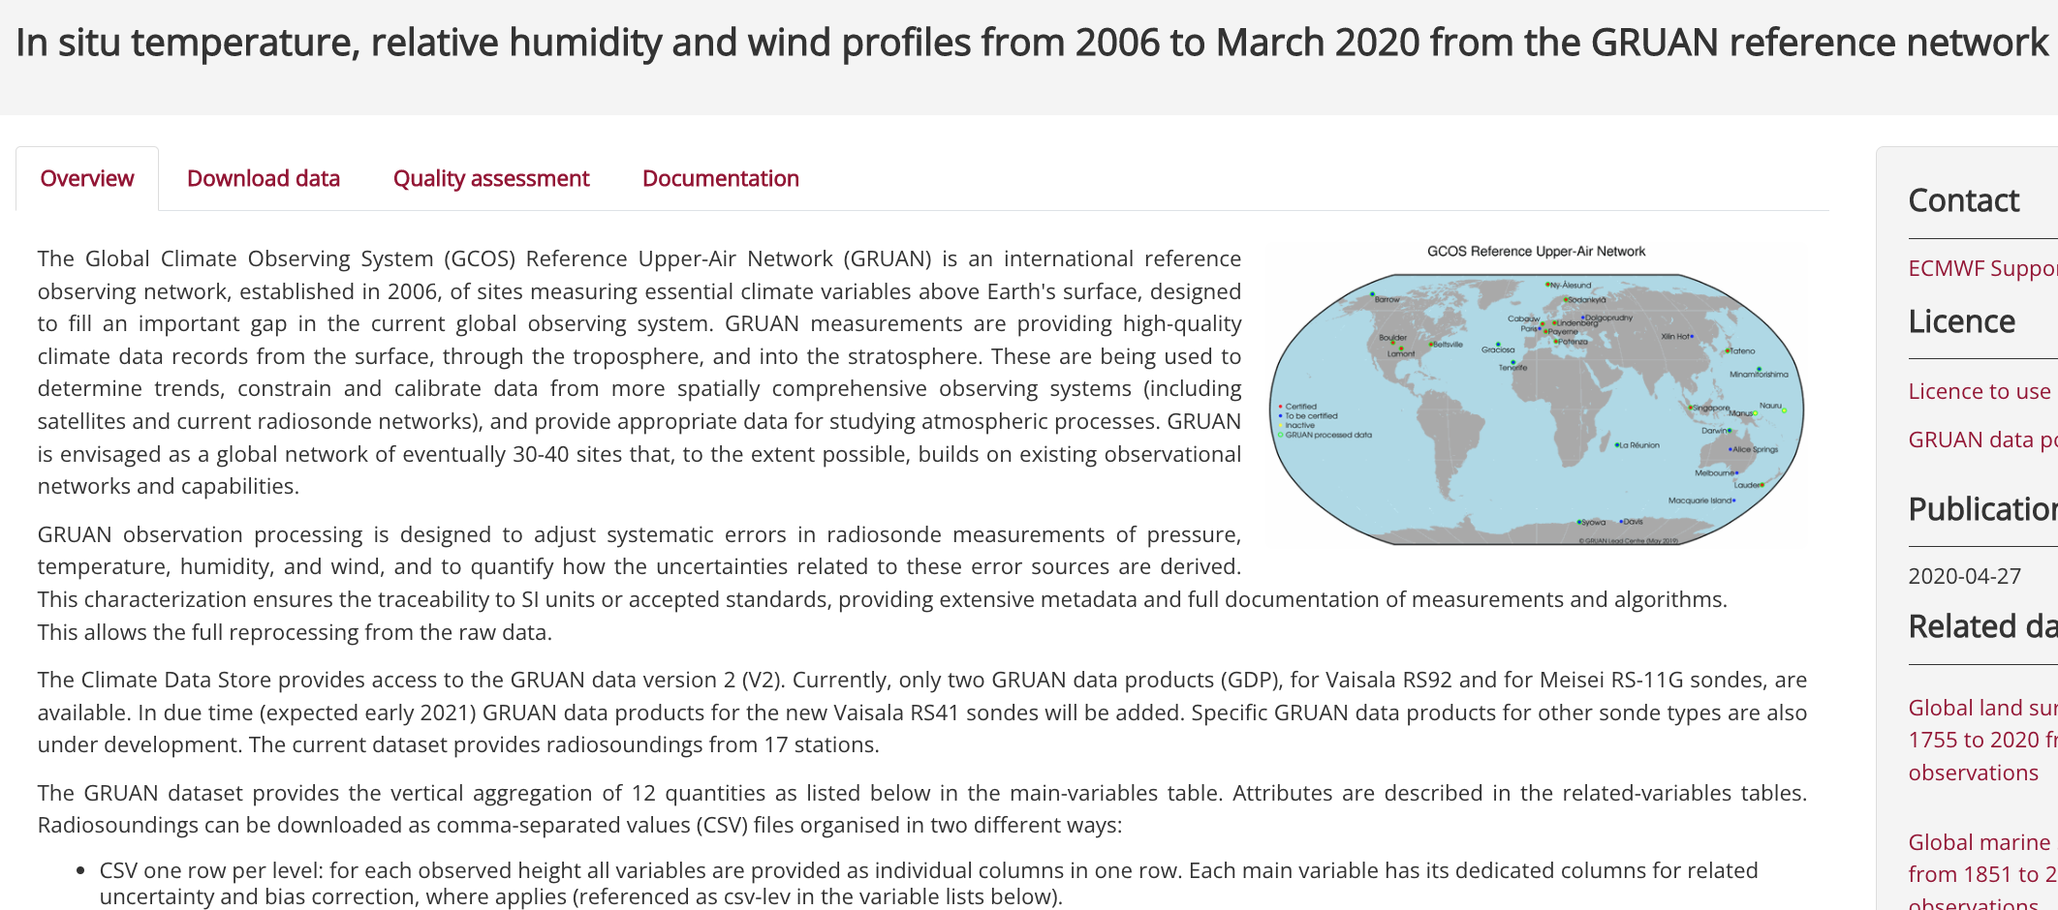
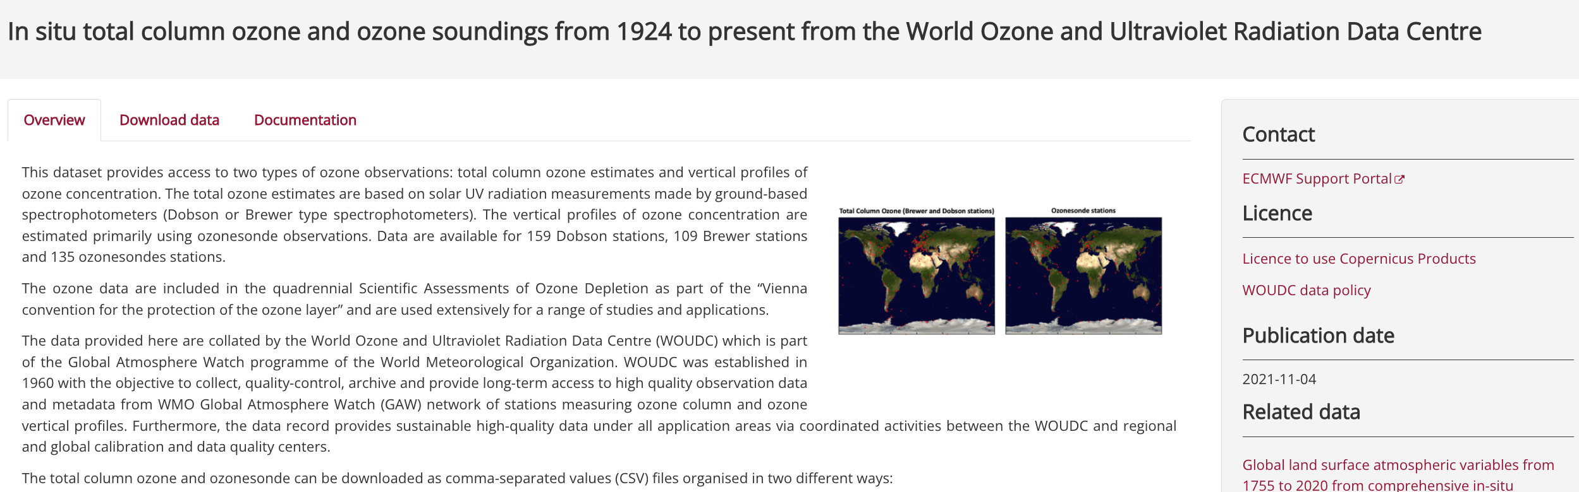
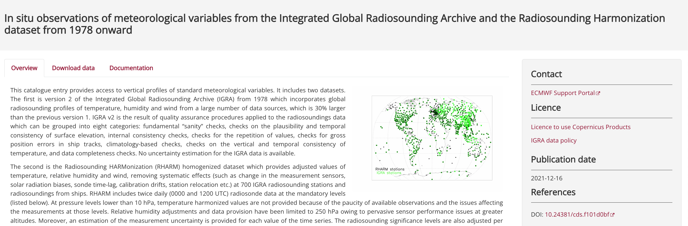
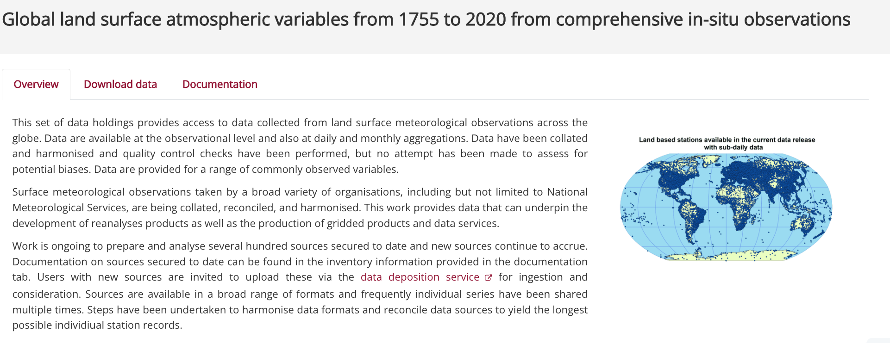
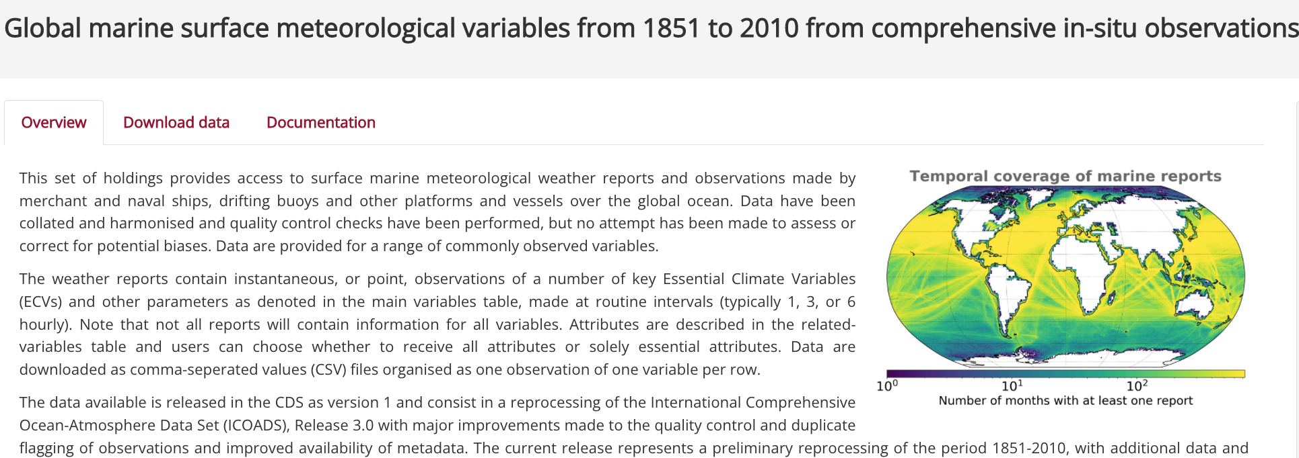
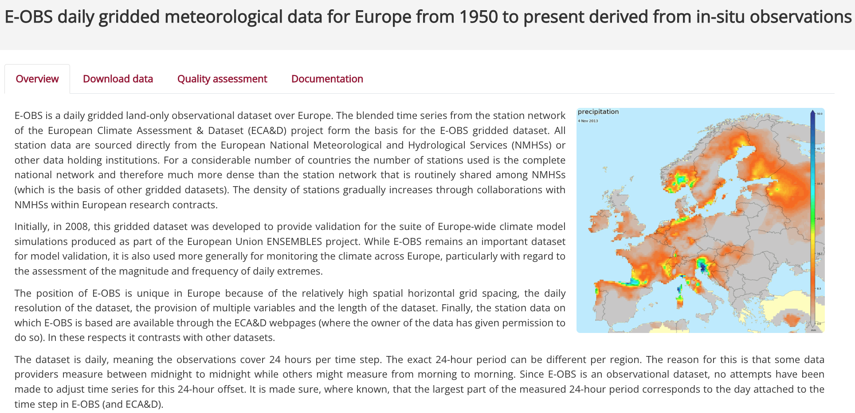
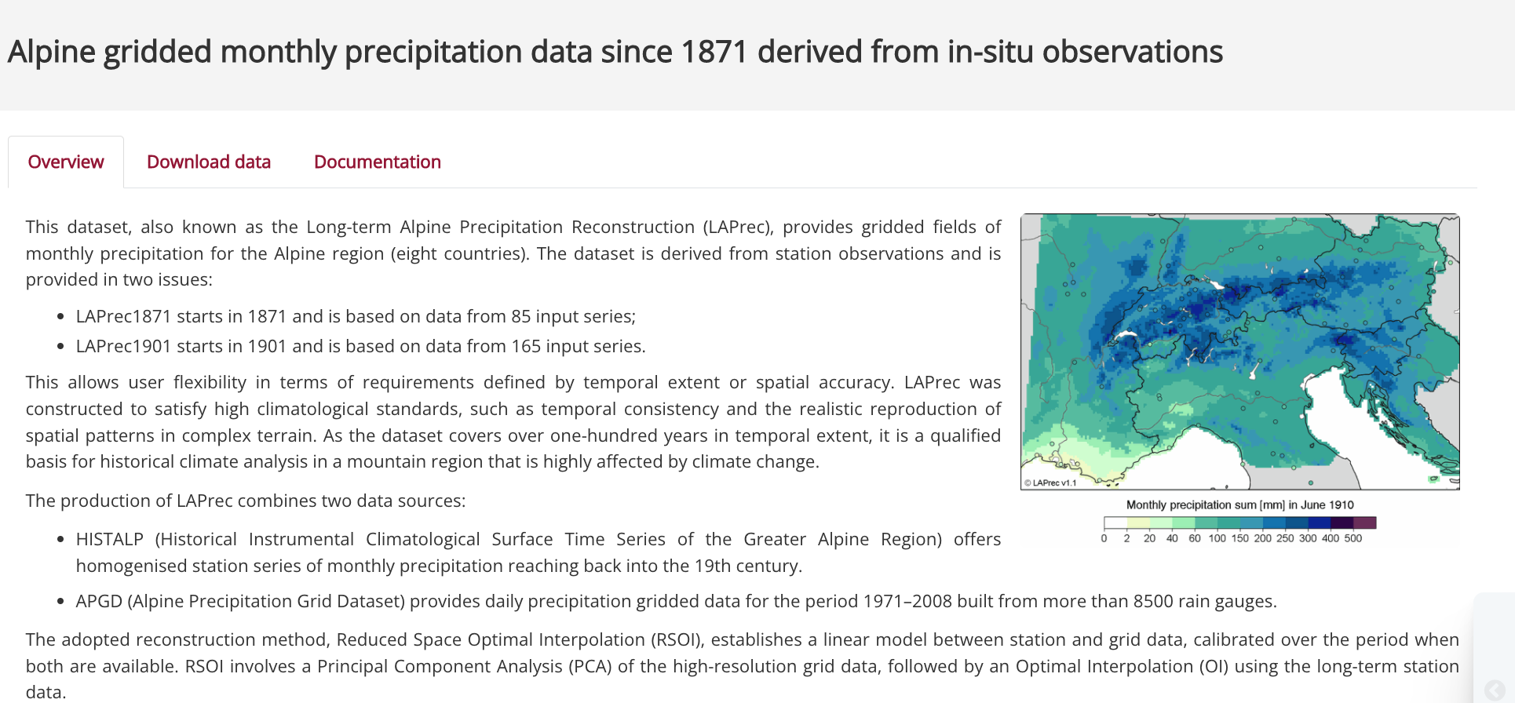
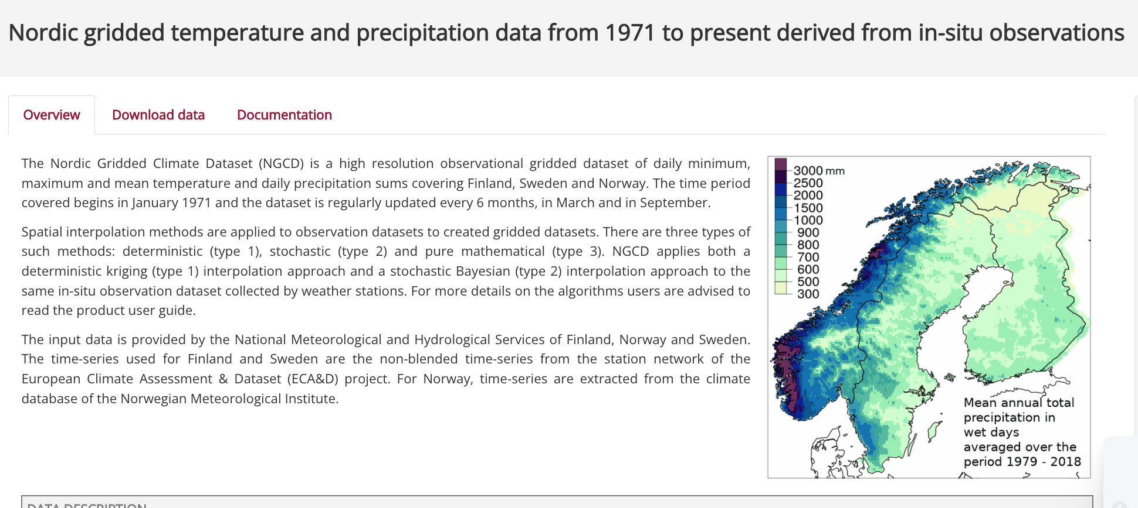
Observations and data rescue
New in-situ products available:
Temperature, RH and wind profiles - GRUAN reference network
In situ total column ozone and ozone soundings from the World Ozone and Ultraviolet Radiation Data Centre.
Integrated Global Radiosounding Archive
Global Land & Marine Observations Database: surface atmospheric variables from comprehensive in-situ observations
E-OBS: 8 gridded, daily variables from 1950 to the present, derived from European station observations
Regional networks:
  NGCD: Nordic gridded, daily temperature and precipitation data from 1971 to present derived from in-situ observations.
  LAPrec: gridded, monthly precipitation from 1871 and 1901, from Alpine stations.
Notes:
MR: lot of text, depends how much time you can dedicate to it

Slide 12

Who is eating all this data?

Slide 13
Reanalysis: our very hungry caterpillar
2000
70% American
20% European
10% Asian
2020
30% American
45% European
25% Asian
~10 satellites
~12 instruments
~50 satellites
~95 instruments
˜100 Billion observations assimilated ( 1979 - 2022 )
ERA5 data usage has increased from 0.75 (1979) to 24 million/day (2019).

Slide 14
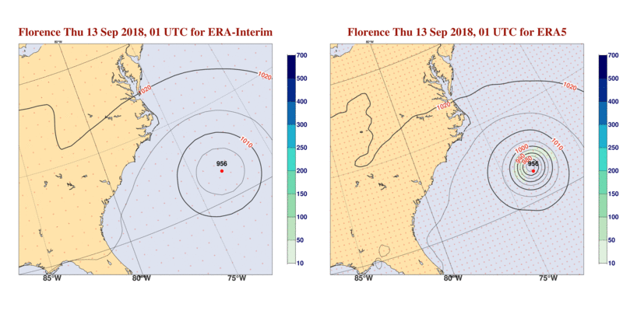
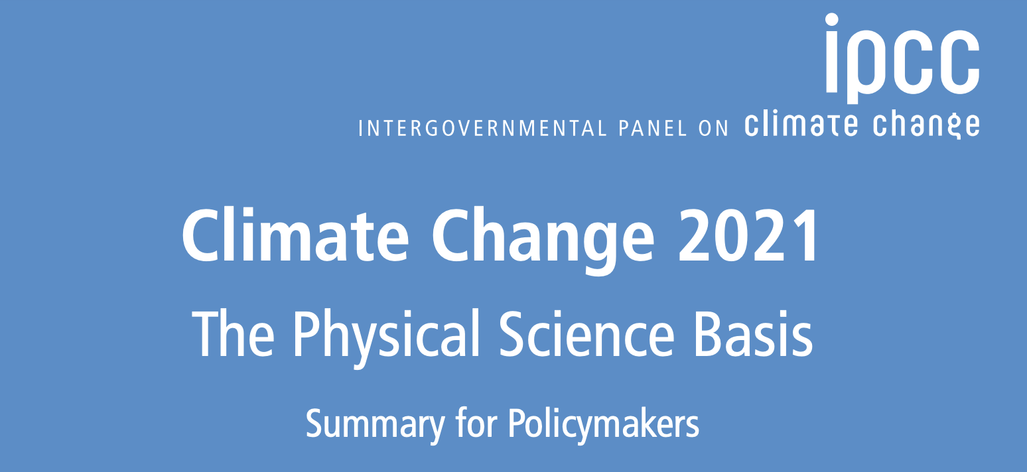
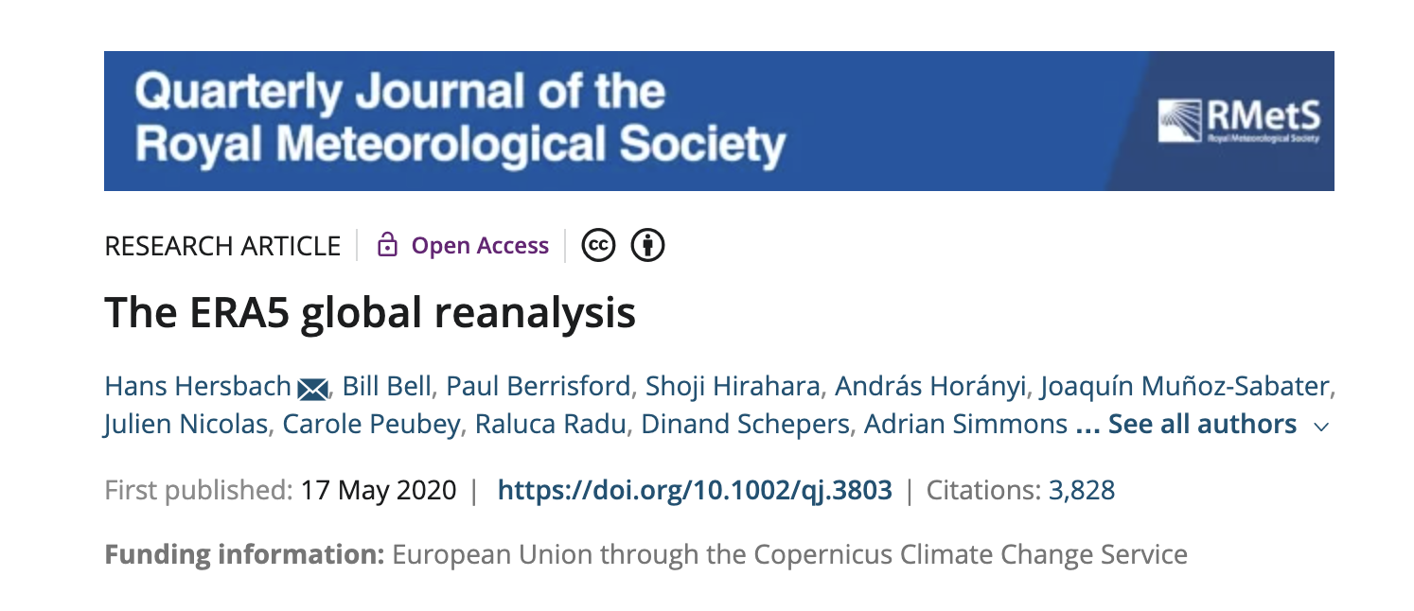
Maps without gaps: global atmospheric reanalysis ERA5
C3S is presented as an exemplar of climate service in IPCC AR6 WG1 report where ERA5 is mentioned over 240 times.

Slide 15
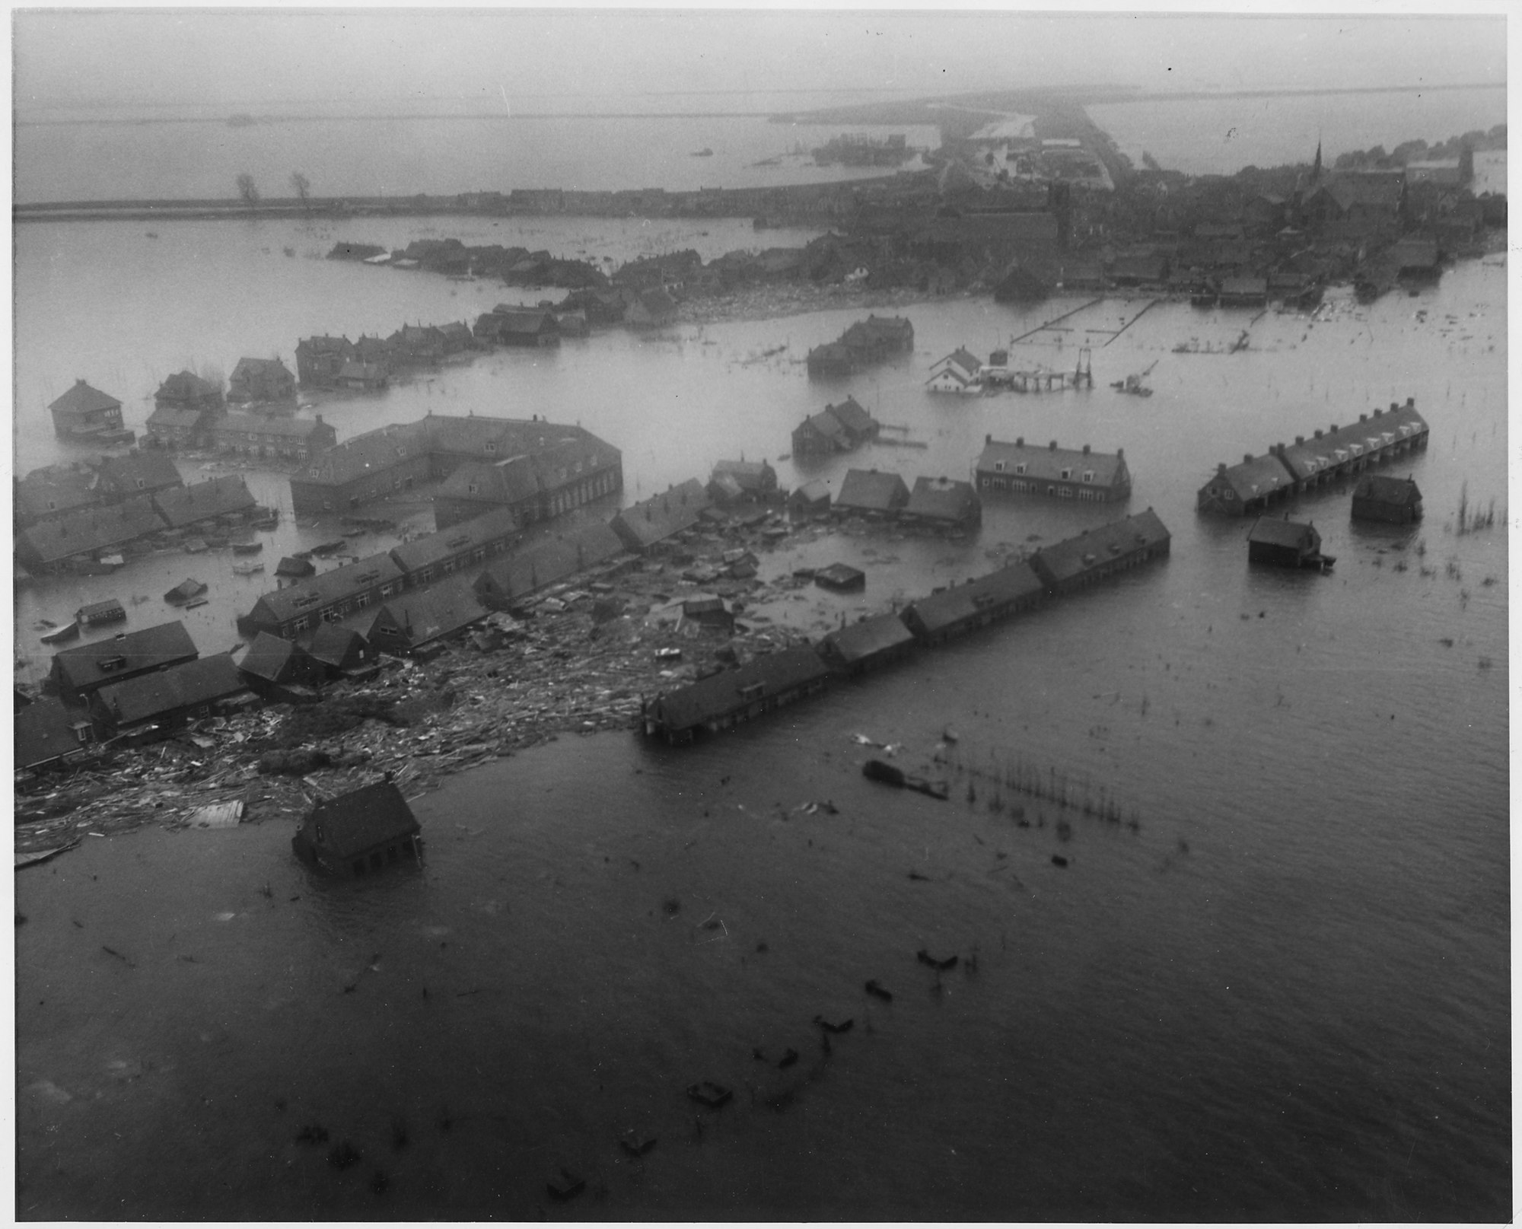
Back extension and risk
North Sea Flood of 1953, which devastated large areas of the southern Netherlands. The storm also affected the UK and Belgium, causing major damage and over 2000 fatalities, and led to widespread projects to prepare for the future storms and flooding.

Slide 16
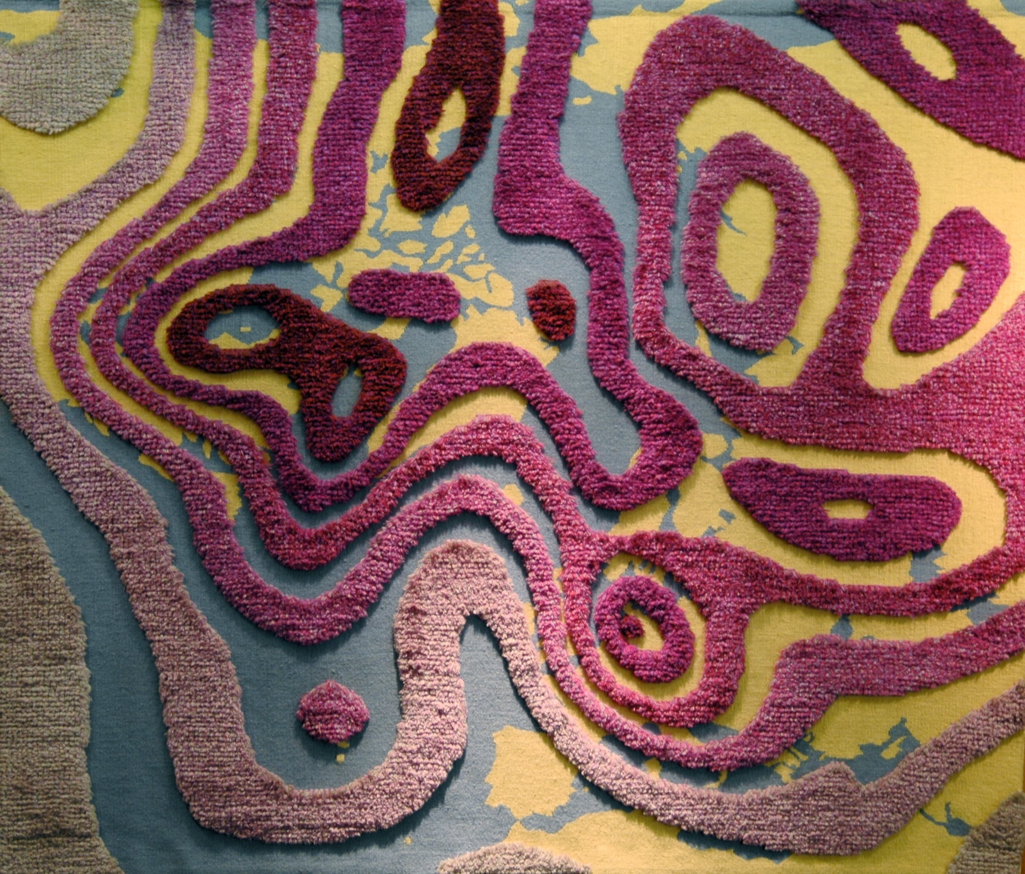
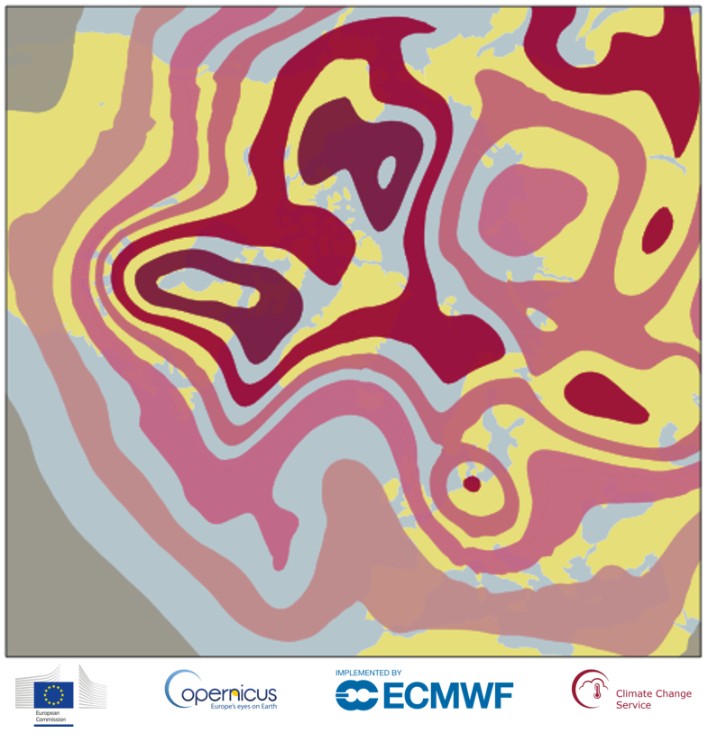
A storm in a tapestry
When ECMWF opened their first buildings in 1979, the Netherlands gifted the fledgling centre with a handmade tapestry depicting a chart of the storm, a tangible reminder of the value of reliable weather forecasting.
ERA5 back-extension allowed C3S to recreate the storm whose pressure field is here reproduce with the same colour scale used in the original tapestry.
More generally ERA5 provide maps without gaps in space and time, including both everyday weather and extreme events. Data like these are key to assess the current level of risks and prepare for climate change.
Credits: Baudouin Raoult

Slide 17
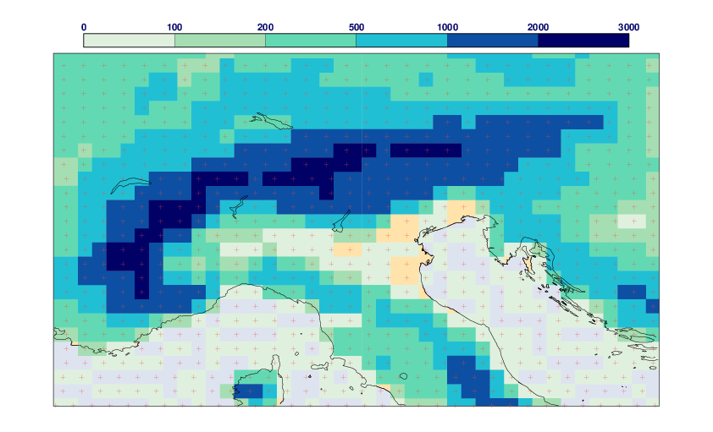
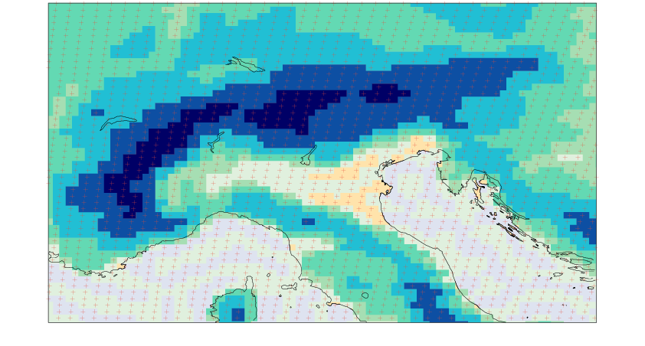
ERA6 in a nutshell
Better resolution (˜18 km vs 31 km)
Higher resolution ensemble of assimilations - improved representation of synoptic uncertainty
Enhanced coupling between atmosphere, land and ocean
Improved treatment of biases (from R&D on DA system)
Extensive use of reprocessed conventional and satellite observations from COP1 investments
Improved forcing datasets (SST, sea ice, GHGs, aerosols) from latest R&D
More optimal data assimilation (observation errors, background errors)
Estimation of mean-state uncertainties (‘benchmarking’)
Wider range of products, based on user feedback
orography / m
ERA5
ERA6

Slide 18

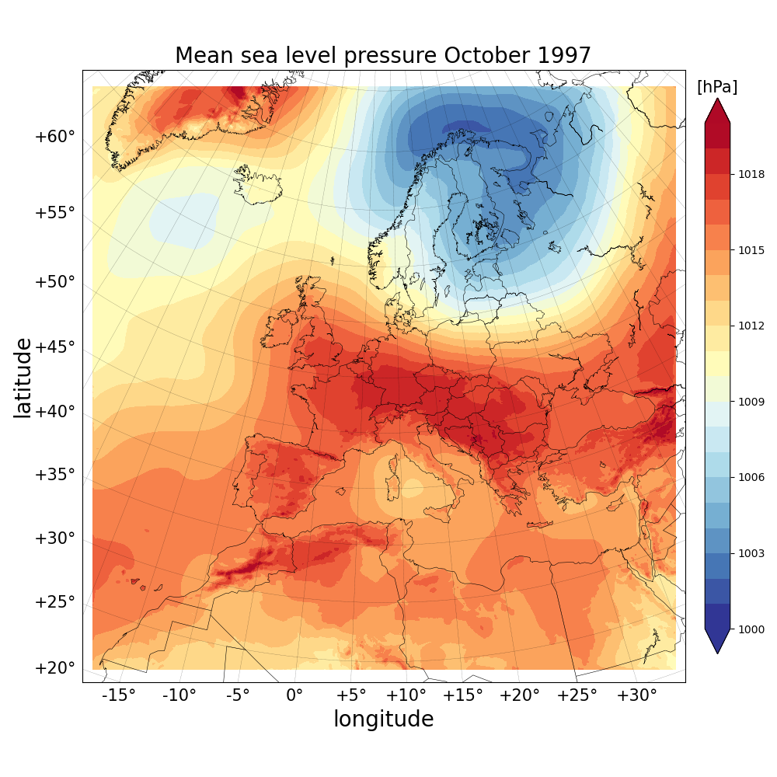
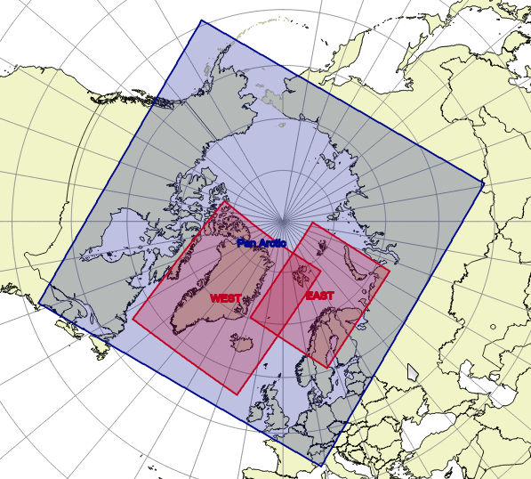
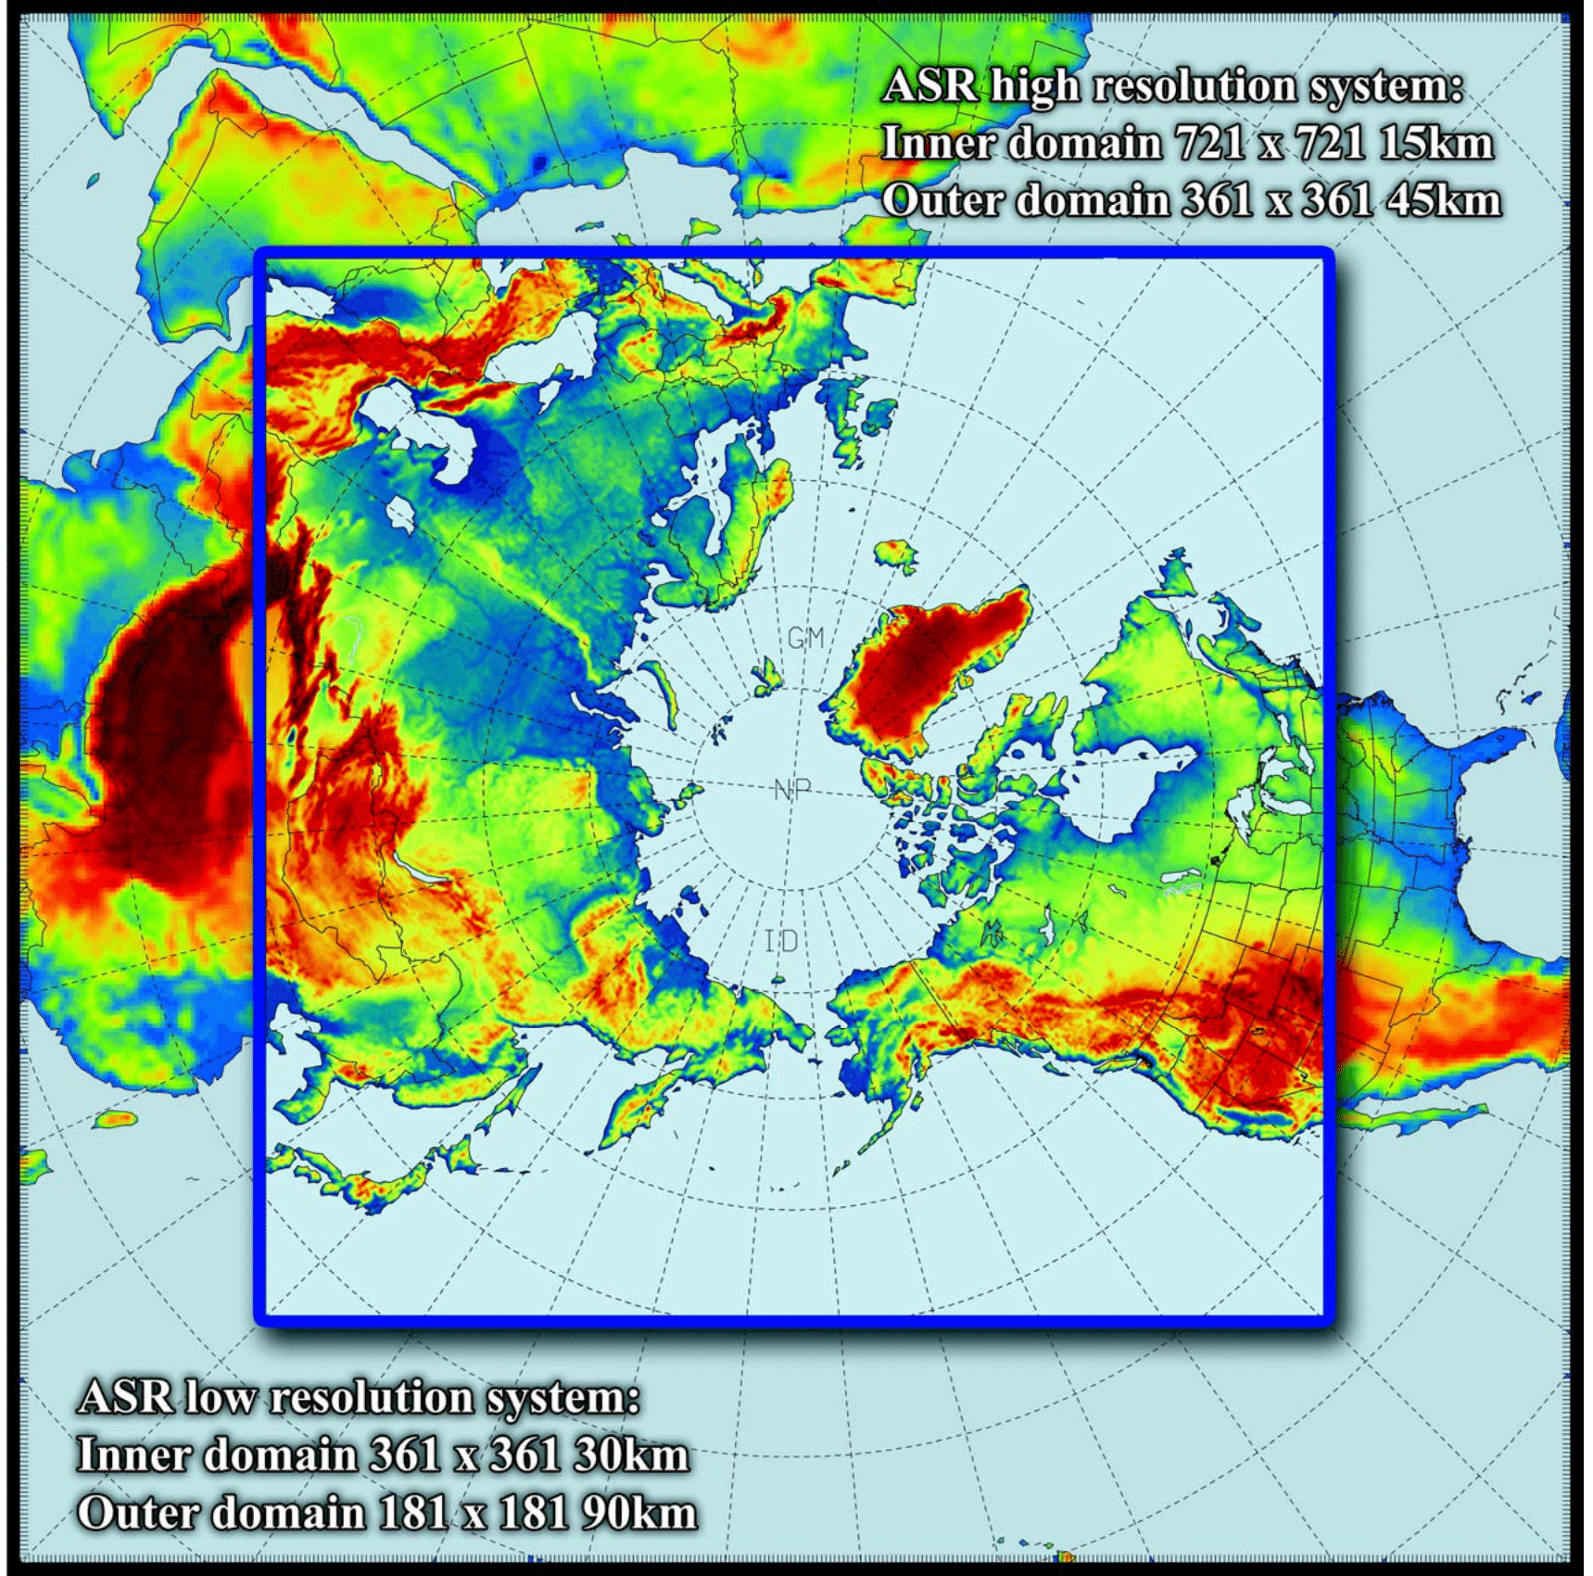
Regional reanalyses: plans
Growing strategic importance of the Arctic for access to natural resources and new shipping routes as a result of rapid climate warming/rapid changes in ice/snow conditions
Next generation pan-Arctic high-res (<5km) regional reanalysis (bottom left).
Timely Updates (2-3 months behind real time) for both European and Arctic regional reanalyses.
Support action for (European) reanalysis downscaling activities.
Above: CERRA domain for Europe
Left: C3S pan-Arctic domain compared with http://polarmet.osu.edu/ASR/; Inner domain @15 km not fully operational

Slide 19
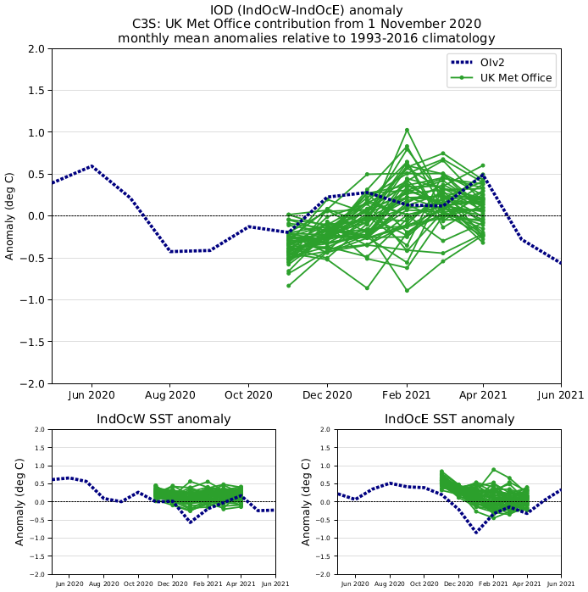
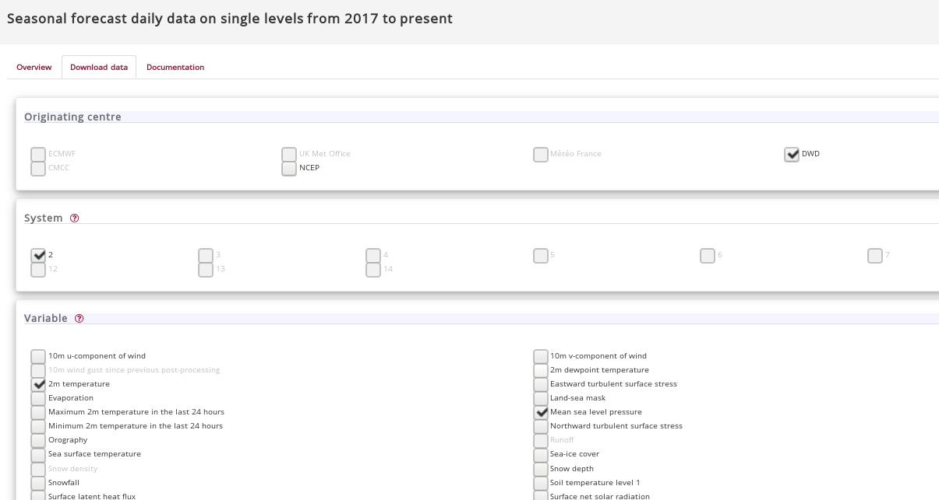
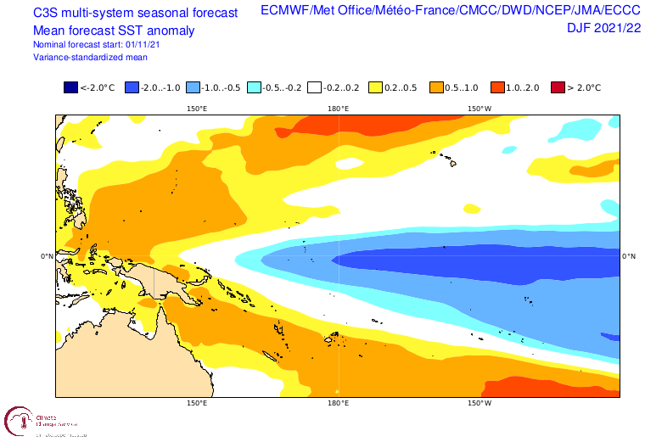
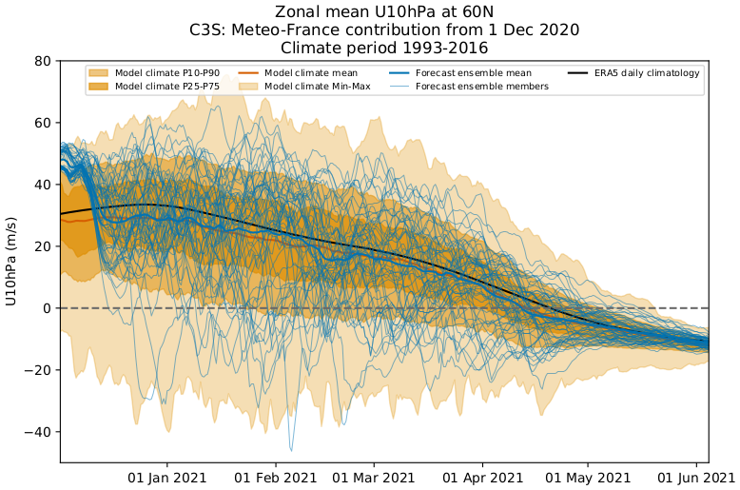
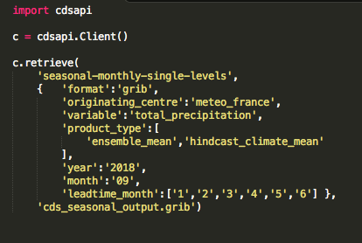
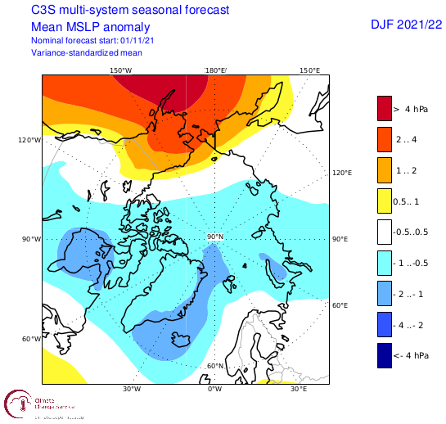
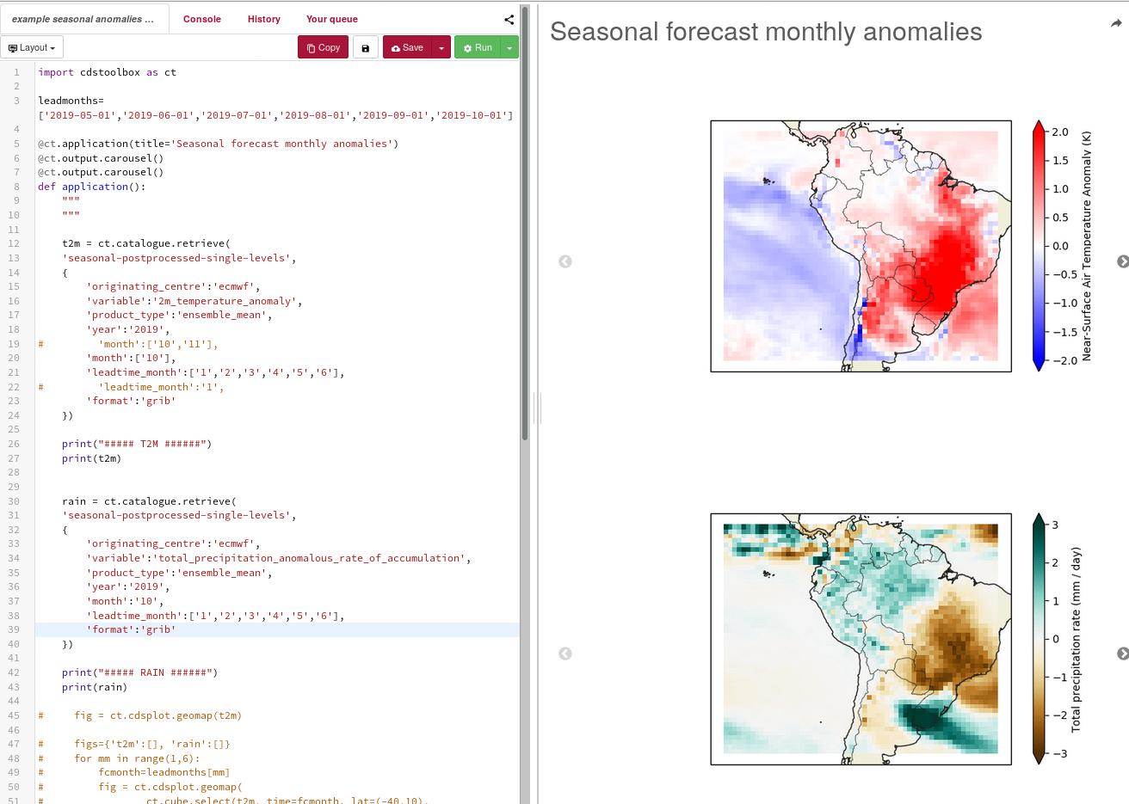

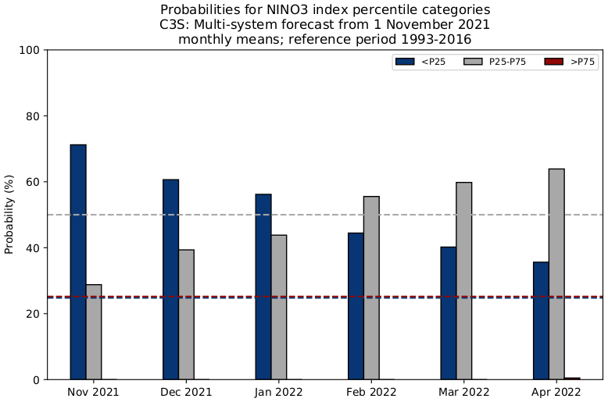
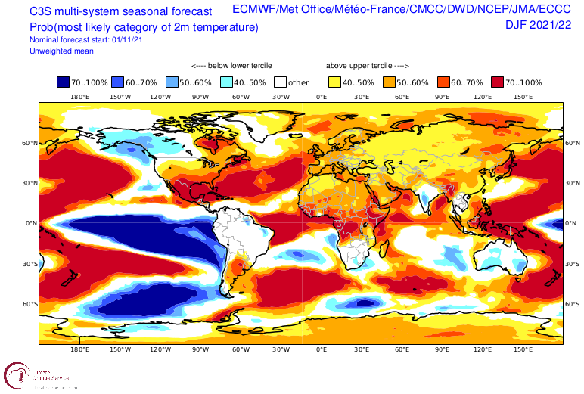
C3S seasonal predictions: evolution
Graphical products
Data products
Infrastructure
Data products:
ECMWF
MF
UKMO
More regions
New products
CMCC
DWD
NCEP
ECCC
Toolbox
JMA
CDS + API
Graphical
products
MARS archive
Notes:
Orange: graphical products
Blue: data products
Green: infrastructure

Slide 20
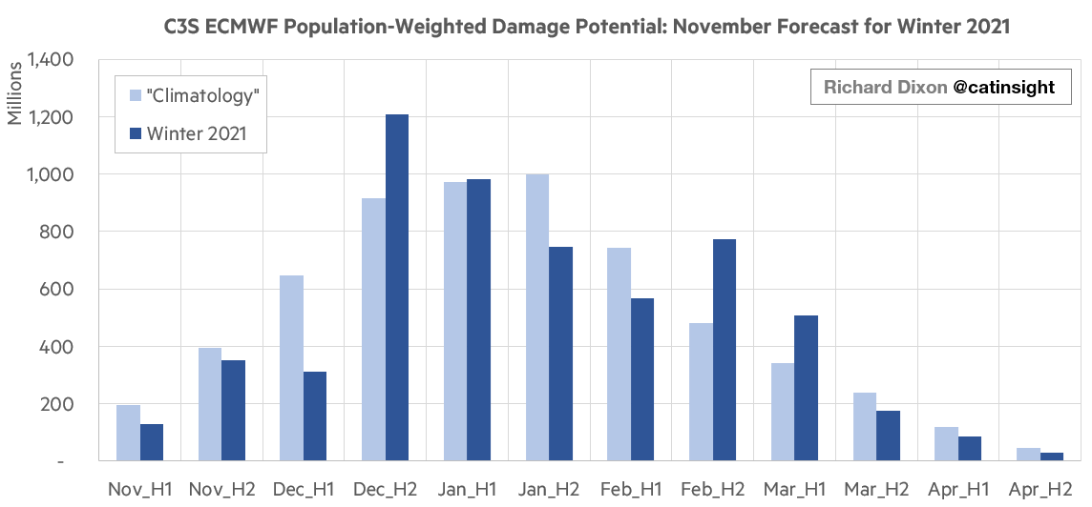
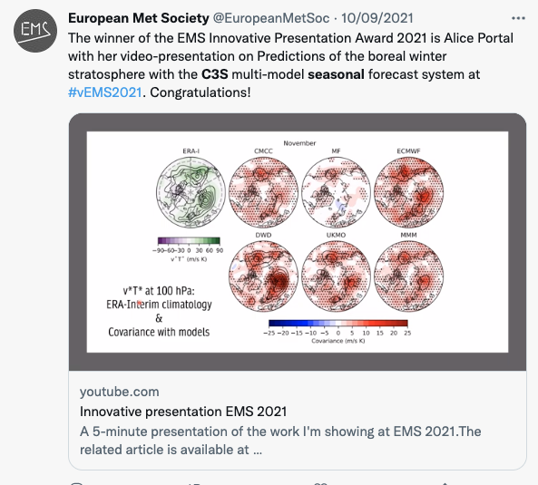
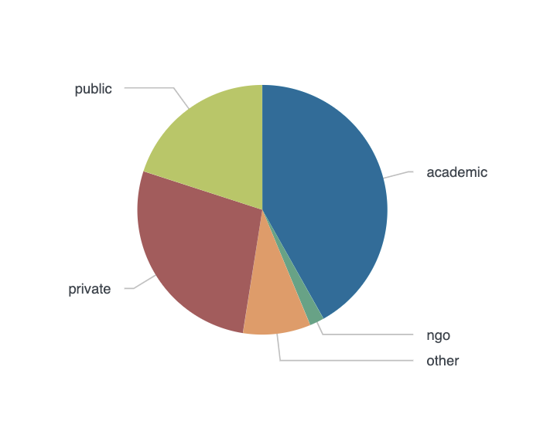
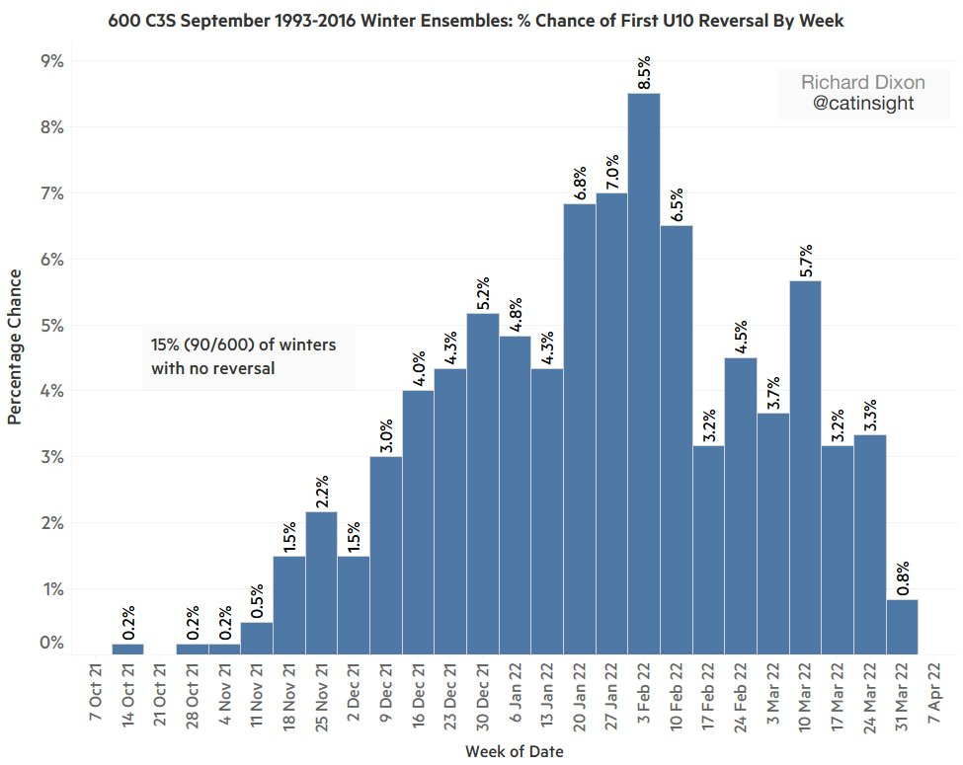
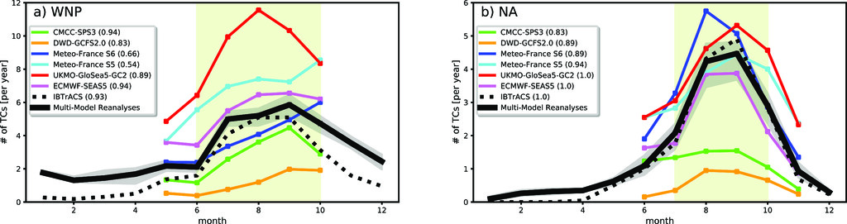
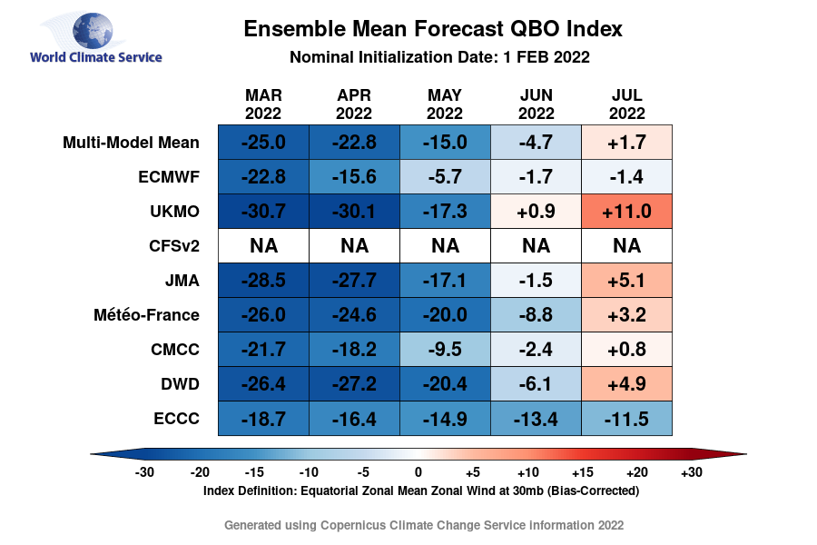
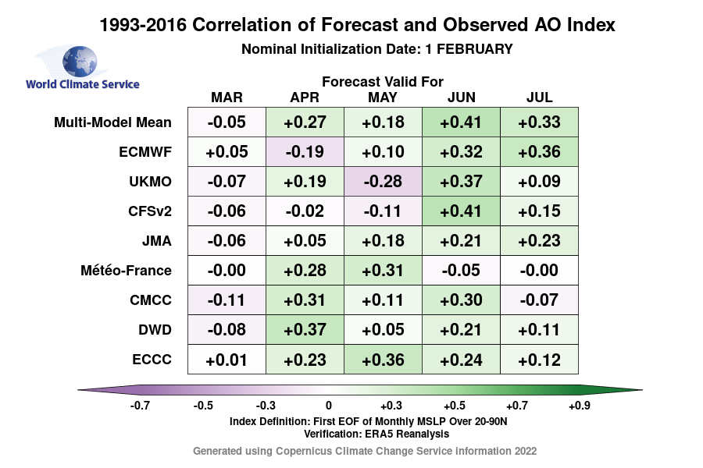



C3S predictions in user diagnostic
Tropical cyclone genesis
Alice Portal and EMS @EuropeanMetSoc
World Climate Service @WorldClimateSvc
Richard Dixon @catinsight
D.Befort et al, 2021
Matteo de Felice @matteodefelice
Simon Lee @SimonLeeWx
Vortex @VortexFdC

Slide 21




May forecast for June-August 2022
Risk of high temperature (left) and below average rain (right) predicted in areas where hot and dry conditions (bottom row) were observed

Slide 22



Regional climate projections: Europe and beyond
New CORDEX simulations including high resolution EURO-CORDEX simulations and world-wide simulations for all 14 CORDEX domains published in the CDS
  World-wide simulations: connected and aligned to the IPCC Climate Atlas.
  Very large ensemble for Europe (130 simulations about half of which was funded by C3S)
Notes:
Why climate projections on a Earth Observation programme?
Because having possibility to access all data streams on climate on the same platform is an asset for the users.

Slide 23



What is an application?

Slide 24


Cataloguing

Slide 25


Operational water
What does it provide? Probabilistic pan-European and global multi-model hydrological seasonal forecast and retrospective forecasts (hindcasts, in synergy with the CEMS hydrological seasonal forecasting component
Definition of indices and tailored products, multi-model composition, bias-adjustment procedures, skills and uncertainty calculation , visualizations

Slide 26




ESOTC 2022

Slide 27






Chain of services and products and feedback loops
Past
Present
Future
Service chain
Feedback loop

Slide 28


Slide 29







The Climate and Atmosphere Data Store (CADS)
modular open-source code base, compatible with scientific Python
infrastructure independence for improved performance
(apps targeting <2s response)
cloud resources and web interface underpinned by Jupyter notebooks
platform flexibility;
toolbox can be run anywhere there’s Python
wide range of analysis, visualisation and GUI tools beyond original CDS
improved interfaces to ever-growing catalogue

Slide 30



cadstoolbox
[user@macbook] $ pip install cadstoolbox
import xarray as xr
import cadstoolbox as cads
# data retrieval
data_1 = cads.catalogue.retrieve(...)
data_2 = cads.catalogue.retrieve(...)
# easy data download
data_1.to_netcdf('my_data.nc')
# compatibility with scientific Python
data = xr.concat([data_1.to_xarray(), data_2.to_xarray()])
# built-in tools
climatology = cads.climatology(data)
# built-in visualisations
plot = cads.chart.line(climatology)
cads toolbox
Open-source Python library
CDS catalogue plus tools and services
Local installation via pip
Not backwards-compatible with CDS

Slide 31



cdslab
Jupyter Lab notebooks
Cloud compute resources
Curated libraries pre-installed

Slide 32





CADS Toolbox and Applications
cadslab offers an online-only platform hosted on the CADS cloud
cads-applications will be deployed as standard-alone instances on the CADS cloud
CADS
Cloud
Application
cads toolbox
cads cloud compute
cads toolbox
heavy jobs (retrieval and reduction) submitted to the CADS cloud to run as services
Service
requests
cads-toolbox can be installed and run anywhere
WEkEO
colab/binder
Local machine
External
platforms
cads toolbox
cads toolbox
cads toolbox

Slide 33









Climate services as an emerging need at a national level: national collaboration

Slide 34
Copernicus EU
@copernicusecmwf
Copernicus ECMWF
Copernicus EU
Copernicus ECMWF
@CopernicusEU
@CopernicusECMWF
@carlo_tuitter
www.copernicus.eu
climate.copernicus.eu
Thank you for your attention

