Slide 1

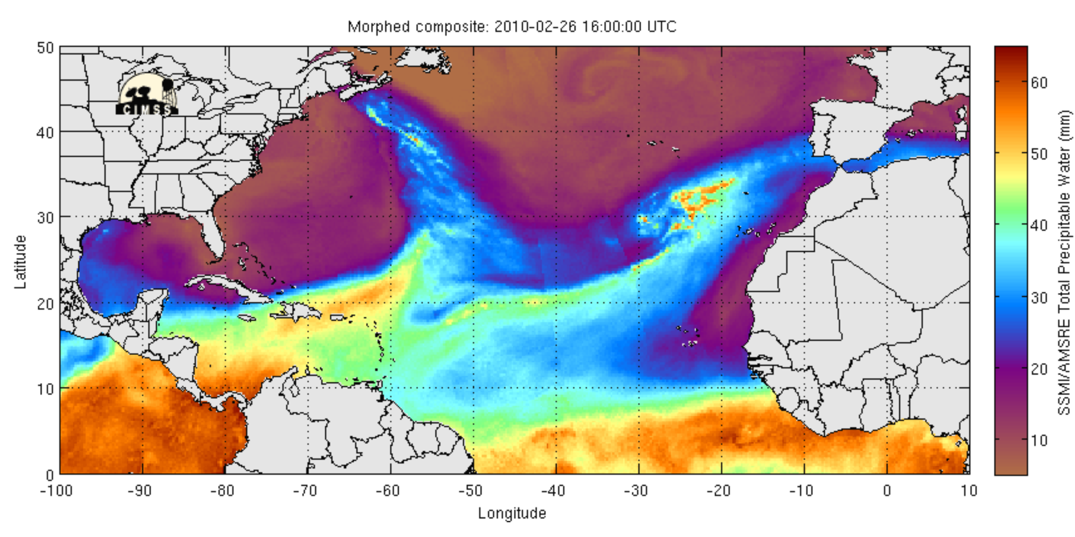
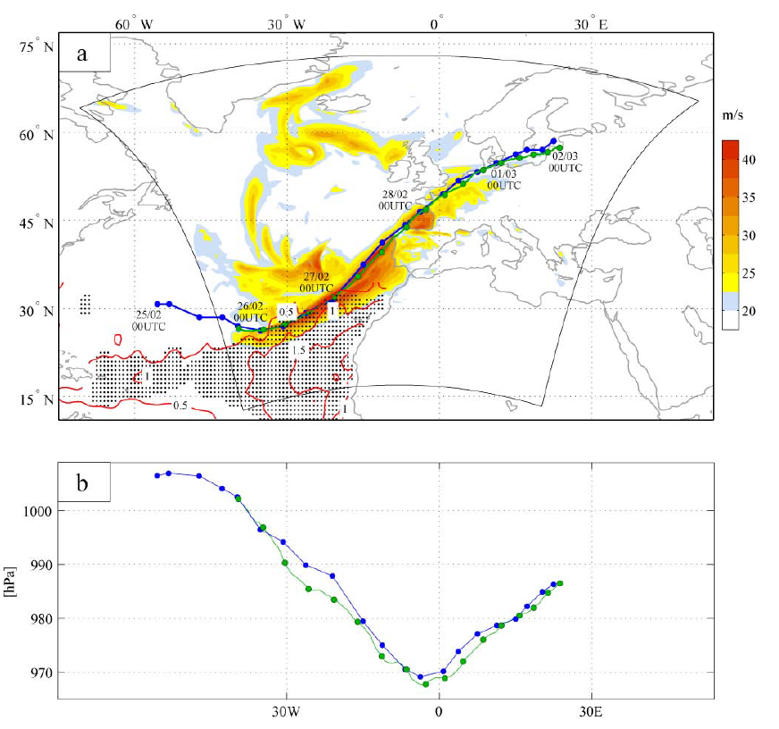
Storm’s explosive development in the subtropical North Atlantic Ocean
Margarida L. R. Liberato
Universidade de Trás-os-Montes e Alto Douro, Vila Real, Portugal
Instituto Dom Luiz (IDL), Universidade de Lisboa, Portugal
Liberato et al. 2013

Slide 2
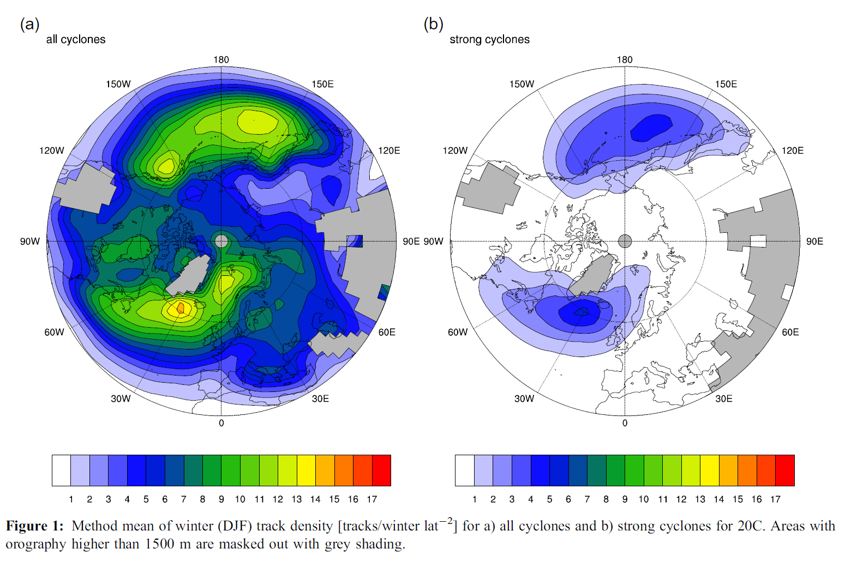
Extratropical cyclones. Mid-latitude extreme cyclones
“Strong Cyclones”
ECHAM5/OM1 – 20C
Ulbrich et al., 2013 (Met Z)

Slide 3
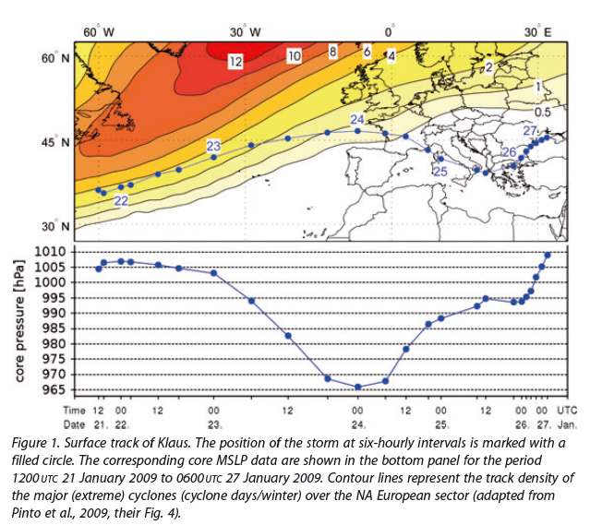
Cyclones with explosive development
Klaus
Jan 2009
“bomb”
>24 hPa/24h
Liberato et al., 2011 (Weather)

Slide 4
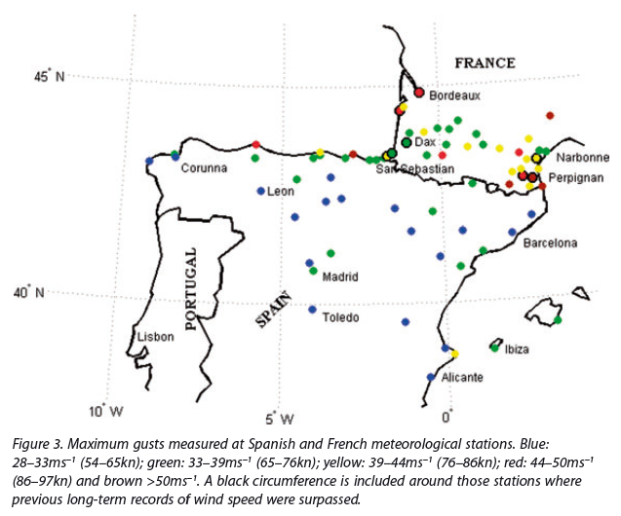
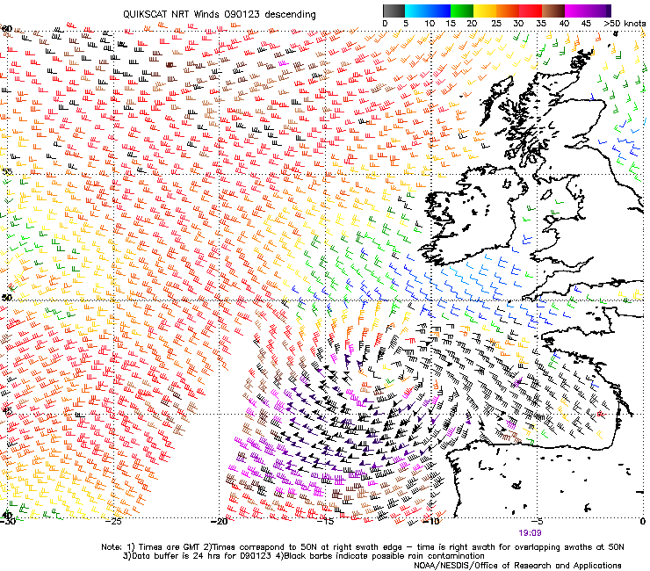
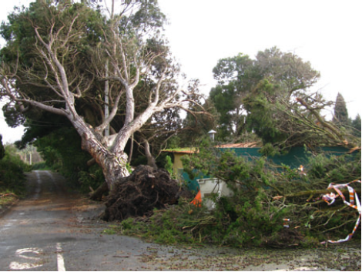
Extreme cyclones vs severe impacts
28 deaths (Spain + France) most costly event of 2009
6.000.000.000 USD
Extreme wind
Klaus
QUIKSCAT NRT winds
(23-01-2009)
Liberato et al., 2011 (Weather)

Slide 5
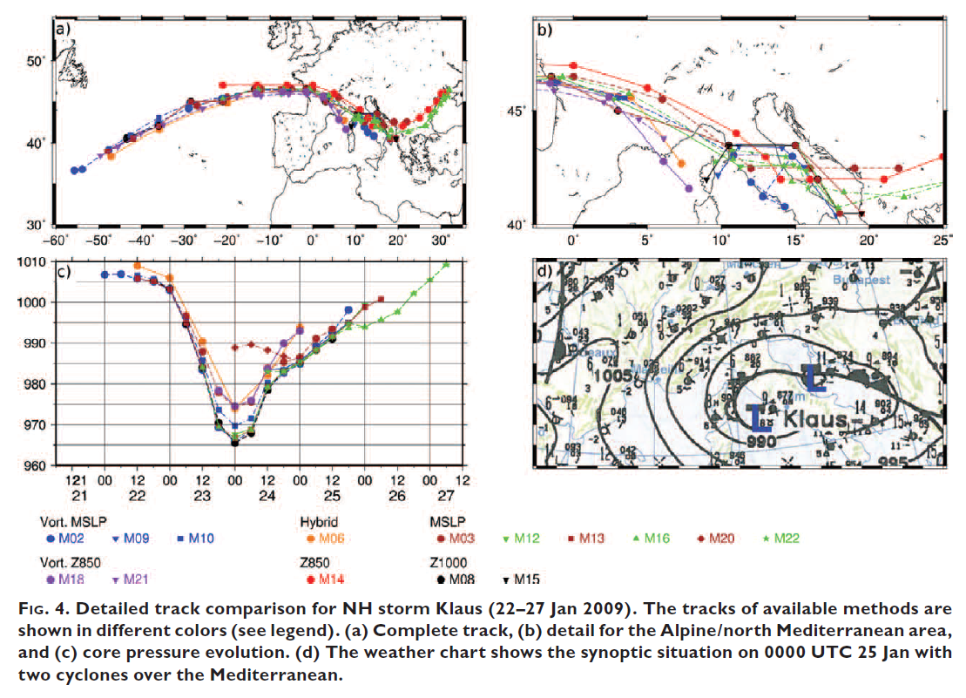
Intercomparison: uncertainty on track and intensity
track
coreP
Neu et al. 2013 (BAMS)

Slide 6
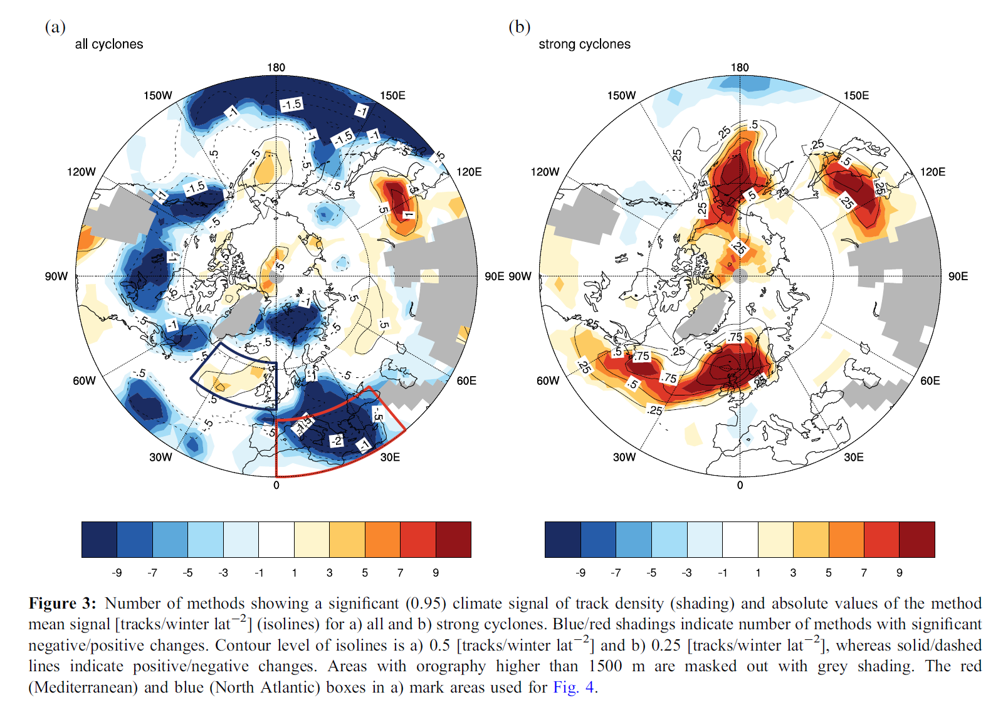
Future scenarios: intercomparison
“Strong Cyclones”
ECHAM5/OM1
SRES A1B scenario
Ulbrich et al. 2013 (Met Z)

Slide 7
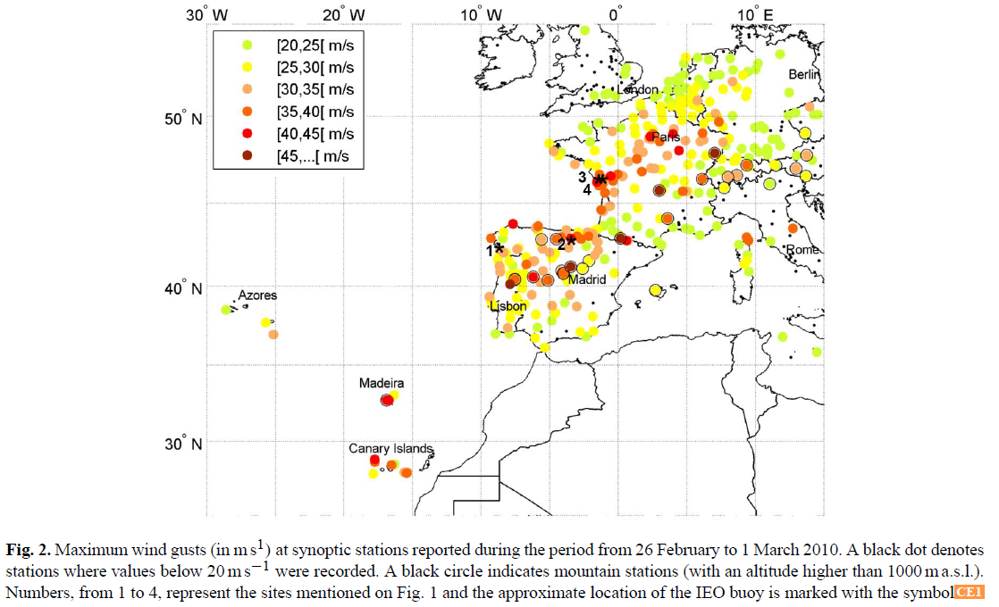
Storm Xynthia (28 Feb 2010)
64 deaths (France) - 2nd most expensive natural hazard event for 2010 in terms of economic losses
4.500.000.000 USD
Storm surge
Maxima wind gusts
Liberato et al. 2013

Slide 8
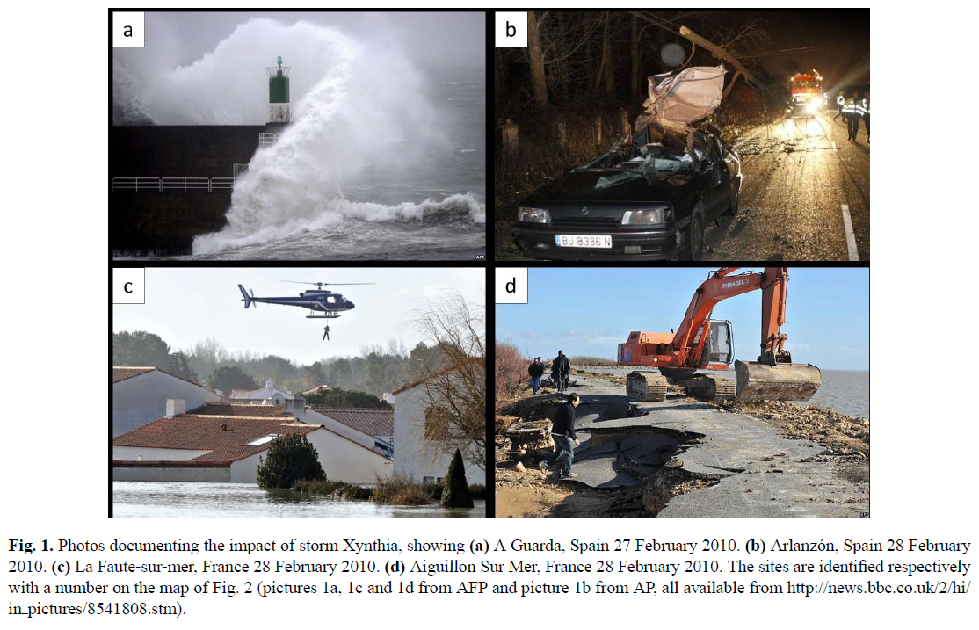
Xynthia (28 Feb 2010): storm surge and coastal impacts
Liberato et al. 2013 (NHESS)

Slide 9
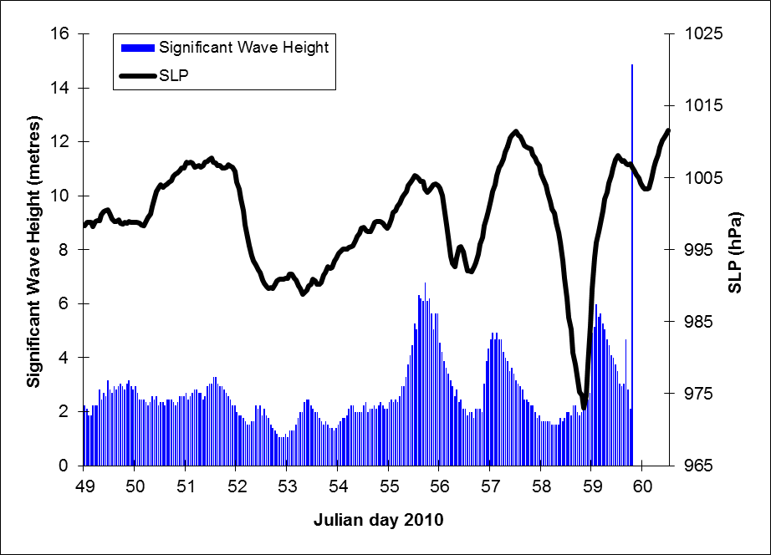
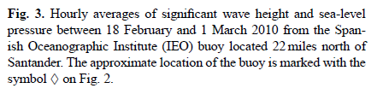
Xynthia (28 Feb 2010): the storm surge
Liberato et al. 2013 (NHESS)

Slide 10
Xynthia (28 Feb 2010): storm footprint
SST anomaly > 1.5ºC
SST anomaly
Surface wind track
“storm footprint”
Liberato et al. 2013 (NHESS)

Slide 11
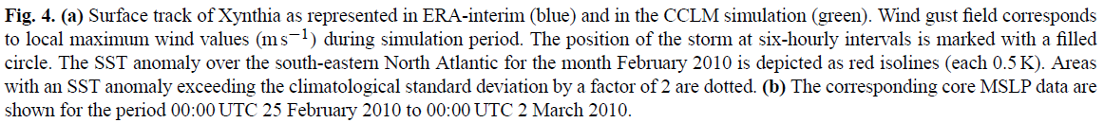
Xynthia (28 Feb 2010): storm footprint
SST anomaly > 1.5ºC
“bomb”
>24 hPa/24h
Liberato et al. 2013 (NHESS)

Slide 12
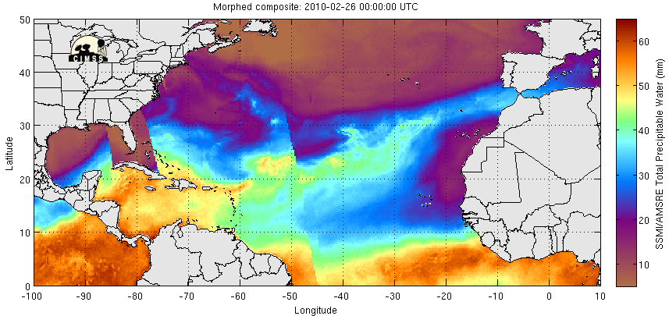

Xynthia (28 Feb 2010): the Atmospheric River
Total Precipitable Water

Slide 13
Xynthia (26 Feb 2010): large-scale conditions
θe at 850 hPa (K)
Jet stream (300 hPa)
Liberato et al. 2013

Slide 14
Xynthia (27 Feb 2010): large-scale conditions
θe at 850 hPa (K)
Jet stream (300 hPa)
Liberato et al. 2013

Slide 15
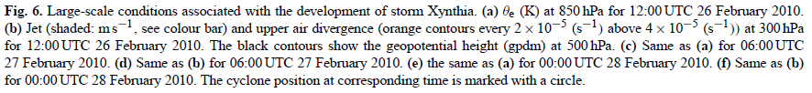
Xynthia (28 Feb 2010): large-scale conditions
θe at 850 hPa (K)
Jet stream (300 hPa)
Liberato et al. 2013

Slide 16
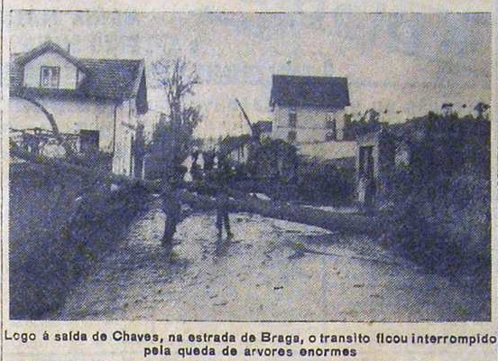
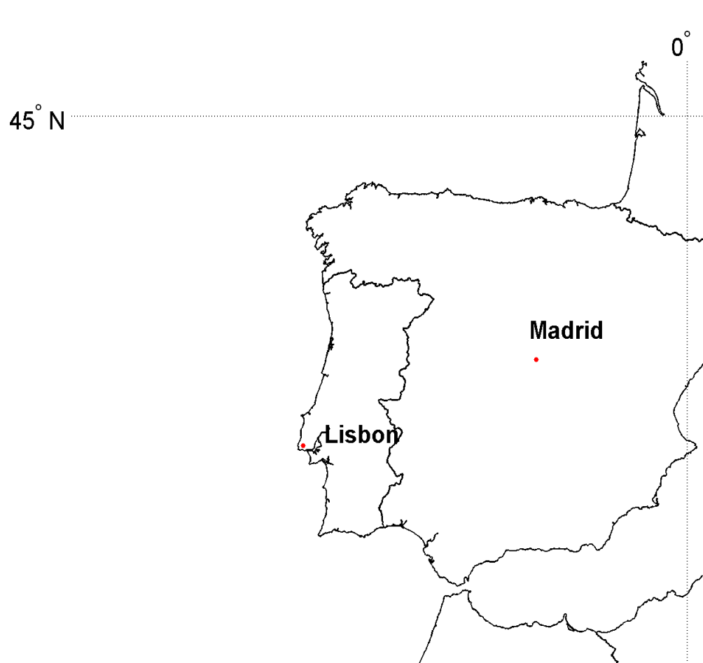

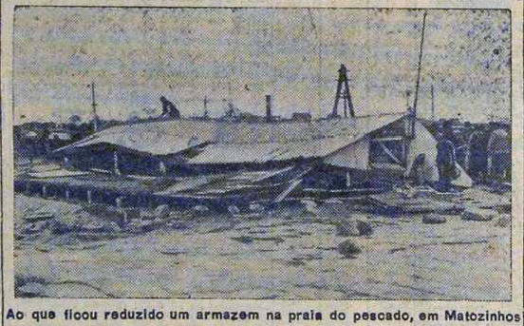
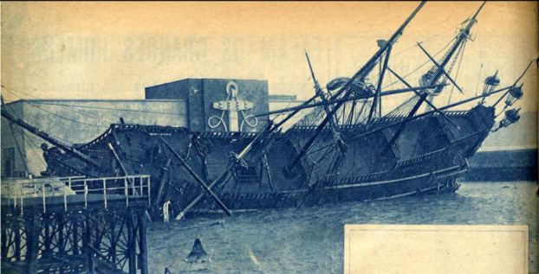
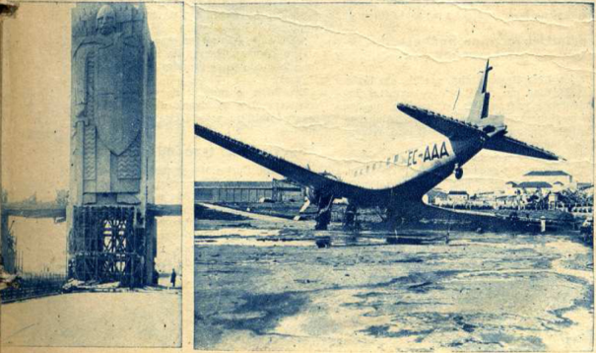
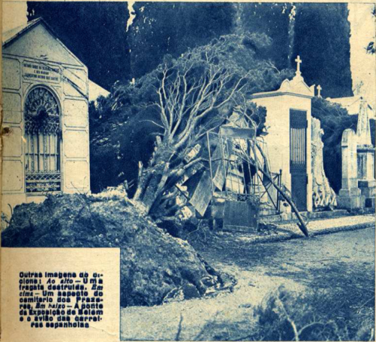
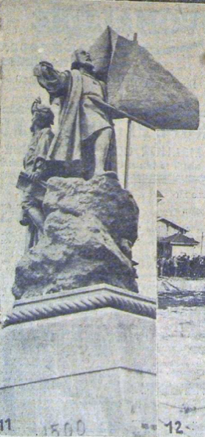
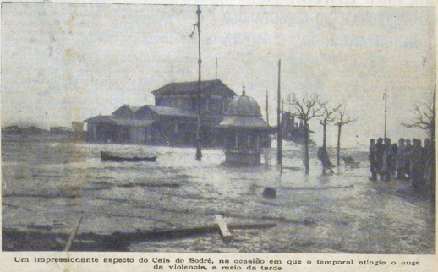
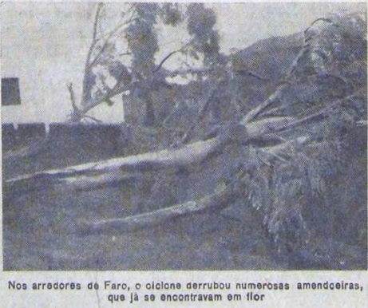
The 1941 (Feb 15) cyclone with explosive development
130 fatalities (Portugal)
>1 million trees downfall
Flash flooding
One of the 5 most severe windstorms in Europe during the XX century
Liberato et al. 2012

Slide 17
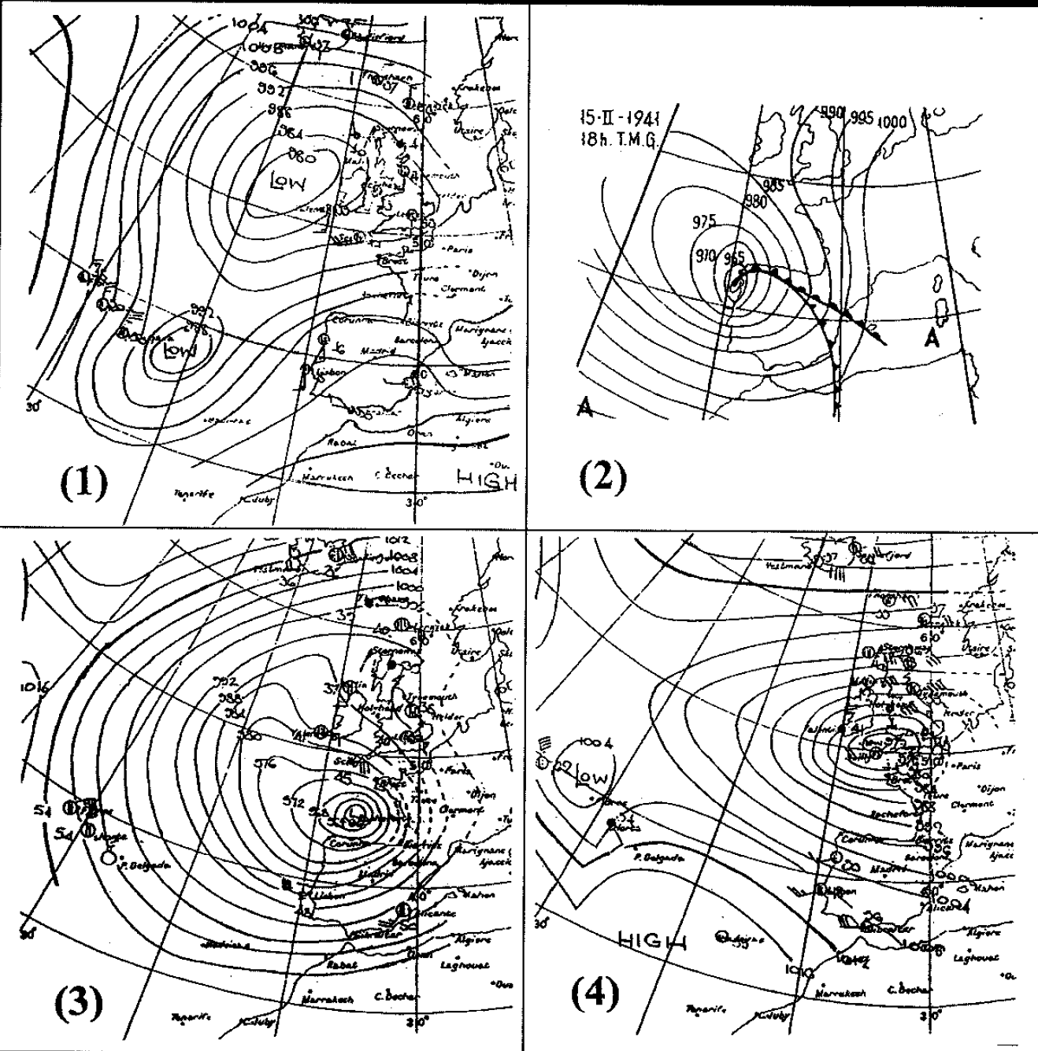
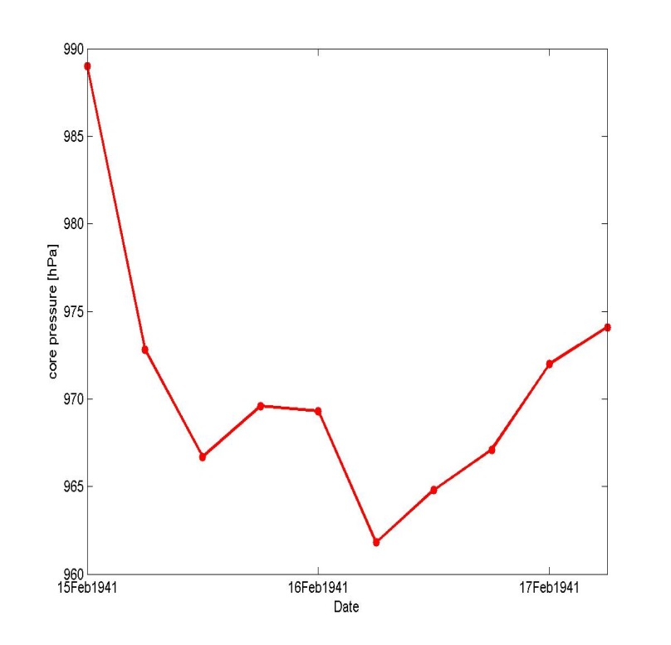
Historical storms: the 1941 (Feb 15) cyclone
06UTC 15FEB1941
18UTC 15FEB1941
Vmax | km/h
Porto | 130
Penhas Douradas | 148
Lisboa | 127
Portimão (Algarve) | 150
00UTC 16FEB1941
09UTC 17FEB1941
22.3 hPa/12h
(32 hPa/12h)
“bomb”
Liberato et al. 2012
Condições sinópticas à superfície. Fonte: (1,3,4) U.K. Met Office; (2) Mateo González (1955). Figura de Rubio (2001)

Slide 18
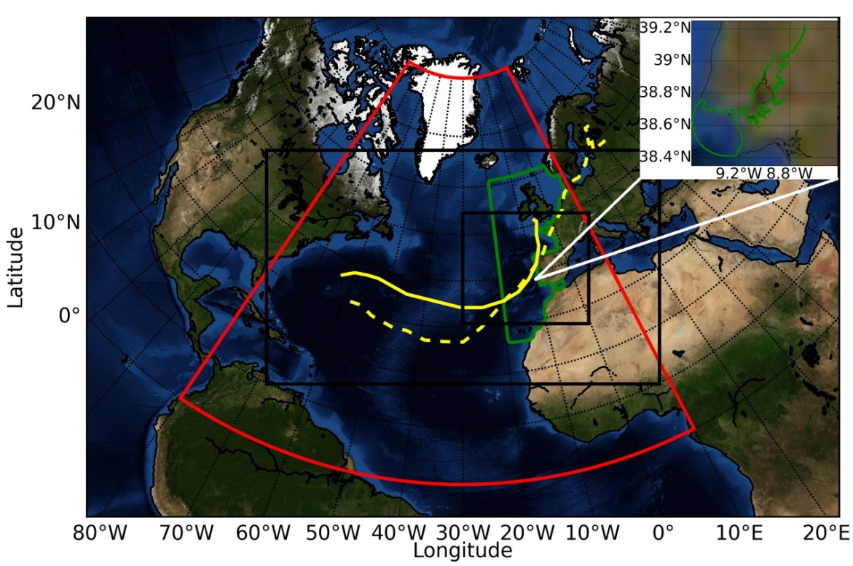
The 1941 cyclone and flooding simulation
a)
Simulation of Tagus flooding
a) present scenario
b) worst scenario (high tide)
c) sea level increase (50 cm)
Fortunato et al. (2017, CSR)

Slide 19
Extreme event – 1941 cyclone and flooding simulation
a)
b)
Simulation of Tagus flooding
a) present scenario
b) worst scenario (high tide)
c) sea level increase (50 cm)
Fortunato et al. 2017

Slide 20
Extreme event – 1941 cyclone and flooding simulation
a)
b)
c)
Fortunato et al. 2017

Slide 21
Take home messages
Historical storms research is fundamental to better understand climate variability of extreme events – mostly in the NE Atlantic
The explosive deepening of cyclones on the southern North Atlantic still needs further understanding of the relative roles of diabatic and baroclinic processes, essential for better forecasting of associated compound events.

Slide 22
Thank you!
Acknowledgments: This work is supported by the Portuguese Fundação para a Ciência e Tecnologia (FCT) I.P./MCTES through national funds (PIDDAC) - UIDB/50019/2020 – Instituto Dom Luiz and project WEx-Atlantic - Weather Extremes in the Euro Atlantic Region: Assessment and Impacts (PTDC/CTA-MET/29233/2017)

Slide 24
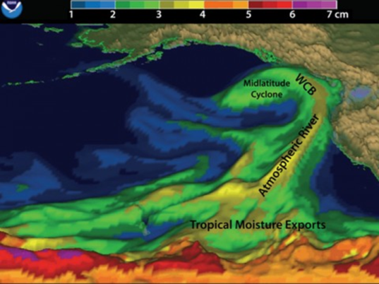
Extreme event – the atmospheric river
00 UTC 19 November 1983
SLP and total column water vapor (mm)
Liberato et al. (2012, Geophysical Monograph Series)
Ramos et al. (2016, GRL)

