Slide 1

Are climate projections underestimating the circulation response to climate forcing?
Albert Ossó
Wegener Center for Climate and Global Change, Graz (Austria)
CAFE conference, BCN Sept. 2022

Slide 2
OUTLINE
Sources of uncertainty in the regional climate projections: Circulation uncertainty, thermodynamic vs dynamic atmospheric response, atmospheric drivers
The signal-to-noise paradox: What is it?
Possible origins of the signal-to-noise paradox: Insufficient eddy convergence and insufficient ocean-atmospheric interactions
Summary

Slide 3
Sources of uncertainty in climate projections
Scenario uncertainty
We won’t deal with this here.
Internal variability
Uncertainty
Model response uncertainty
Irreducible but quantifiable
Potentially reducible
e.g., Hawkins and Sutton (2009).

Slide 4
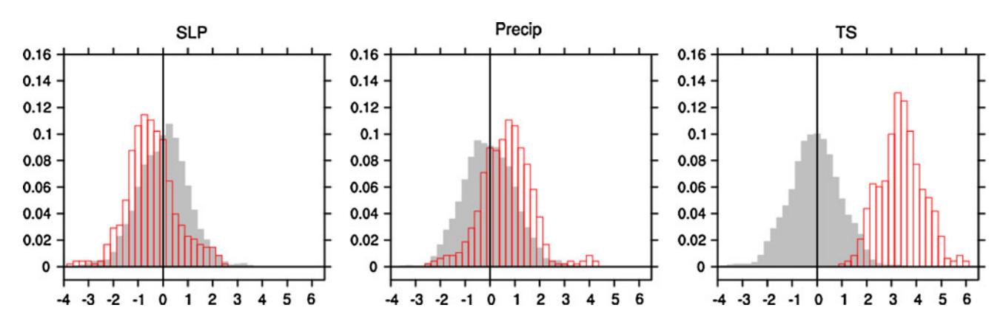
Dynamical vs thermodynamic response
2005–2060 CCSM3 trends
Adapted from Deser et al. (Clim. Dyn. 2012)
Dynamic changes are small but the change in the associated risk is not!

Slide 5
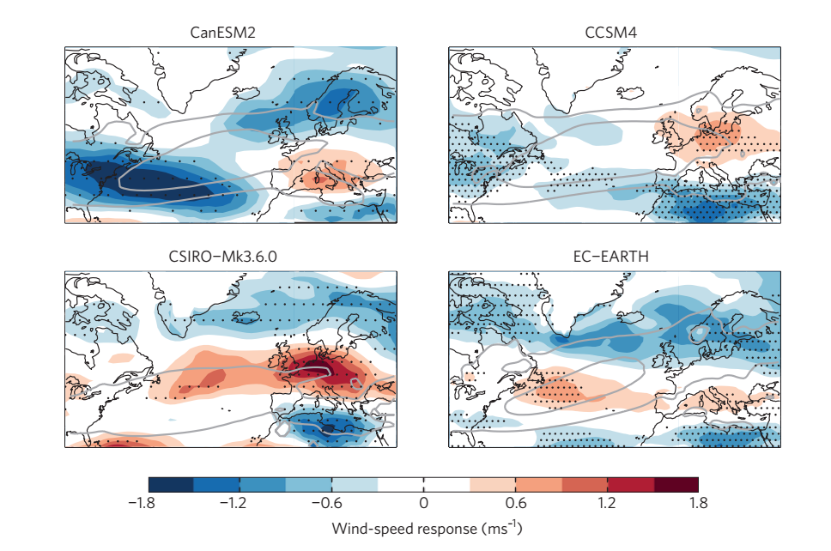
Uncertainty of the circulation response
Winter U850 response to GHG increase (2070–2099, from RCP8.5 minus 1976–2005, from historical simulations)
From Shepherd (Nature Geosci. 2014)
Models exhibit very different circulation response to forcing

Slide 6
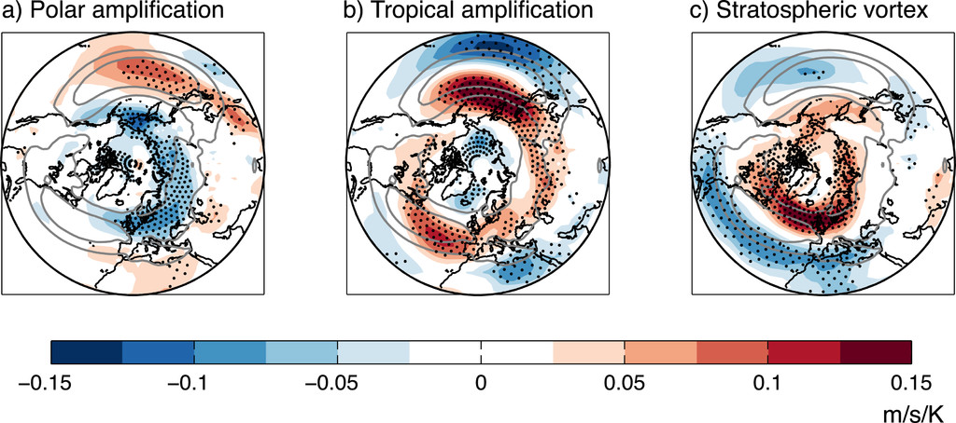
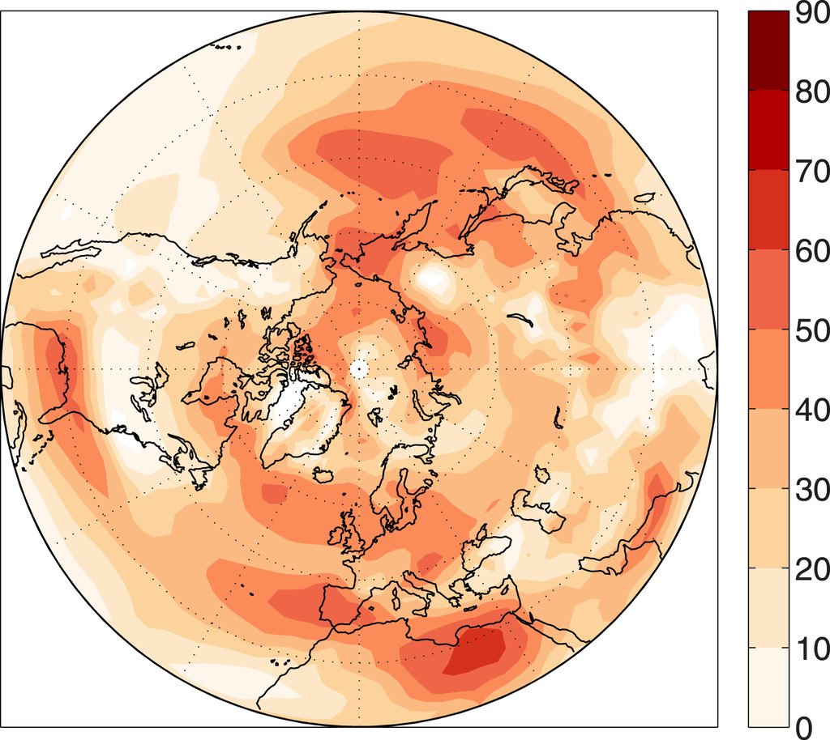
Uncertainty of the circulation response and the storyline approach
Atmospheric circulation sensitivity to the remote drivers
R²
U850 wind response scaled by global warming associated with a one sigma positive anomaly in a driver in the CMIP5 intermodel spread
Fraction of variance (R²) of the CMIP5 intermodel spread in the cold season U850 response that can be related to the remote drivers and global warming uncertainty
From Zappa et al. (J.Clim. 2017)

Slide 7
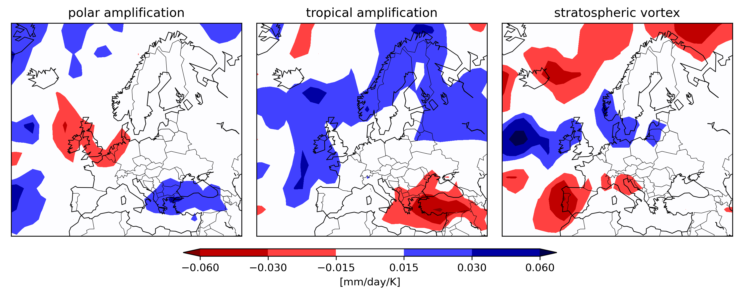
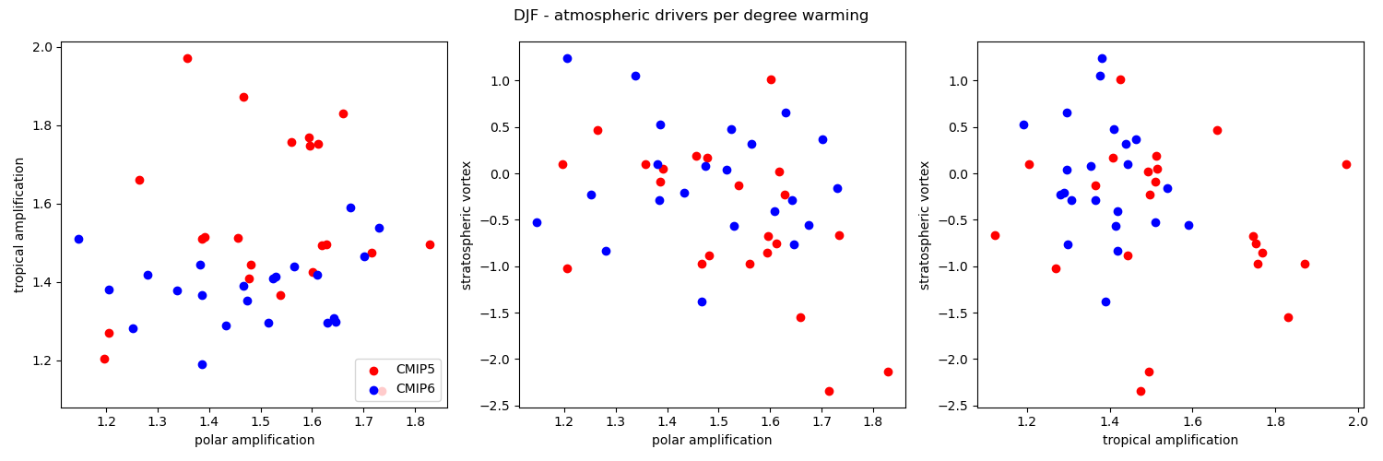
Uncertainty in the precipitation response
.
CMIP5/6 precipitation sensitivity to remote drivers
The ensemble mean response is most possibly a very diluted picture of the future real world response!
CMIP5/6 atmospheric drivers response to warming
Ritzhaupt et al. (In preparation)

Slide 8
The story line approach
“Classical” probability approach
Storyline approach
vs
Alternative physically motivated consistent futures.
Most likely response
You can update the storyline as new information becomes available.
e.g., Hazeleger et al. 2015; Meredith et al. 2015; Shepherd 2016a

Slide 9
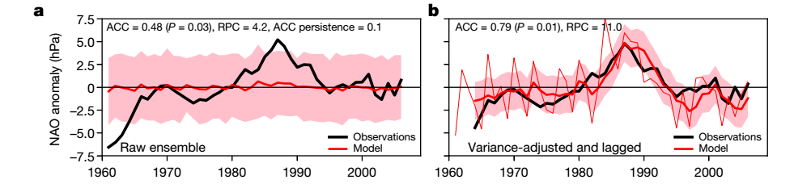
The signal to noise paradox
The case of the North Atlantic Oscillation
14 different models and a total of 169 runs!
Raw model output
Variance adjusted
RPC=11!
677 members!
Adapted from Smith et al. (NPJ, 2019)
The ensemble mean is highly correlated (r=0.78)!
It should explain 62% of observed variability but the magnitude of the ensemble mean variability is inconsistent with correlation.
There is very little agreement between ensemble members.
Notes:
This hso

Slide 10
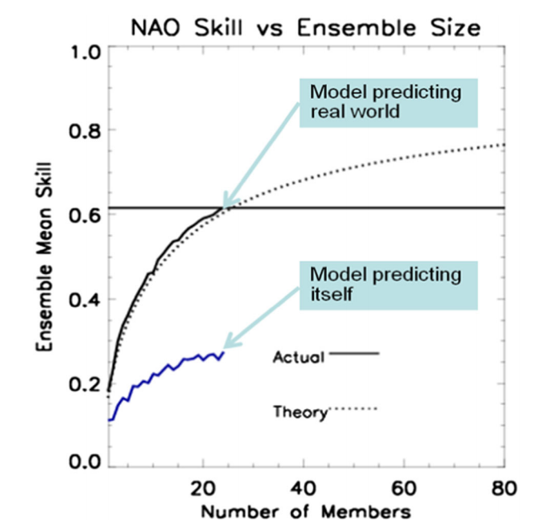
A signal to noise paradox
Why a “paradox”? Models predict the real world better
than themselves.
E.g., Eade et al. 2014; Scaife et al. 2014; Dunstone et al 2018; Scaife and Smith 2018.

Slide 11
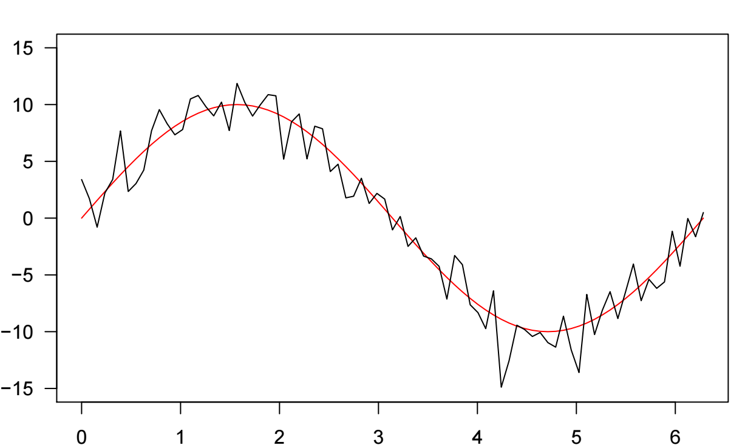
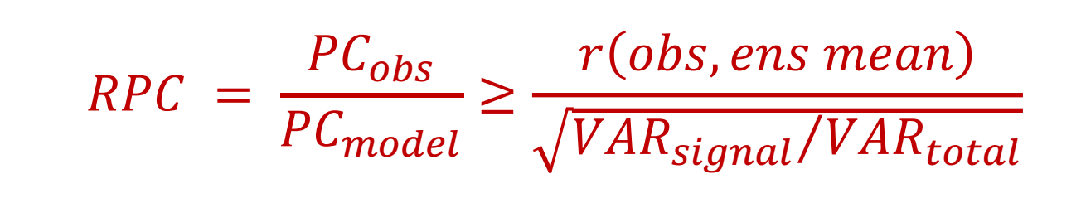
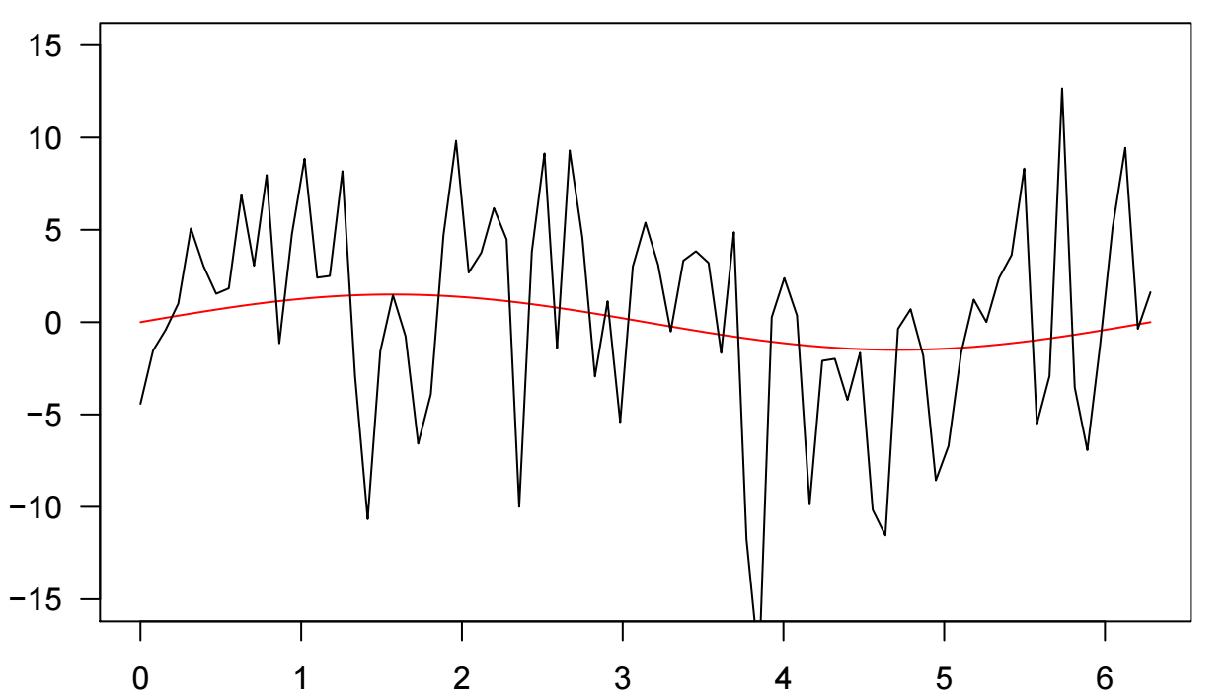


A signal to noise paradox interpretation
Climate models have the right amount of variability but the proportion of variability that is predictable is too small
Observations
Signal
Signal + Noise
Dynamic variable
$$σ_{s}^{2}$$
σ²
Predictable Components (PCs): Predictable part of the total variance
PC_{obs} is estimated from explained variance = r²(obs,ensmean)
PC_{model} estimated from ratio of signal variance to total variance
Models
Signal
Signal + Noise
Dynamic variable
σ²
$$σ_{s}^{2}$$
The real world seems to be more predictable than the models imply
Time
Scaife and Smith (NPJ, 2018)

Slide 12
A signal to noise paradox interpretation
14 different models and a total of 169 runs!
Raw model output
Variance adjusted
RPC=11!
RPC can be interpreted as the error in the predictable signal, in that case is one order of magnitude too weak in the ensemble.

Slide 13
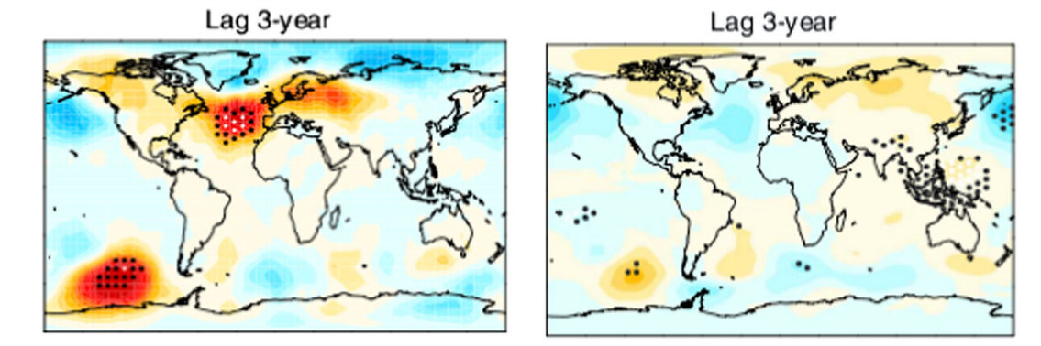
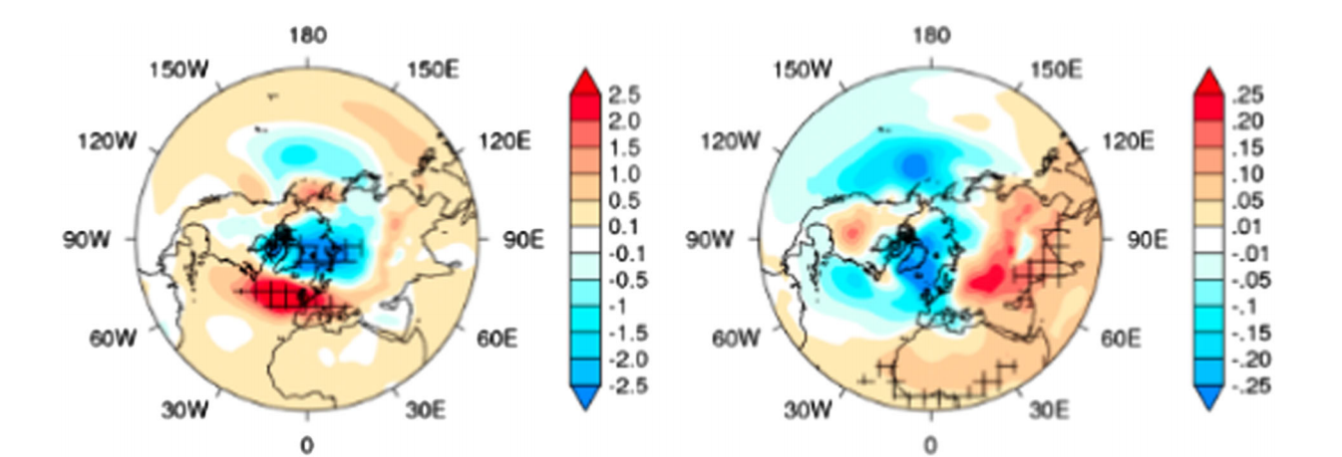
A signal to noise paradox in the response to external climate forcing
Model circulation response to volcanic eruptions is too weak
SLP response to solar forcing is too weak
HadSLP response
Model response
20Cr reanalysis SLP response
CMIP5 winter SLP response
From Driscoll et al. 2012
Adapted from Gray et al. 2013
Some consequences:
Estimates of unpredictable internal variability in regional climate change over the coming decades may be too large and forced signals too weak.
Models may underestimate extreme events associated with atmospheric circulation.

Slide 14
Origins of the signal to noise paradox
Two leading hypothesis:
1. Eddy- momentum flux convergence too weak. (Scaife et al. ASI 2019).
2. Insufficient ocean-atmospheric interaction (Ossó et al. 2020; Zhang et al. 2021)

Slide 15
Insufficient ocean-atmospheric interaction
Summer SLP response to precursor spring SST anomalies in ERA-Interim
Ossó et al. 2018; 2020

Slide 16
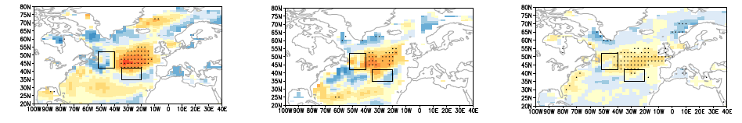
Insufficient ocean-atmospheric interaction
SST dipole - SEA pattern feedback
ΔSST(Aug - Jul)~ SSTI(MA)
Ttend ~ SSTI(MA)
(4)Rad flux ~ SSTI(MA)
(1)
(2)
(3)
(4)
Ttend* ≈ (Ekman advection) + (Ekman pumping) + (Turbulent flux) + (Rad flux)
The radiation flux anomaly is responsible of about 50% of the observed warming
Ossó et al. 2020

Slide 17
Ocean-atmospheric feedbacks
The SEA pattern leads to clear skies and increased radiation
The SST dipole forces the SEA pattern
The warm anomaly is intensify and the SSTI increases
The SEA pattern is the product of SST forcing + a feedback mechanism
Ossó et al. 2020

Slide 18
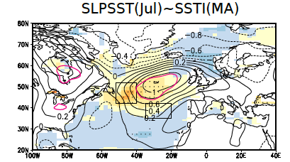
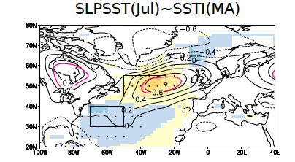
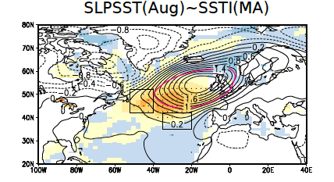
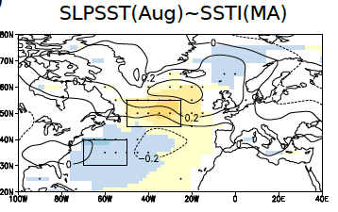
Insufficient ocean-atmospheric interaction
ERA-Interim
HadGEM-GC2
Ossó et al. 2020

Slide 19
Summary and outlook
The atmospheric circulation response to increase GHG is uncertain.
A fraction of the uncertainty is associated with internal variability and different model representation of the remote drivers change. These uncertainty sources can be quantified using large ensembles and a storyline approach.
The “signal-to-noise paradox” indicates that the model response to external forcing is too weak.
The signal-to-noise paradox is associated with insufficient eddy-mean flow feedbacks and insufficient ocean-atmospheric coupling.
NEGATIVES: We might be underestimating the force response (some studies suggest by a large amount).
POSITIVES: However, the good news is that the real world appears to be more predictable than the models suggest.

Slide 20
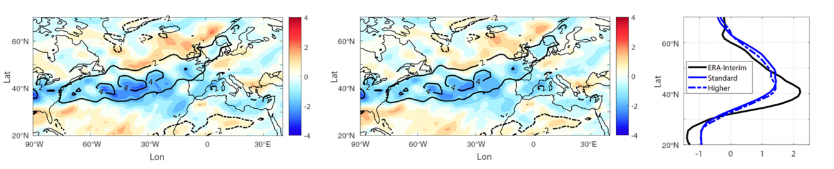
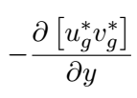
Too weak Eddy-momentum flux convergence
GloSea5 eddy-feedback strength bias
Standard resolution
High resolution
From Scaife et al. ASI 2019

Slide 21
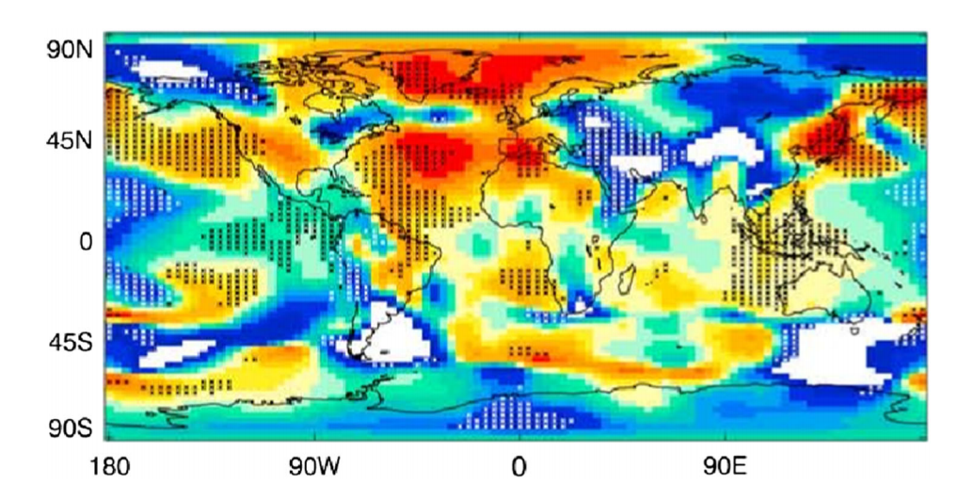
A widespread phenomenon
Ratio of predictable components (RPC) for seasonal predictions
of winter sea level pressure
Orange and red values indicate RPC > 1 whereas blue and green values indicate RPC < 1. Data are from the GloSea5 forecast system. From Scaife et al. 2018

Slide 22
Polar warming: temperature change at 850 hPa averaged between 60° and 90°N.
Tropical warming: Temperature change at 250 hPa averaged between 30°S and 30°N.
Stratospheric vortex strength: zonal mean zonal-wind change at 20 hPa averaged between 70° and 80°N.

