Slide 1

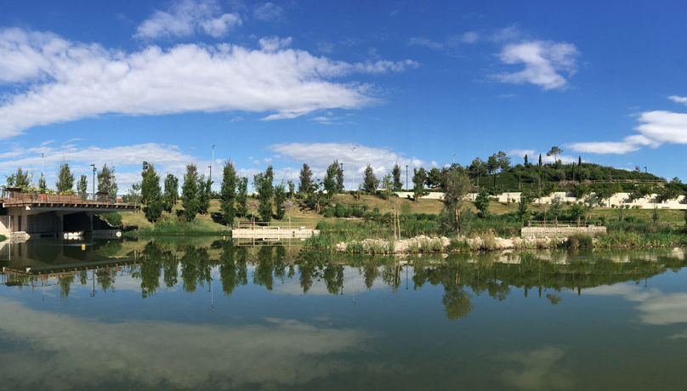

REGIONALIZATION OF THE EFFECTS OF CLIMATE CHANGE ON PRECIPITATION AND TEMPERATURE CONDITIONS IN THE CITY OF ALICANTE (SPAIN)
Luis G. Cutillas Lozano (lgabino.cutillas@aguasdealicante.es)
Aguas Municipalizadas de Alicante, E.M.
September 2022

Slide 2
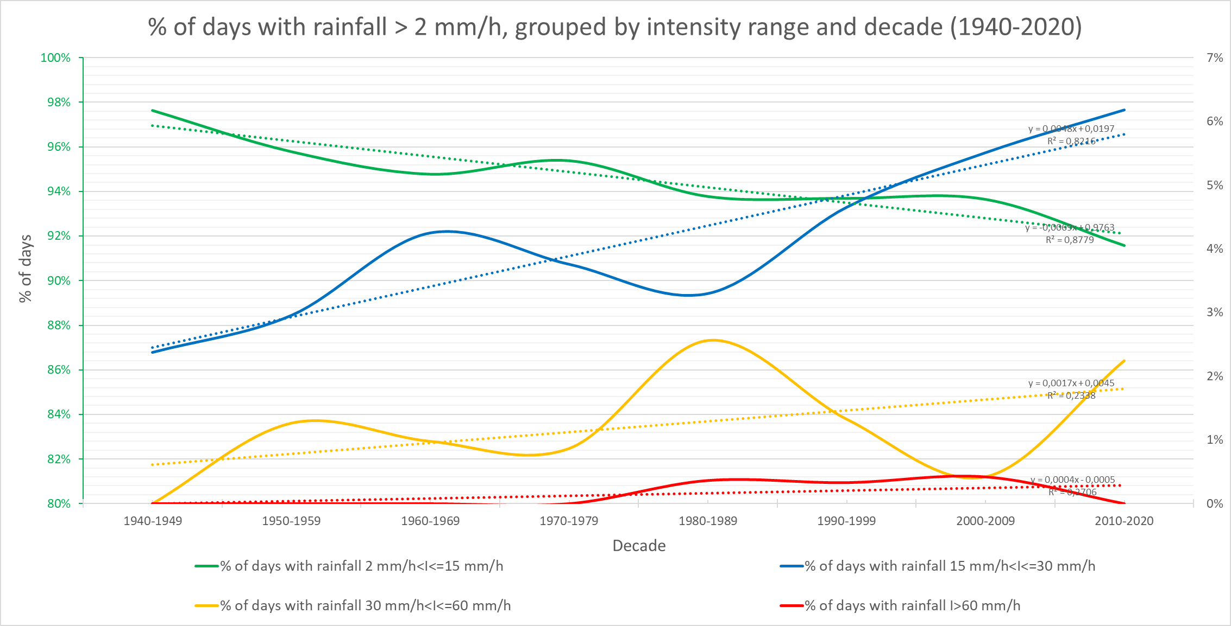
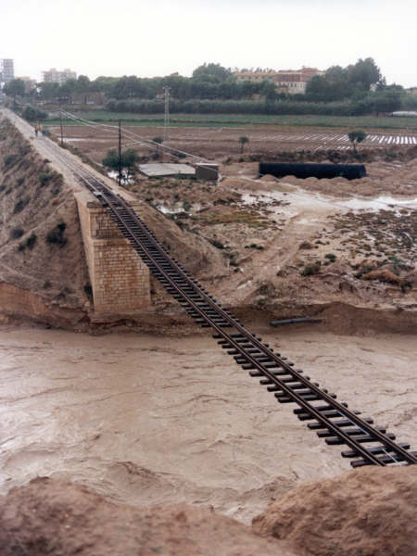
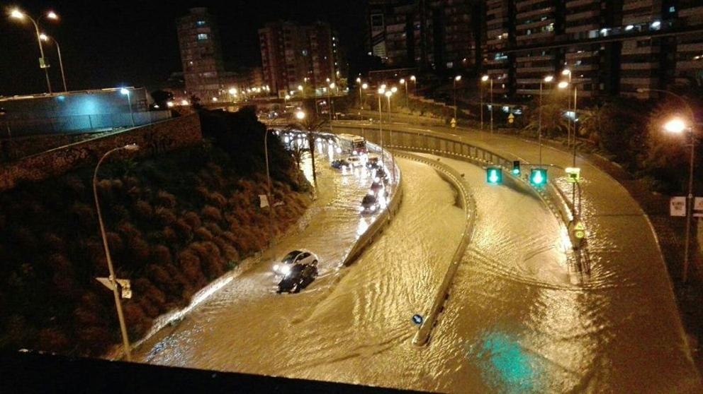
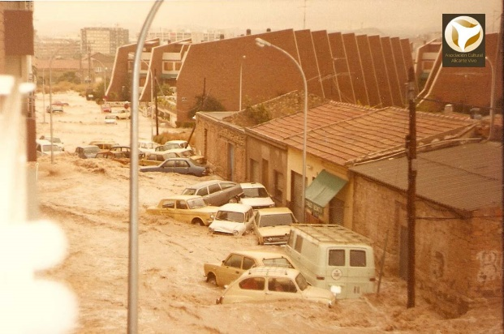
How does it rain in Alicante?
Rainfall classification based on the Intensity value in 1 hour (AEMET)
Classification | Intensity (mm/h)
Weak | btw 0,1 and 2 mm/h
Moderate | btw 2,1 and 15 mm/h
Heavy | btw 15,1 and 30 mm/h
Very heavy | btw 30,1 and 60 mm/h
Torrential | More than 60 mm/h
Source: Own elaboration with AEMET data
Source: Own elaboration
30/09/1997 Source: Data base of images from AMAEM
13/03/2017 Source: Diario Las Provincias
20/10/1982 Source: Asociación Cultural “Alicante Vivo”

Slide 3
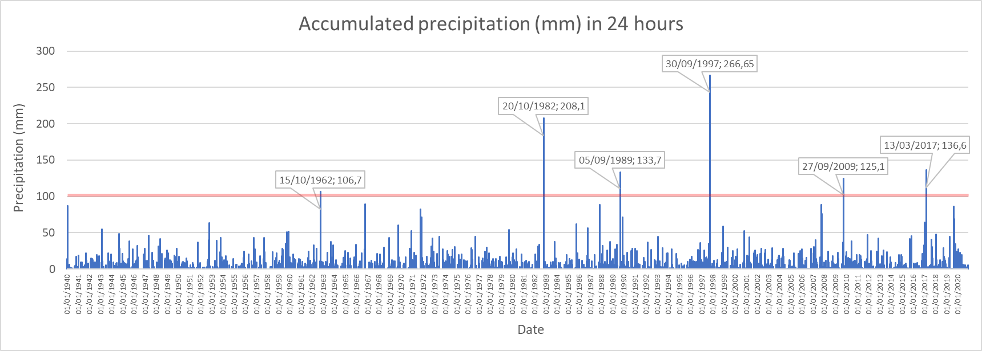
How does it rain in Alicante?
Ranking Top 10 accumulated rainfall in 24 hours in Ciudad Jardín Observatory (AEMET)
P (mm) | Date
266,7 | 30/09/1997
208,1 | 20/10/1982
136,6 | 13/03/2017
133,7 | 05/09/1989
125,1 | 27/09/2009
106,7 | 15/10/1962
89,5 | 07/10/1966
89,0 | 04/11/1987
88,4 | 20/09/2007
87,3 | 13/01/1940
Ranking Top 10 accumulated rainfall in 1 hour in Ciudad Jardín Observatory (AEMET)
P (mm) | Date
101,2 | 30/09/1997
81,5 | 20/10/1982
80,2 | 20/09/2007
56,5 | 05/09/1989
55,5 | 30/09/1997
50,5 | 07/10/1966
46,7 | 30/09/1997
45,2 | 13/03/2017
41,0 | 23/09/1985
41,0 | 27/09/2009
Rainfall classification based on the Intensity value in 1 hour (AEMET)
Classification | Intensity (mm/h)
Weak | btw 0,1 and 2 mm/h
Moderate | btw 2,1 and 15 mm/h
Heavy | btw 15,1 and 30 mm/h
Very heavy | btw 30,1 and 60 mm/h
Torrential | More than 60 mm/h

Slide 4
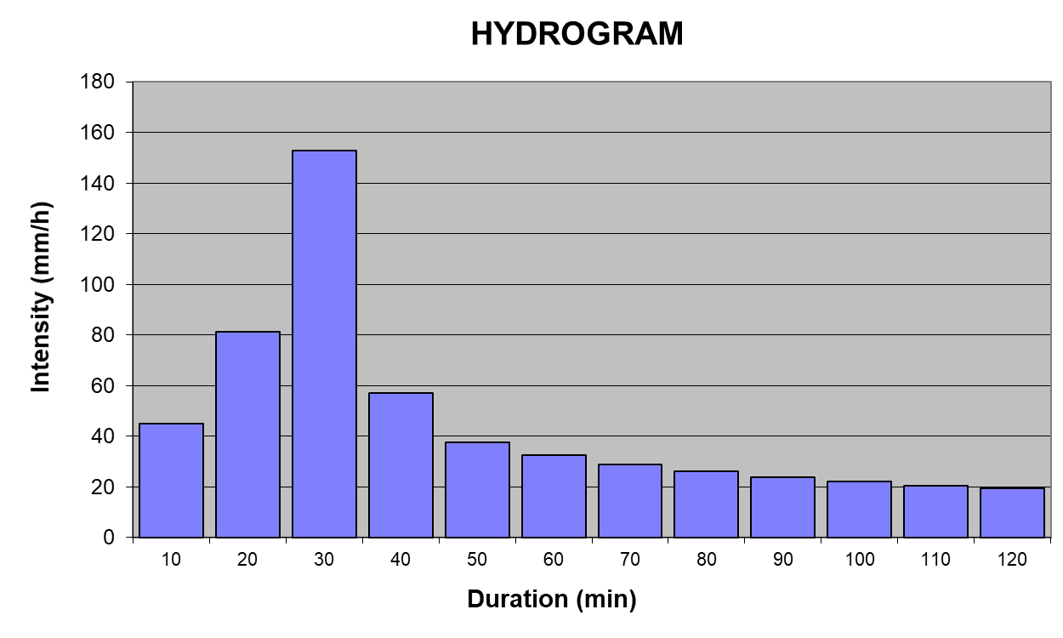
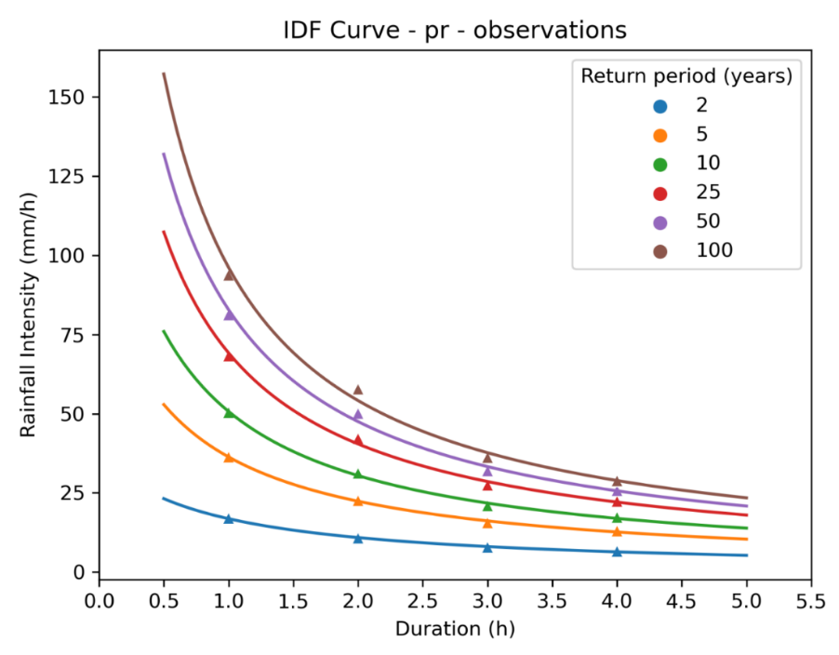
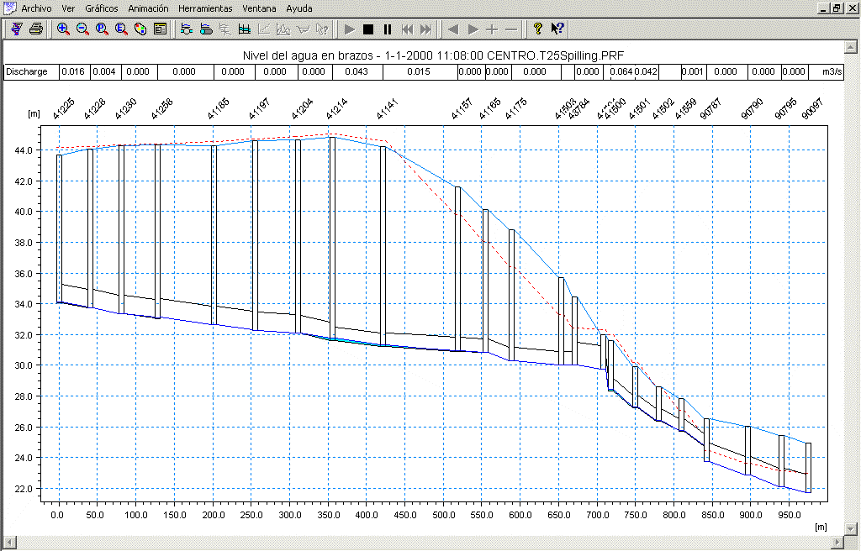
How do we design the urban drainage infrastructures?
The IDF curve: mathematical relationship between the intensity of a precipitation, its duration and the frequency with which it is observed.
Source: Own elaboration
IDF curve constructed with historical data (1940-2020) in Alicante
Bounday condition to hydraulic models
Source: Own elaboration
Source: DHI MOUSE

Slide 5




30/09/1997 Fuente: Repositorio de imágenes de AMAEM
Some effects of the heaviest rains in the city…
13/03/2017 Fuente: Diario Las Provincias
20/10/1982 Fuente: Asociación Cultural “Alicante Vivo”

Slide 6
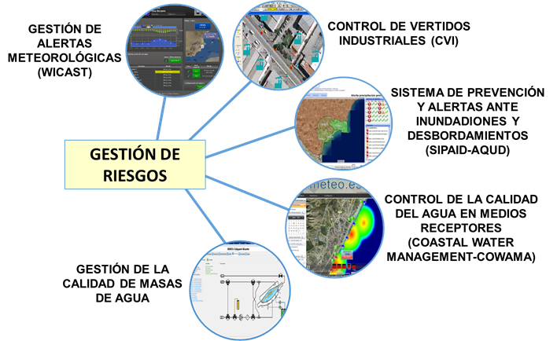
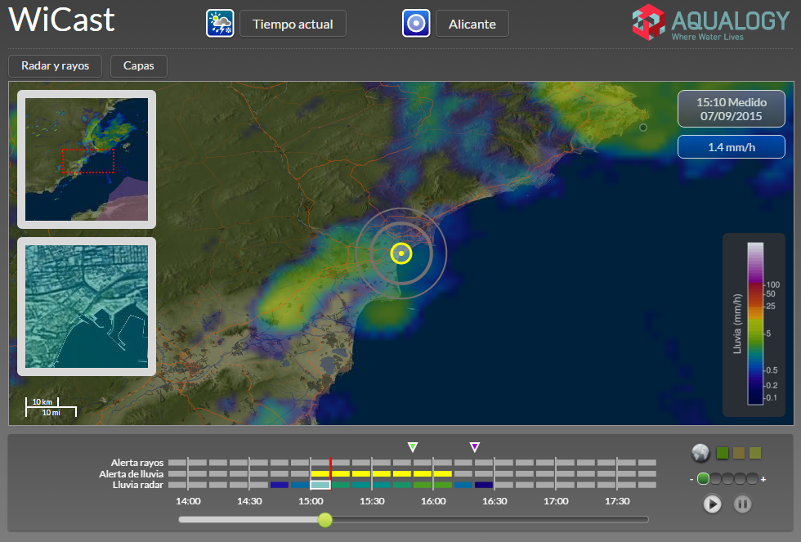
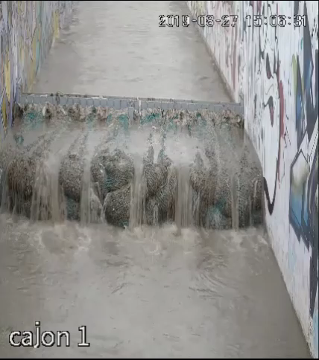
How do we deal with very short-term problems?
CONTROL OF INDUSTRIAL DISCHARGES (CVI)
WEATHER WARNING MANAGEMENT (FLOODALERT)
FLOODS AND SEWER OVERFLOW PREVENTION AND WARNING SYSTEM.
ENERGENCY MANAGEMENT (SIPAID)
RISK MANAGEMENT TOOLS
BATHING WATER QUALITY CONTROL (COASTAL WATER MANAGEMENT-COWAMA)
MANAGEMENT OF THE QUALITY OF WATER BODIES
But… what about the future?
According to AR-6 inform…

Slide 7
What about the future?
Starting hypothesis (according to IPCC AR-6 inform):
“It is very likely that heavy precipitation events will intensify and become more frequent in most regions with additional global warming. (…)”
“Cities intensify human-induced warming locally, and further urbanization together with more frequent hot extremes will increase the severity of heatwaves (very high confidence).”
“Urbanization also increases mean and heavy precipitation over and/or downwind of cities (medium confidence) and resulting runoff intensity (high confidence).”
“In coastal cities, the combination of more frequent extreme sea level events (due to sea level rise and storm surge) and extreme rainfall/riverflow events will make flooding more probable (high confidence).”
“In the European Mediterranean, the magnitude and sign of observed land precipitation trends depend on time period and exact study region (medium confidence). There is medium confidence that river floods will decrease in Northern, Eastern and Southern Europe for high warming levels.”
What will happen in the local scale of Alicante?
Notes:
De acuerdo a lo expresado en el último informe del IPCC, las hipótesis de partida para evaluar los efectos del CC sobre el clima futuro en áreas mediterráneas son:
Pero estas hipótesis son aplicables a grandes áreas de nuestra geografía, por lo tanto la siguiente pregunta que hemos de hacernos es… cómo afectará el cambio climático a la escala local de la ciudad de Alicante?

Slide 8

What about the future?
Future problem: How will change the main weather variables (precipitation and temperature) and how will evolve the IDF curves in Alicante for next years based on CC conditions?
Regionalisation of General Circulation Models (GCM) at local scale in the city of Alicante
Create a new framework of boundary conditions for the design of more resilient infrastructures
Projection datasets: climate projections from CMIP-6 (5 simulations) and EURO-CORDEX (51 simulations) ➔ projections to year 2100 in 3 CC scenarios (SSP1-2.6 (optimistic), SSP2-4.5 (continuistic), SSP5-8.5 (pessimistic)
Reference datasets:
  observational data for precipitation from Ciudad Jardin (Alicante) station (latitude = 38.37º, longitude = -0.49º) from year 1938 to 2021 (83 years).
  reanalysed datasets ERA5-Land for temperatures.
Climate Services
To adjust the data, Climadjust employs the Bias Adjustment capabilities of the Open Access framework Climate4R (2 selected):
ISIMIP3
Empirical Quantile Mapping (EQM)

Slide 9
What about the future?
Future problem: How will change the main weather variables (precipitation and temperature) and how will evolve the IDF curves in Alicante for next years based on CC conditions?
Temporal disaggregation of metheorological data
MELODIST software:
Daily temporal resolution data: For every future climate change scenarios (CMIP6: SSP1-2.6, SSP2-4.5, SSP5-8.5; and EURO-CORDEX: RCP2.6, RCP4.5, RCP8.5)
Hourly temporal resolution data: For every future climate change scenarios (CMIP6: SSP1-2.6, SSP2-4.5, SSP5-8.5; and EURO-CORDEX: RCP2.6, RCP4.5, RCP8.5)
Yearly average precipitation for every model as well as the ensemble mean for the bias adjusted results and the original data.
Number of days per year with precipitation over 0.1 mm for every model as well as the ensemble mean for the bias adjusted results and the original data.
Number of days per year with precipitation over 1 mm for every model as well as the ensemble mean for the bias adjusted results and the original data.
Yearly average temperatures (average, min, max.) in ºC for every model as well as the ensemble mean for the bias adjusted results and the original data.
IDF curve for every model as well as the ensemble mean for the bias adjusted results and the original data.
Torrentiality coefficient as a relation between 1 hour intensity and 24 hours average intensity
Notes:
Then, with this daily data we have made temporal disaggregation of metheorological data to obtain hourly data and, with this:
the IDF curves for every projection model and
the Torrentiality coefficient for every projection model.
Let’s see some of these reults, first, on a daily basis:

Slide 10
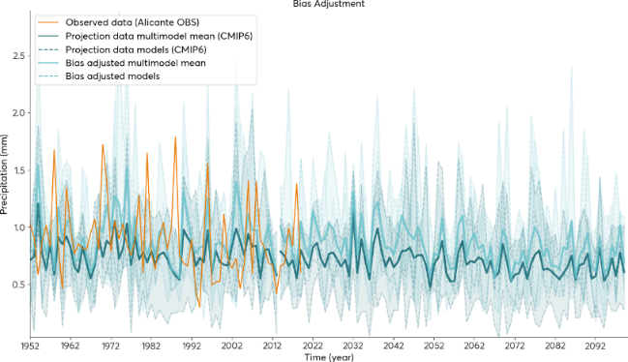
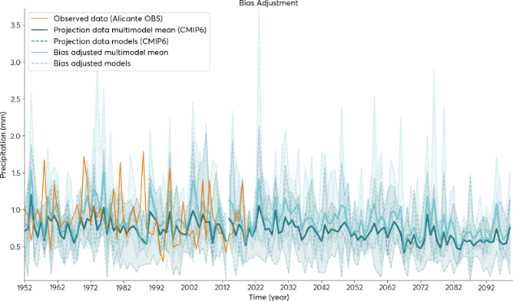
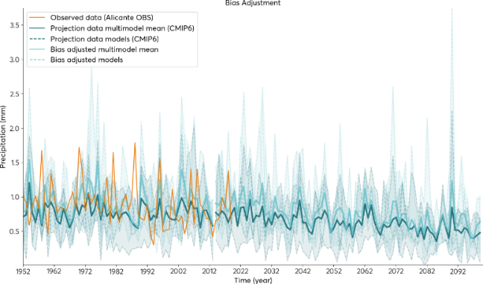
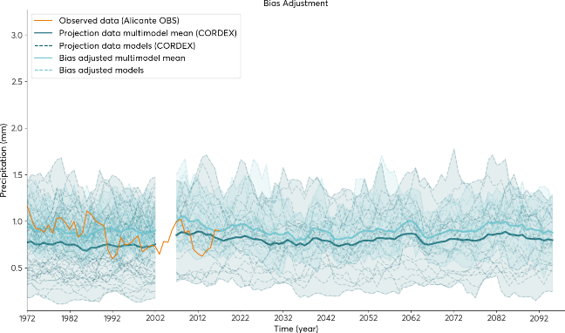
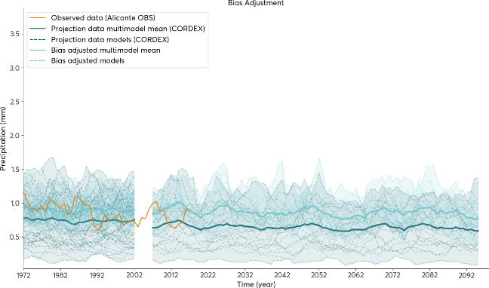
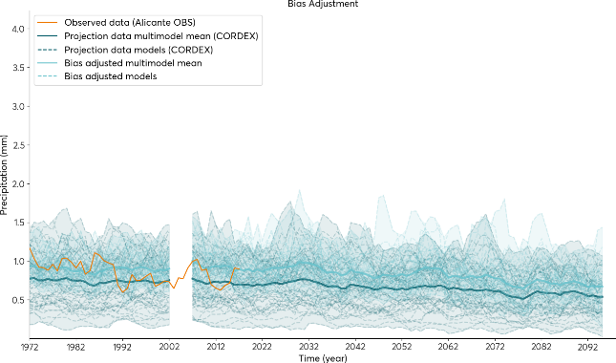
Results on precipitation with daily resolution
pr: The sum of liquid and frozen water, comprising rain and snow, that falls to the Earth's surface (mm / day).
Images with yearly average for each model, as well as the ensemble mean for the bias-adjusted results and the original data.
CMIP-6:
SSP 2.6
SSP 4.5
SSP 8.5
EURO-CORDEX:
RCP 2.6
RCP 4.5
RCP 8.5
Notes:
Lo que vemos en estas gráficas son las proyecciones derivadas de los experimentos de CMIP-6 (arriba) y EUROCORDEX (abajo) para la variable precipitación media acumulada al año, para los tres escenarios indicados anteriormente. Así, vemos que:

Slide 11
Results on precipitation with daily resolution
pr: The sum of liquid and frozen water, comprising rain and snow, that falls to the Earth's surface (mm / day).
Images with yearly average for each model, as well as the ensemble mean for the bias-adjusted results and the original data.
CMIP-6:
SSP 2.6
SSP 4.5
SSP 8.5
Optimistic Scenario: Mean reduction of yearly average precipitation in 5% (2022-2100)
Continuistic Scenario: Mean reduction of yearly average precipitation in 15% (2022-2100)
Pessimistic Scenario: Mean reduction of yearly average precipitation in 35% (2022-2100)
EURO-CORDEX:
RCP 2.6
RCP 4.5
RCP 8.5

Slide 12
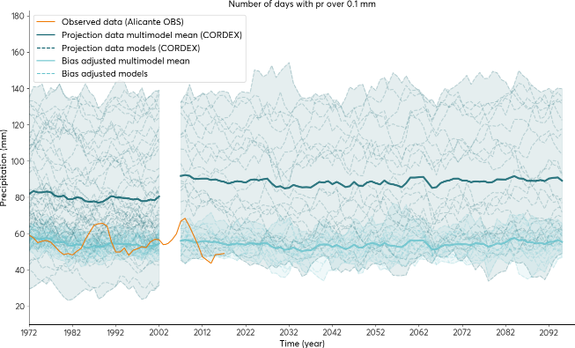
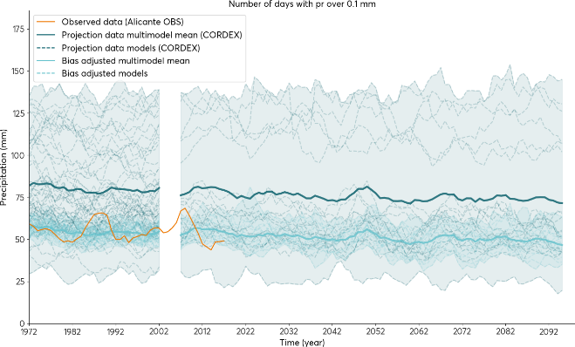
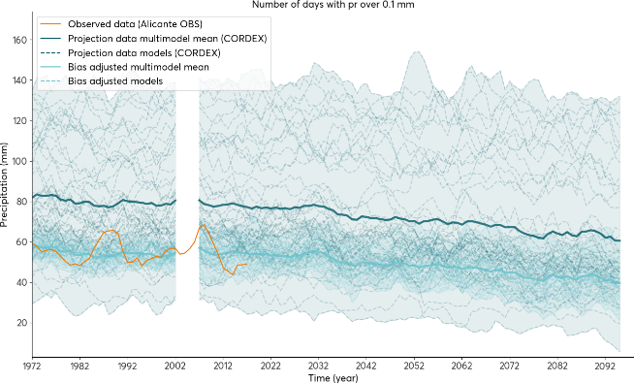
Results on precipitation with daily resolution
Imágenes con número de días por año con precipitación superior a 0,1 mm para cada modelo, así como la media del conjunto para los resultados ajustados por sesgo (mediante metodología ISIMIP-3) y los datos originales. Uno por escenario futuro (ssp126, ssp245, ssp585).
CMIP-6:
SSP 2.6
SSP 4.5
SSP 8.5
EURO-CORDEX:
RCP 2.6
RCP 4.5
RCP 8.5

Slide 13
Results on precipitation with daily resolution
Imágenes con número de días por año con precipitación superior a 0,1 mm para cada modelo, así como la media del conjunto para los resultados ajustados por sesgo (mediante metodología ISIMIP-3) y los datos originales. Uno por escenario futuro (ssp126, ssp245, ssp585).
CMIP-6:
SSP 4.5
SSP 8.5
SSP 2.6
Best Scenario: Mean reduction of days with rainfall >0,1mm in 4.5% (2022-2100)
Medium Scenario: Mean reduction of days with rainfall >0,1mm in 13% (2022-2100)
Worst Scenario: Mean reduction of days with rainfall >0,1mm in 27% (2022-2100)
EURO-CORDEX:
RCP 2.6
RCP 4.5
RCP 8.5

Slide 14
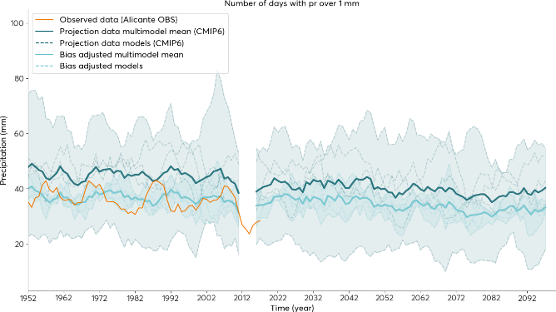
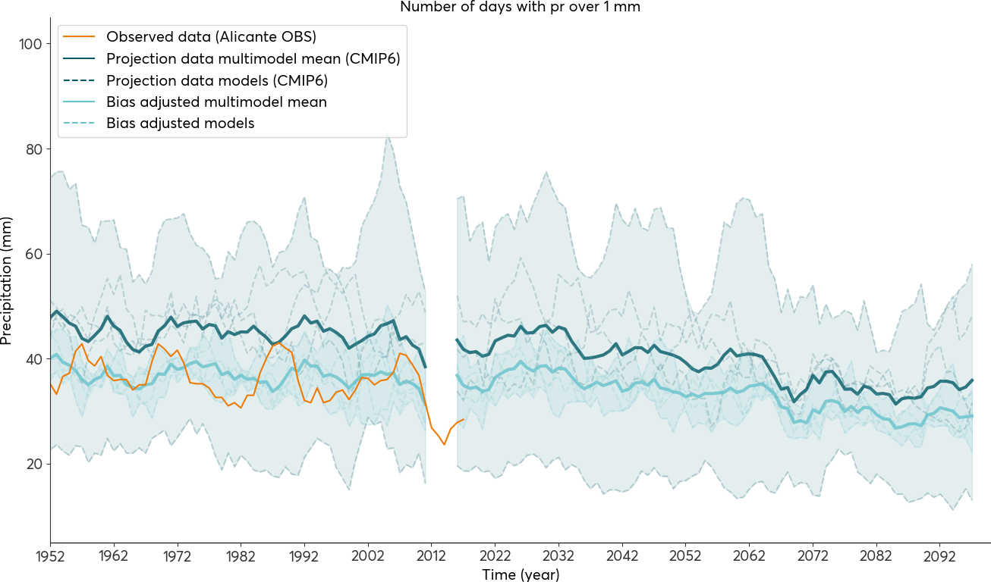
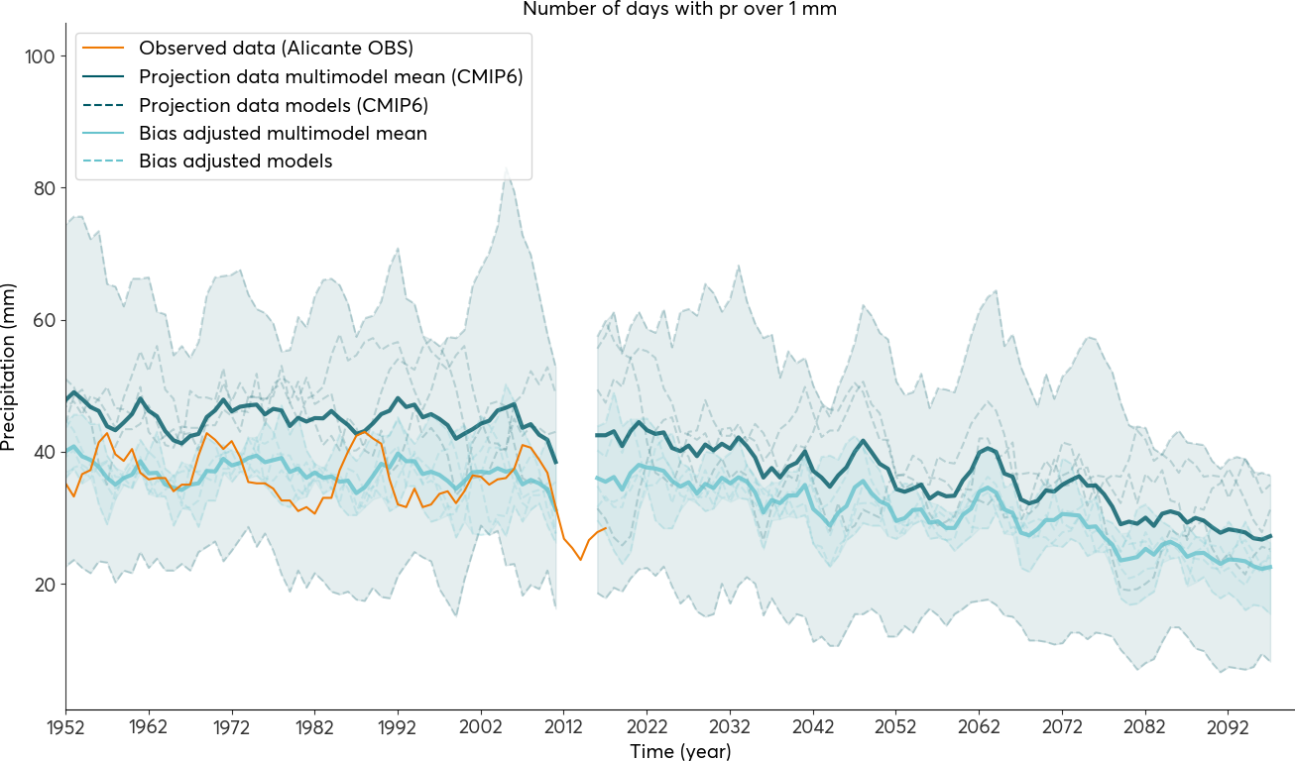
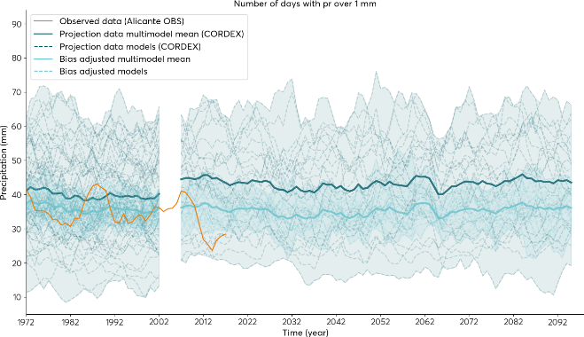
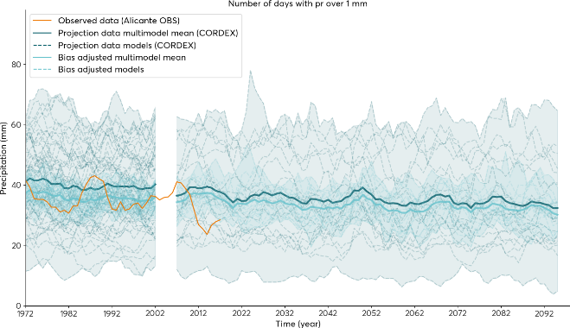
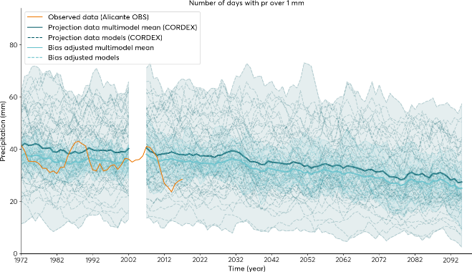
Results on precipitation with daily resolution
Images with number of days per year with precipitation greater than 1 mm for each model, as well as the mean of the set for the bias-adjusted results (using ISIMIP-3 methodology) and the original data. One per future scenario (SSP126, SSP245, SSP585 // RCP 2.6, RCP 4.5, RCP 8.5).
CMIP-6:
SSP 2.6
SSP 4.5
SSP 8.5
EURO-CORDEX:
RCP 4.5
RCP 2.6
RCP 8.5

Slide 15
Results on precipitation with daily resolution
Images with number of days per year with precipitation greater than 1 mm for each model, as well as the mean of the set for the bias-adjusted results (using ISIMIP-3 methodology) and the original data. One per future scenario (SSP126, SSP245, SSP585 // RCP 2.6, RCP 4.5, RCP 8.5).
SSP 2.6
SSP 4.5
SSP 8.5
Optimistic Scenario: Mean reduction of days with rainfall >1mm in 10% (2022-2100)
Continuistic Scenario: Mean reduction of days with rainfall >1mm in 20% (2022-2100)
Pessimistic Scenario: Mean reduction of days with rainfall >1mm in 30% (2022-2100)
EURO-CORDEX:
EURO-CORDEX:
RCP 4.5
RCP 2.6
RCP 4.5
RCP 2.6
RCP 8.5
RCP 8.5

Slide 16
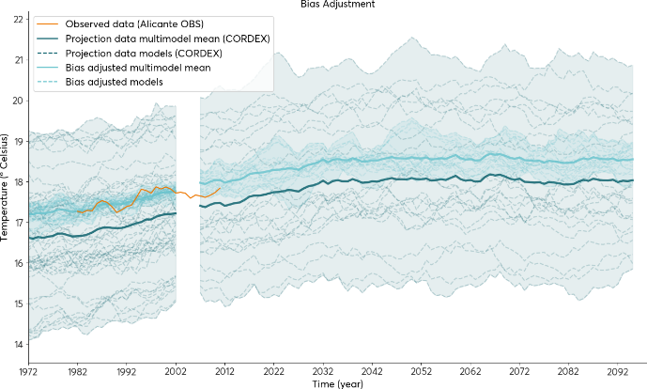
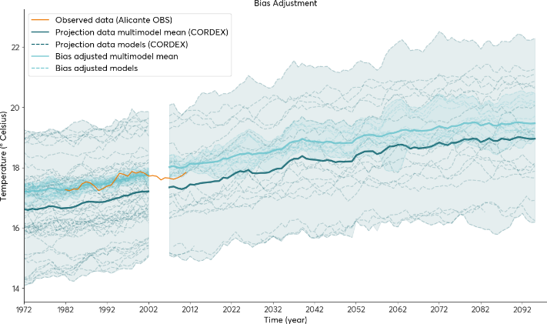
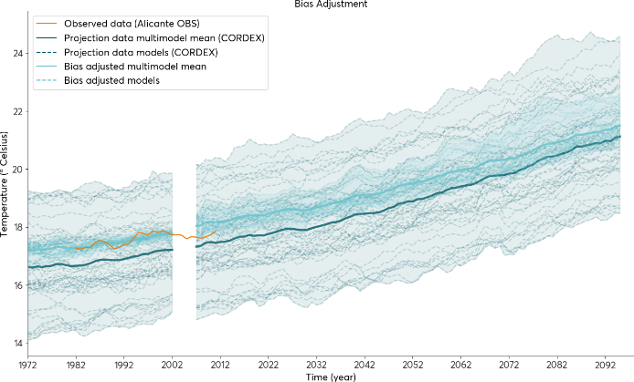
Results on average temperature with daily resolution
Temperature of air at 2m above the surface of land, sea or inland waters (Celsius).
CMIP-6:
SSP 4.5
SSP 8.5
SSP 2.6
EURO-CORDEX:
RCP 2.6
RCP 4.5
RCP 8.5

Slide 17
Results on average temperature with daily resolution
Temperature of air at 2m above the surface of land, sea or inland waters (Celsius).
CMIP-6:
SSP 4.5
SSP 8.5
SSP 2.6
Optimistic Scenario: Mean increase of temperature in 1,6% ̴ 0,5 ºC (2022-2100)
Continuist Scenario: Mean increase of temperature in 6,7% ̴ 1,5 ºC (2022-2100)
Pesimistic Scenario: Mean increase of temperature in 19,4% ̴ 3,0 ºC (2022-2100)
EURO-CORDEX:
RCP 2.6
RCP 4.5
RCP 8.5

Slide 18
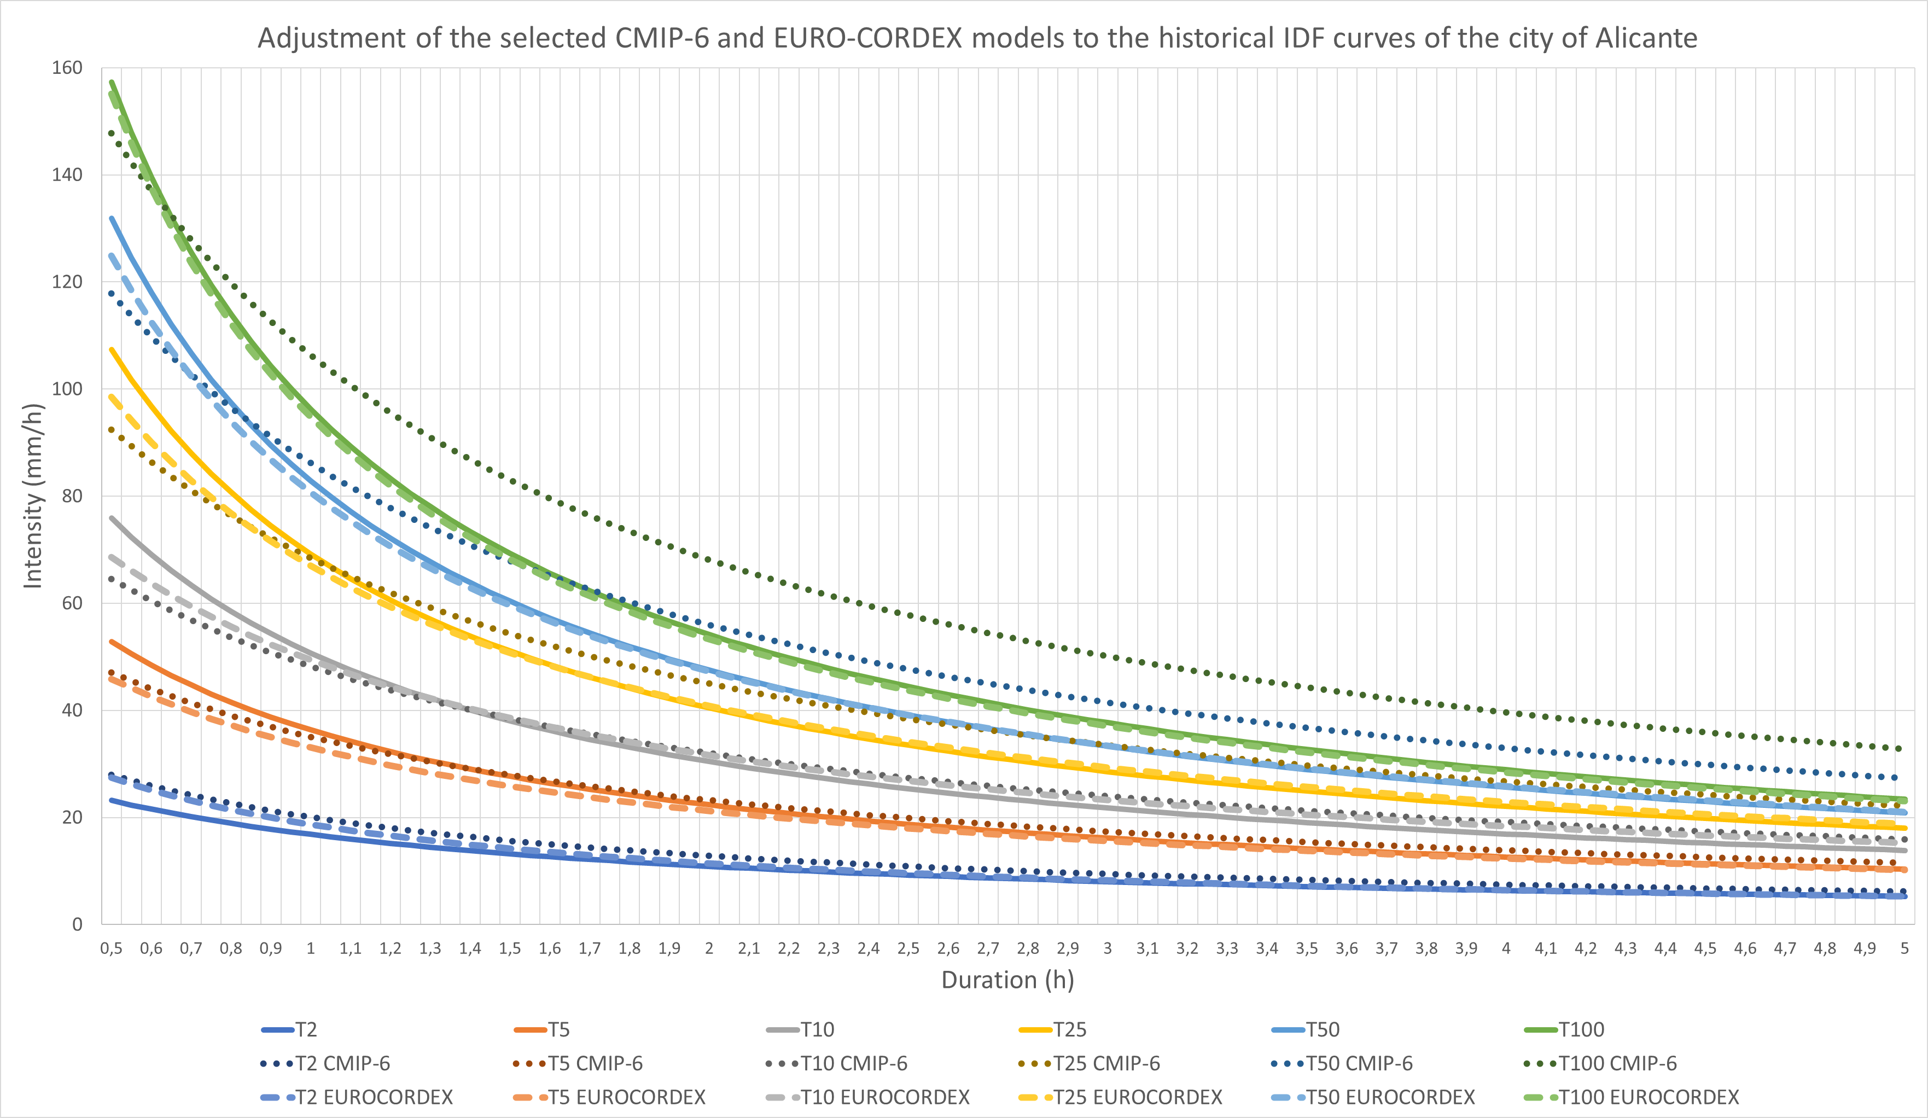
Results on precipitation with hourly resolution: IDF curves for the future climate
Identification of models that best fit wih the historical IDF curves of Alicante
CMIP-6 experiments:
MPI-ESM1-2-HR_r1i1p1f1 (Max Planck Institute for Meteorology)
EUROCORDEX experiments:
CCCma-CanESM2_r1i1p1_CLMcom-CCLM4-8-17 (CLM Community with contributions by BTU, DWD, ETHZ, UCD, WEGC): For return period minor than T10
MPI-M-MPI-ESM-LR_r1i1p1_CLMcom-ETH-COSMO-crCLIM-v1 (CLM Community with contributions by BTU, DWD, ETHZ, UCD, WEGC): For return period greater or equal to T10
Notes:
Veamos a continuación los resultados basados en los datos a nivel horario. Para calcular las curvas IDF represetnativas del clima futuro de la ciudad, lo primero que necesitamos es seleccionar los modelos de proyección que mejor se ajustan al contexto de la ciudad de Alicante, lo cual se ha realizado mediante un ajuste al período histórico y su comparativa con las curvas IDF históricas de la ciudad. Así, los modelos que mejor se ajustan son los indicados en la diapositiva. Estos modelos se tomarán como referente para realizar las proyecciones a futuro.

Slide 19
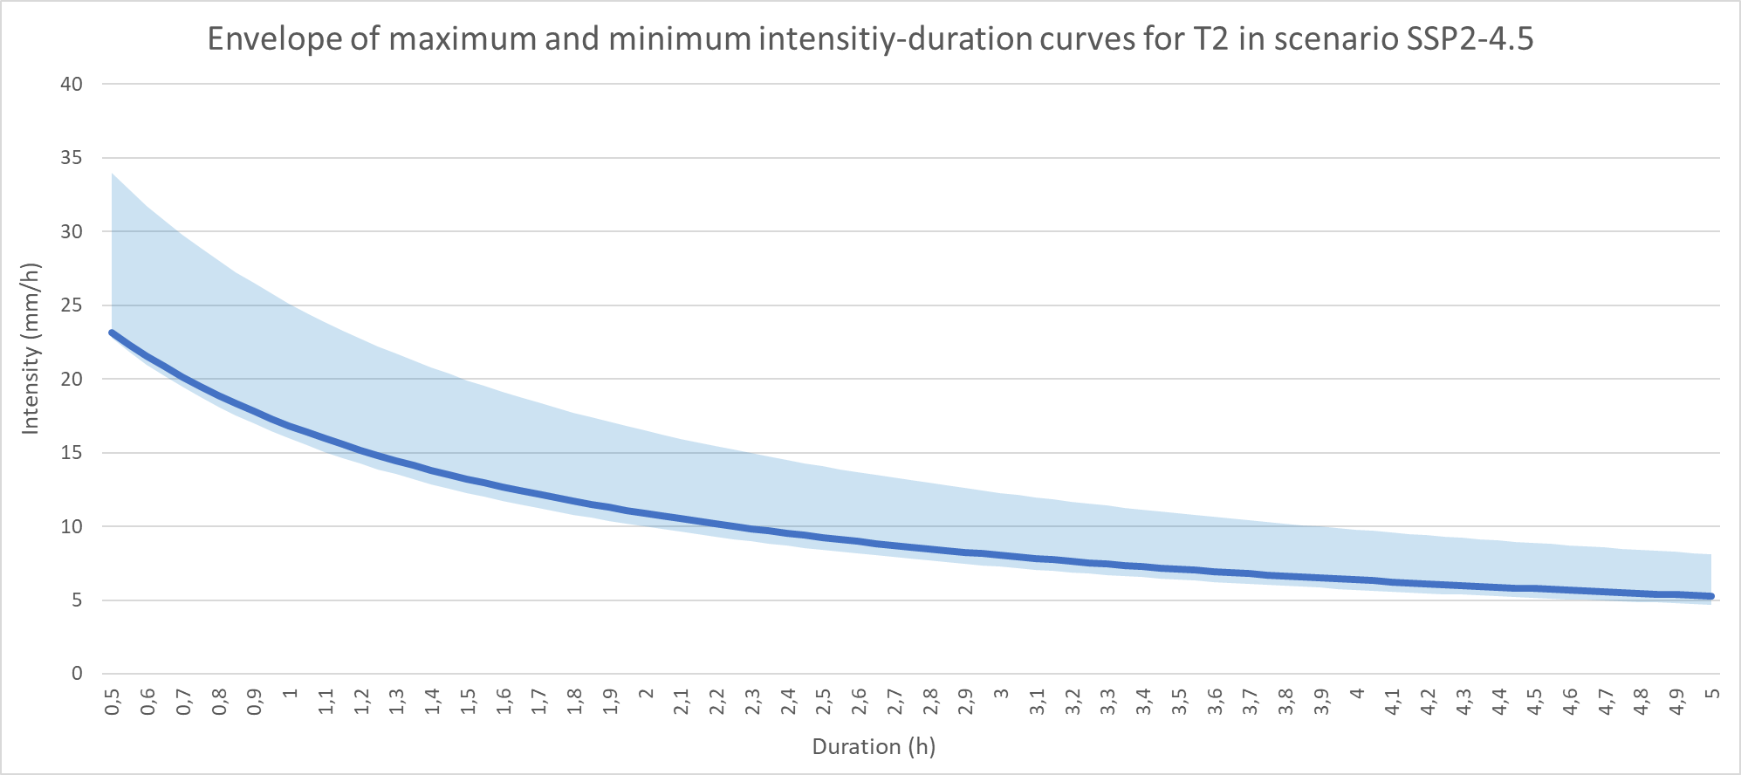
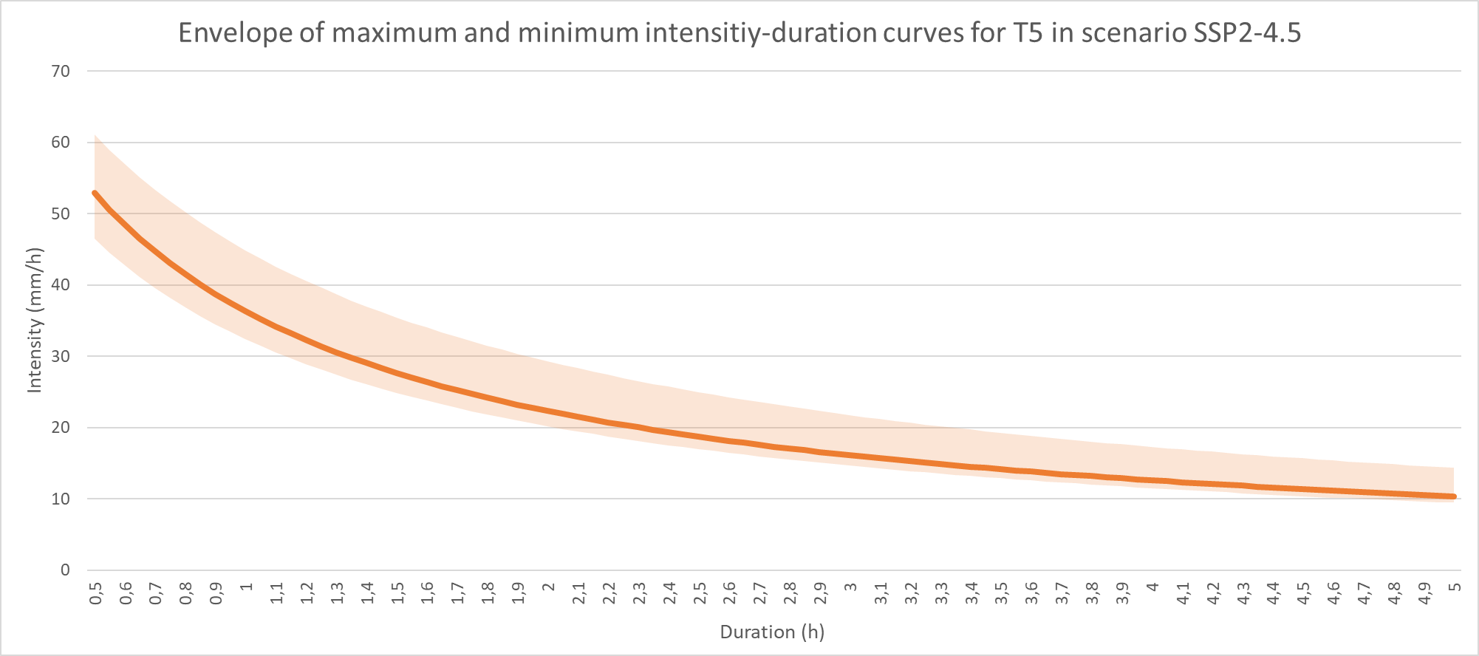
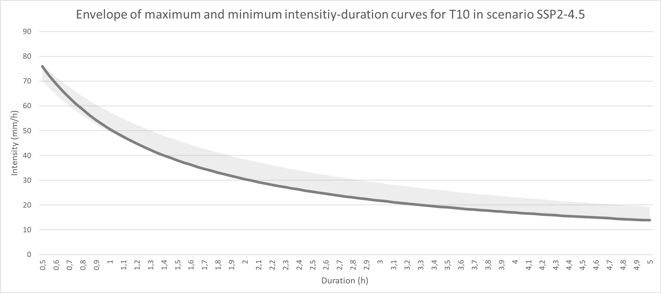
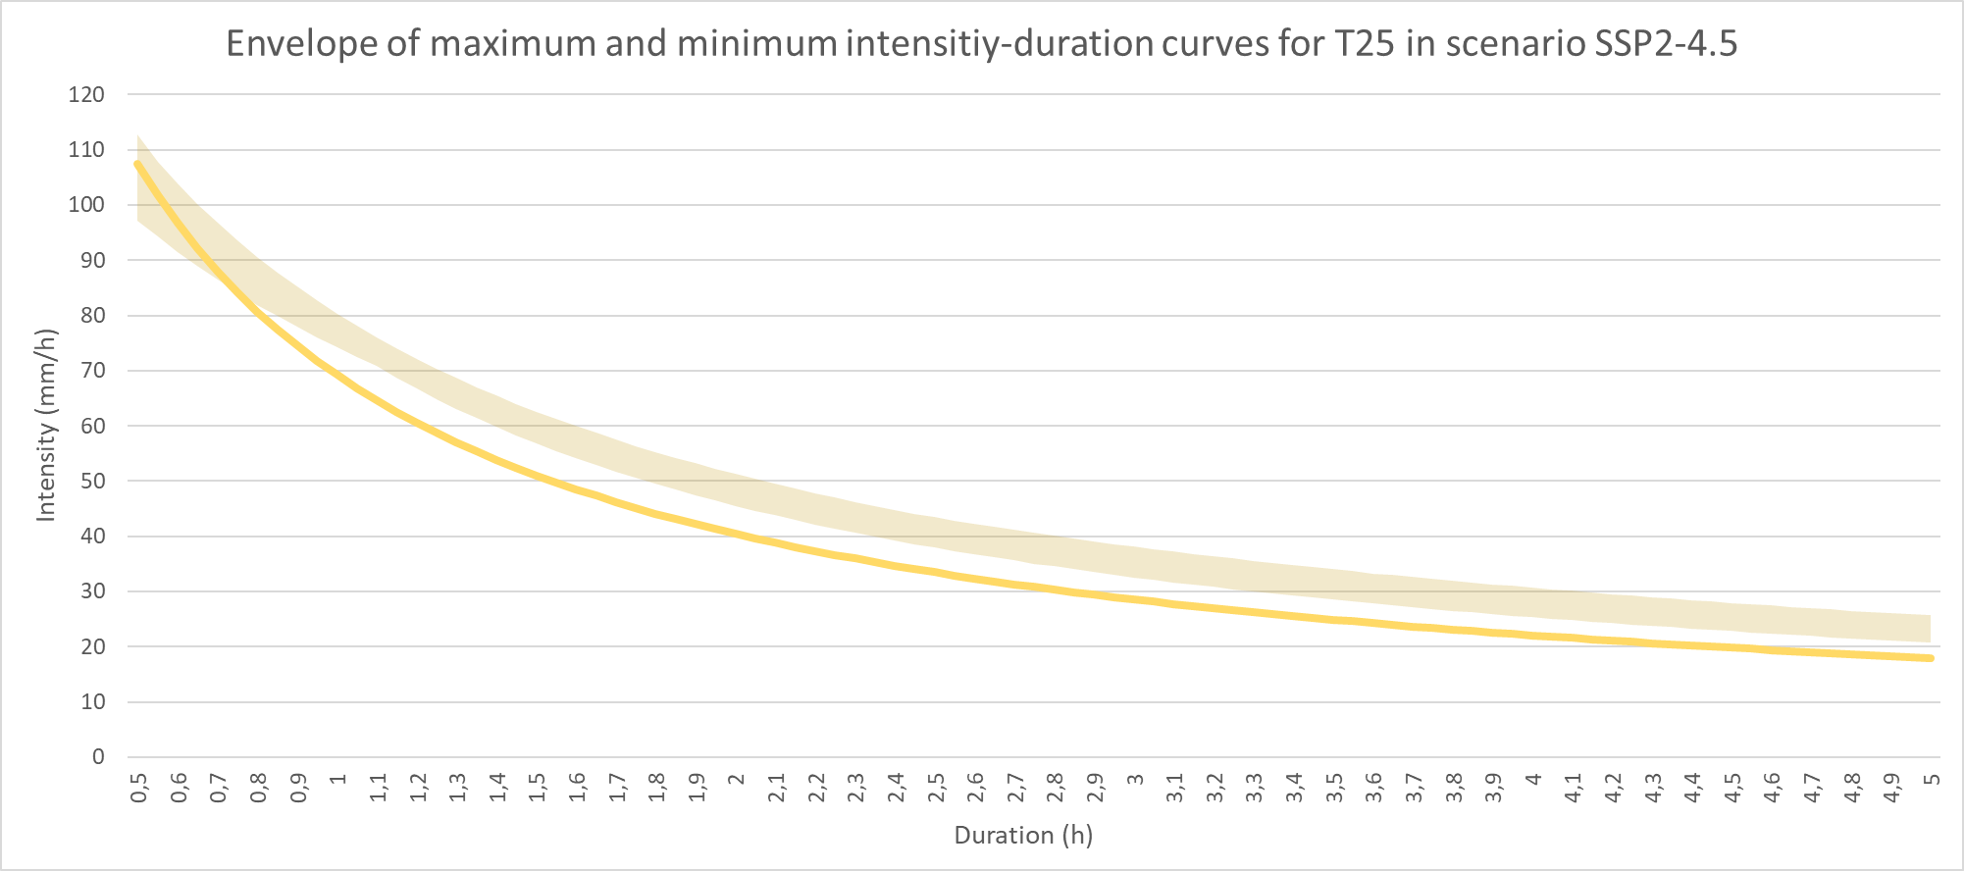
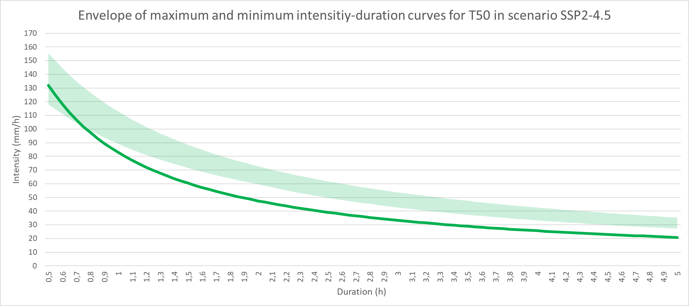
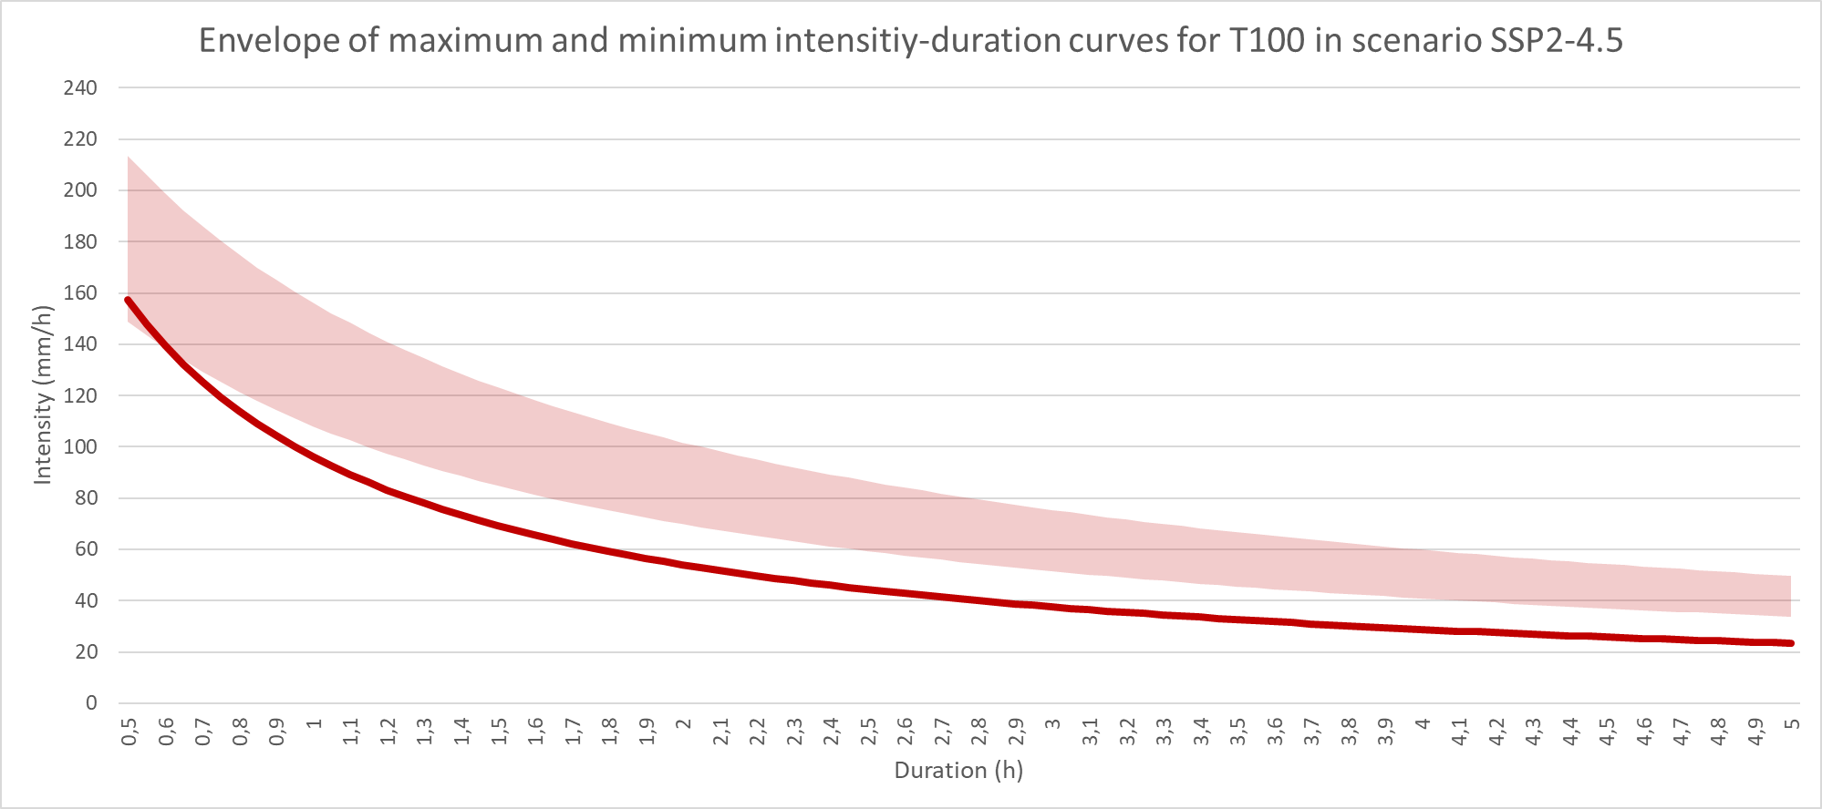
Results on precipitation with hourly resolution: IDF curves for the future climate (CMIP-6).
Projections of the selected models to identify the IDF curves for the future climate in the most likely (IPCC AR-6) scenario: scenario SSP2-4.5
34 mm/h
61 mm/h
79 mm/h
52 mm/h
76 mm/h
23 mm/h
115 mm/h
155 mm/h
220 mm/h
108 mm/h
135 mm/h
160 mm/h
Conclusions:
For return periods shorter than T25, we can consider that the present IDF curves may be representative of the future climate, although with a clear tendency to increase.
Considering the most likely scenario according to AR-6 (continuist)
For equal or greater return periods, it will be necessary to update the IDF curves to prevent possible increases in extreme rainfall, which can be greater the longer the return period is.

Slide 20
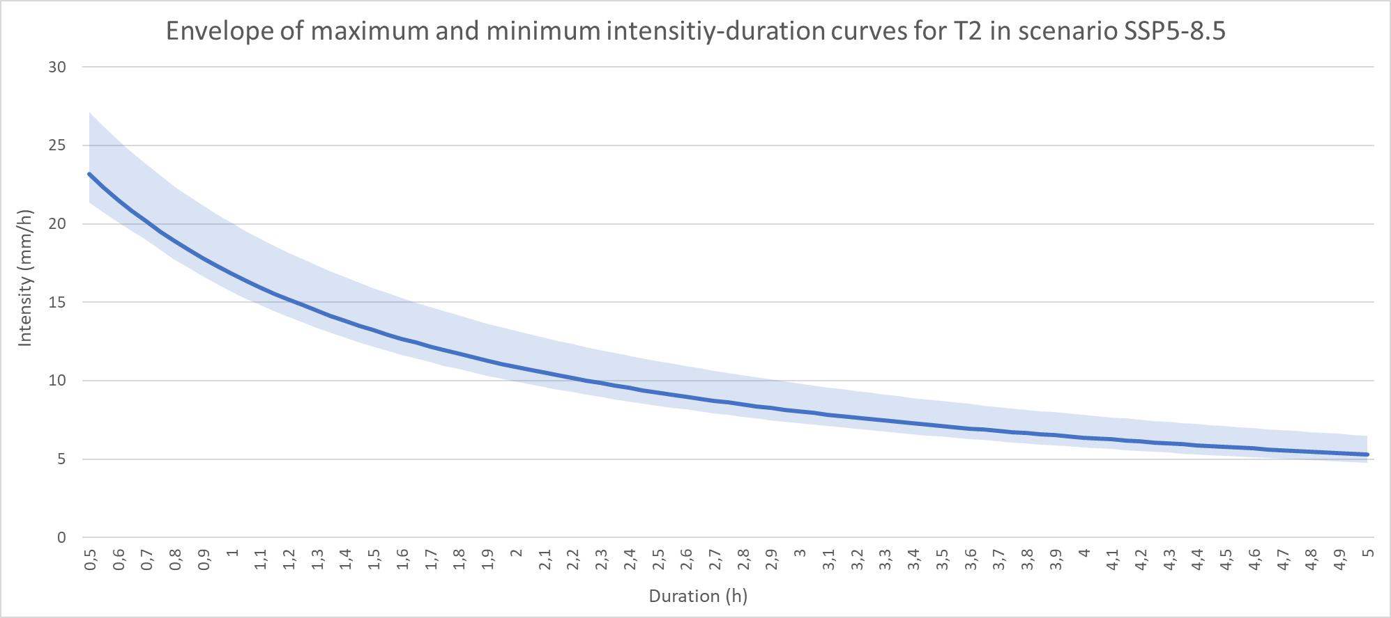
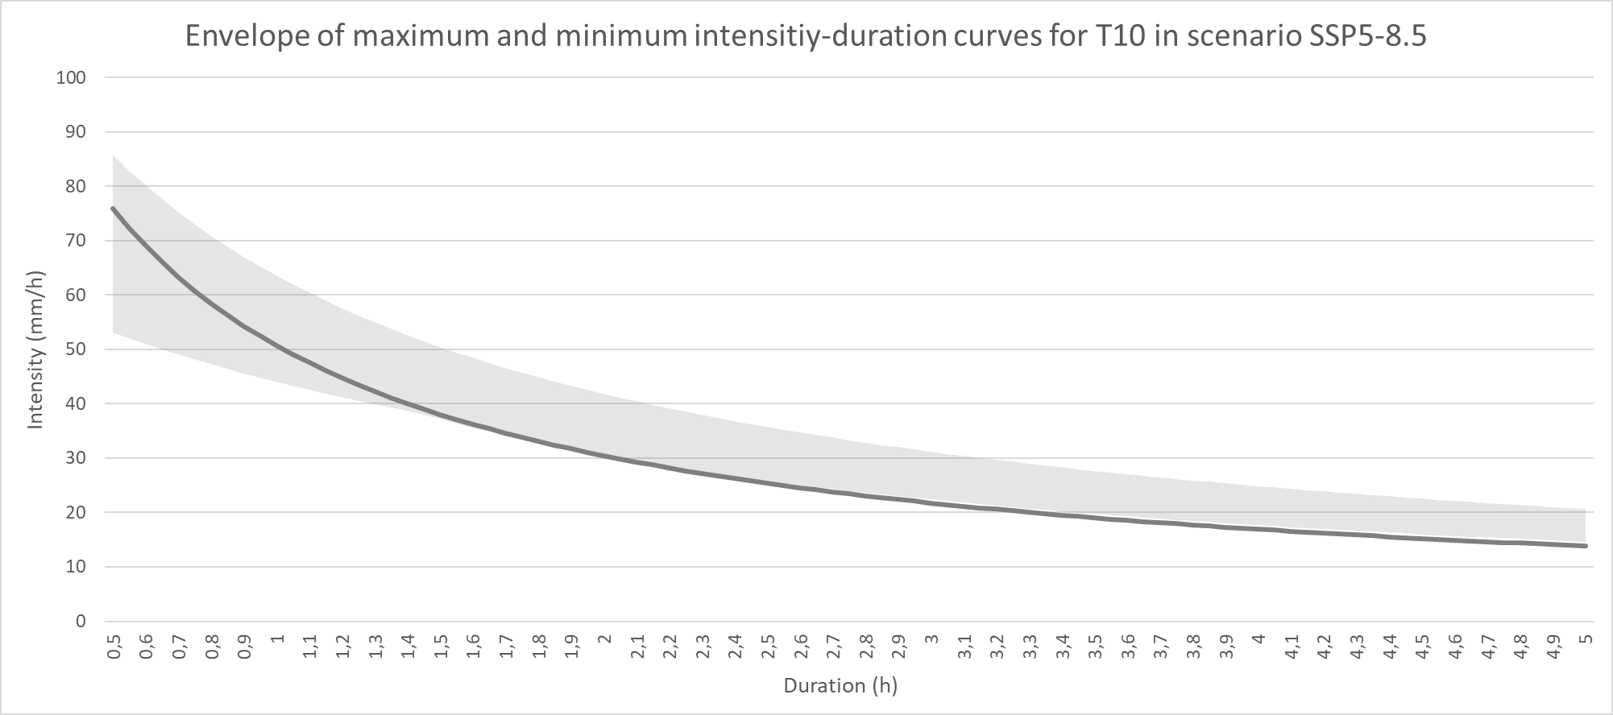
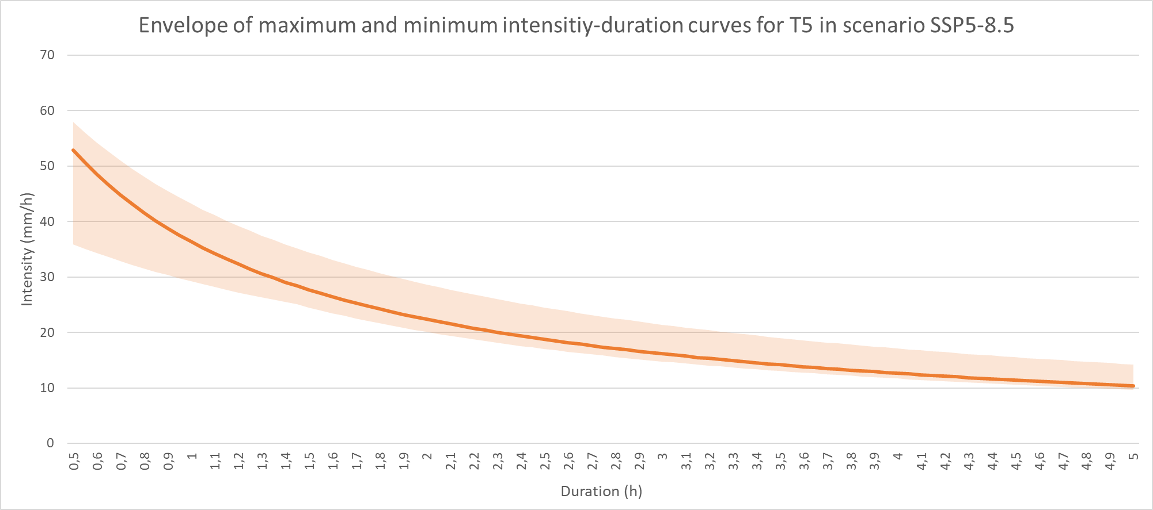
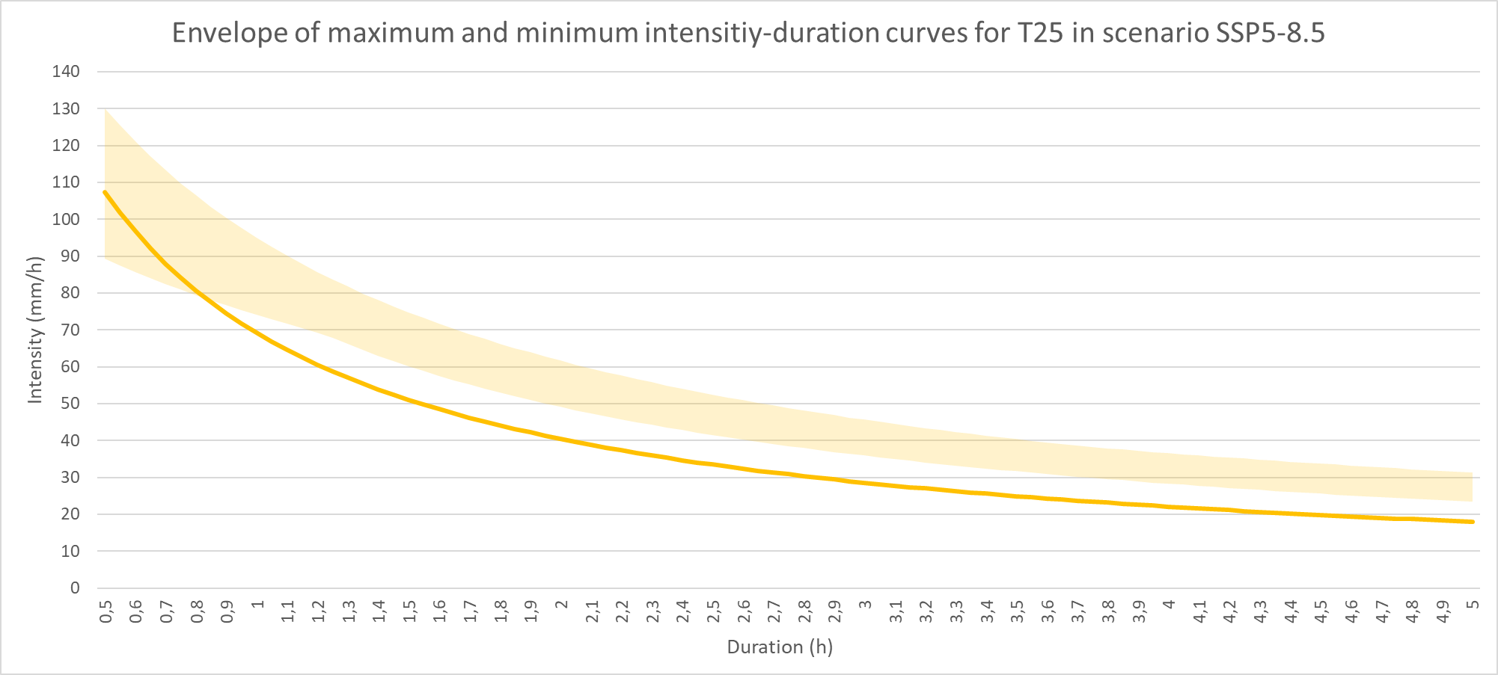
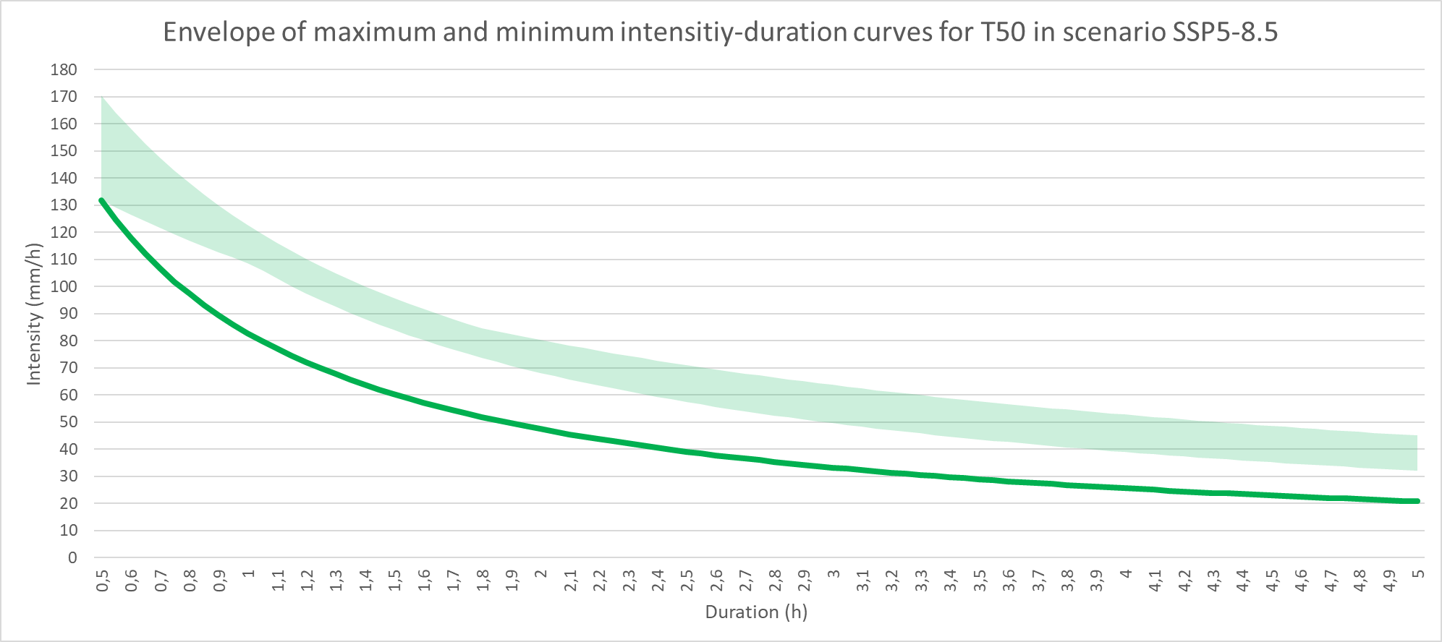
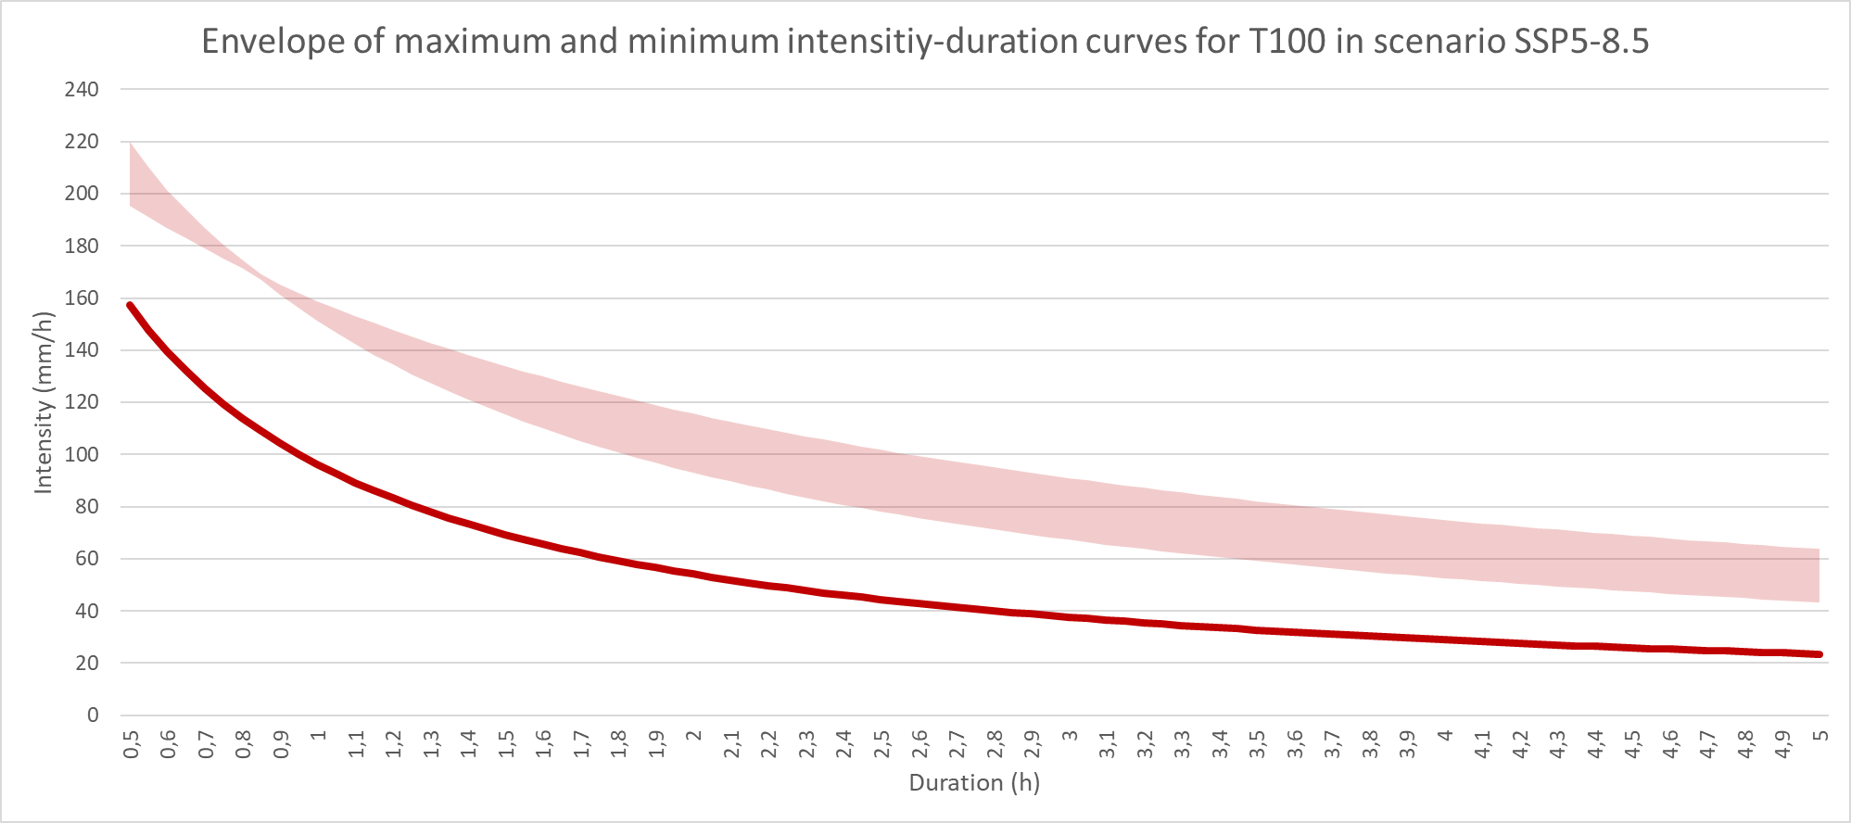
Results on precipitation with hourly resolution: IDF curves for the future climate (CMIP-6).
Projections of the selected models to identify the IDF curves for the future climate in the most pesimist (IPCC AR-6) scenario: scenario SSP5-8.5
Conclusions:
For return periods shorter than T25, we can consider that the present IDF curves may be representative of the future climate, although with a clear tendency to increase.
Considering the most likely scenario according to AR-6 (continuist)
For equal or greater return periods, it will be necessary to update the IDF curves to prevent possible increases in extreme rainfall, which can be greater the longer the return period is.

Slide 21
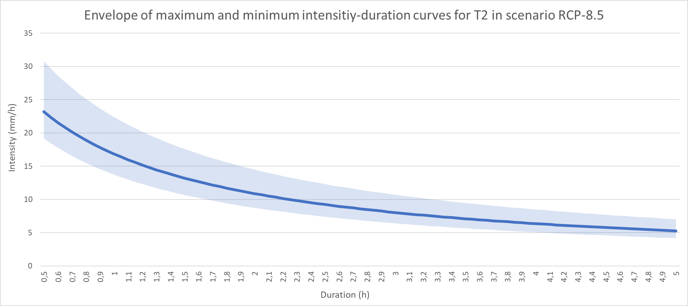
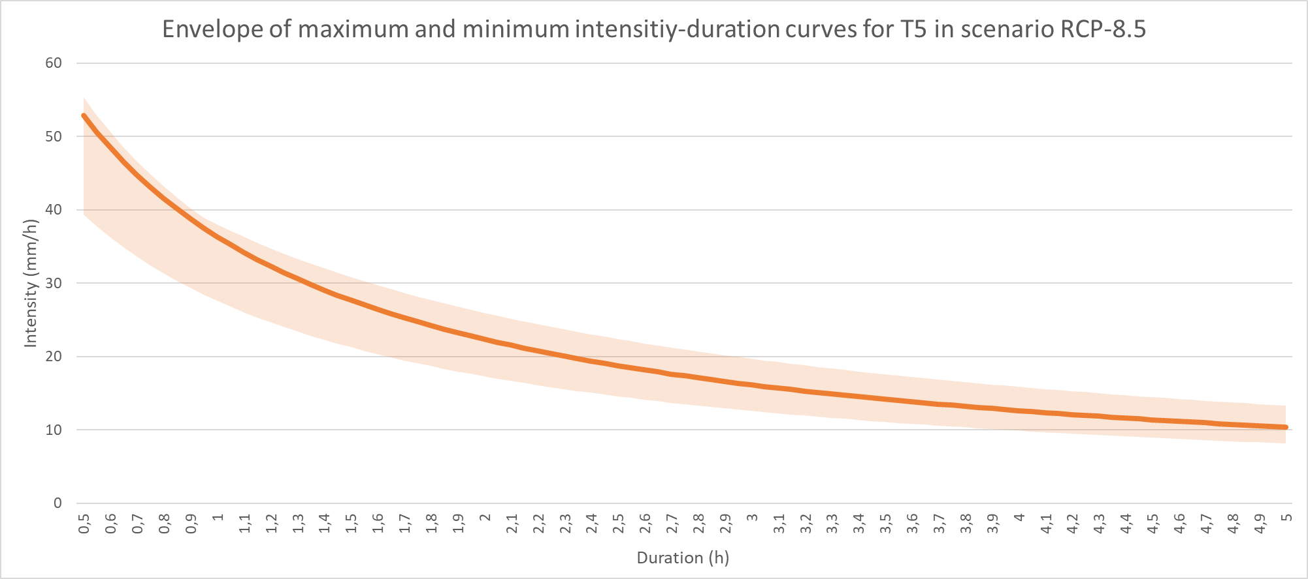
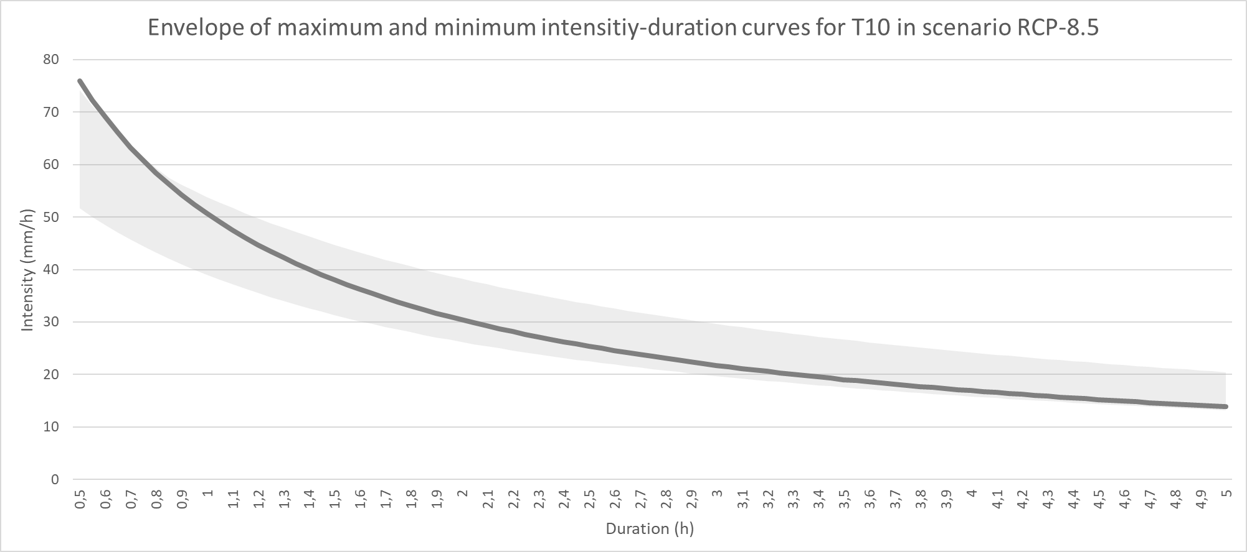
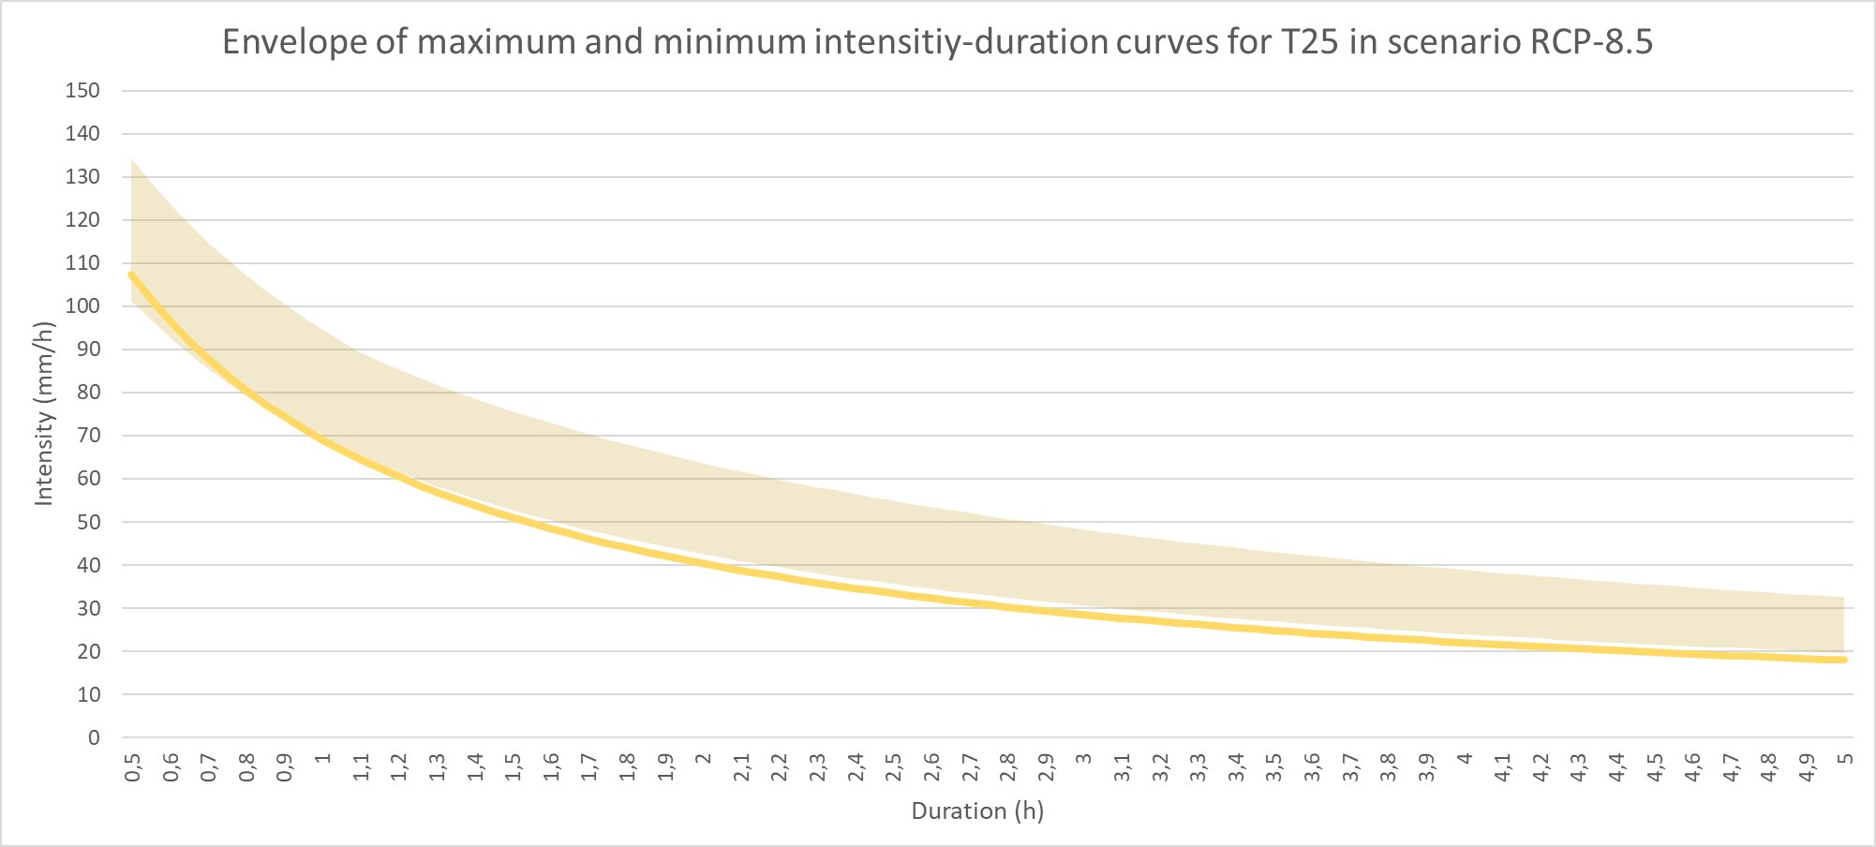
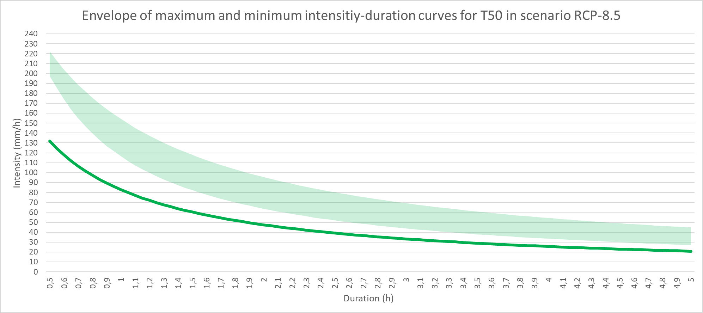
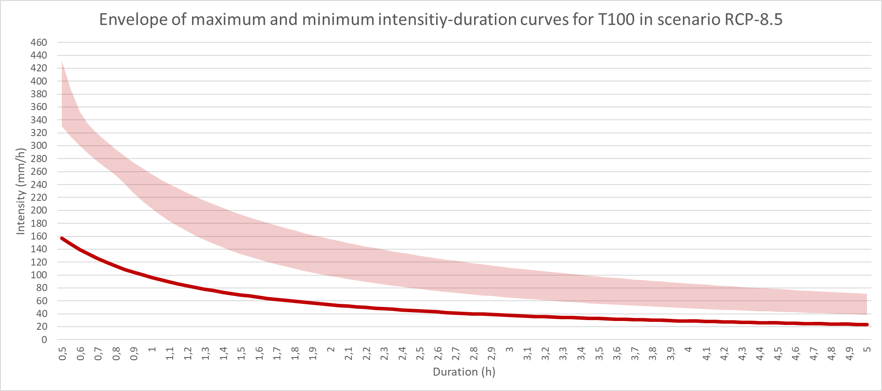
Resultados de proyecciones de precipitación con resolución horaria: Curvas IDF para el clima futuro (EURO-CORDEX).
Proyecciones de los modelos seleccionados para identificación de curvas IDF de clima futuro en escenario más desfavorable (IPCC AR-6): escenario RCP-8.5
Conclusiones:
En el caso de los ajustes de las proyecciones de CORDEX, igualmente se aprecia que para períodos de retorno inferiores a T25 podemos considerar que las presentes curvas IDF pueden ser representativas del clima futuro.
Considerando el escenario más desfavorable según AR-6 (producción energética basada en combustibles fósiles)
Sin embargo, para períodos de retorno iguales o superiores a T25 los incrementos en las curvas ajustadas son muy superiores a los obtenidos mediante CMIP-6.

Slide 22
Results on precipitation with hourly resolution: IDF curves for the future climate
Identification of models that best fit wih the historical IDF curves of Alicante
CMIP-6 experiments:
MPI-ESM1-2-HR_r1i1p1f1 (Max Planck Institute for Meteorology)
Most common rainfalls (pr > 1mm) in Alicante have a duration of 2 hours, with maximum intensity at 30 minutes
EUROCORDEX experiments:
CCCma-CanESM2_r1i1p1_CLMcom-CCLM4-8-17 (CLM Community with contributions by BTU, DWD, ETHZ, UCD,WEGC): For return period minor than T10
MPI-M-MPI-ESM-LR_r1i1p1_CLMcom-ETH-COSMO-crCLIM-v1 (CLM Community with contributions by BTU, DWD, ETHZ, UCD,WEGC): For return period greater or equal to T10

Slide 23
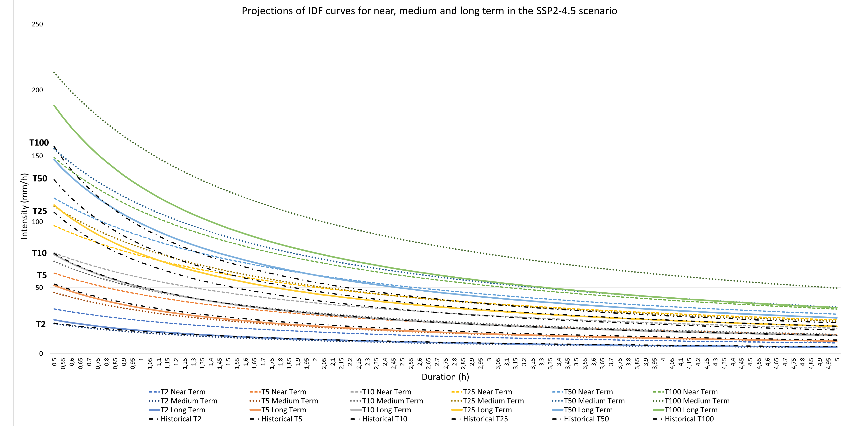


Results on precipitation with hourly resolution: IDF curves for the future climate
Projections of the models selected to identify the IDF curves of the future climate for SSP2-4.5 scenario
CMIP-6 experiments:
MPI-ESM1-2-HR_r1i1p1f1 (Max Planck Institute for Meteorology)
NOTES:
  In all cases worst scenario is linked with near term previsions.
  The results are highly influenced by the temporal downscaling method used.
  To determine the final value of intensity in the IDF curve, we will adopt the mean of values at near, medium and long term.

Slide 24
Results on precipitation with hourly resolution: IDF curves for the future climate
Projections of the models selected to identify the IDF curves of the future climate for SSP5-8.5 scenario
CMIP-6 experiments:
MPI-ESM1-2-HR_r1i1p1f1 (Max Planck Institute for Meteorology)
NOTES:
  In all cases worst scenario is linked with near term previsions.
  The results are highly influenced by the temporal downscaling method used.
  To determine the final value of intensity in the IDF curve, we will adopt the mean of values at near, medium and long term.

Slide 25

Results on precipitation with hourly resolution: IDF curves for the future climate
Projections of the models selected to identify the IDF curves of the future climate for RCP 8.5 scenario
EUROCORDEX experiments:
CCCma-CanESM2_r1i1p1_CLMcom-CCLM4-8-17 (T<10 years)
MPI-M-MPI-ESM-LR_r1i1p1_CLMcom-ETH-COSMO-crCLIM-v1 (T>= 10 years)
NOTES:
  In many cases worst scenario is linked with medium term previsions.
  The results are highly influenced by the temporal downscaling method used.
  To determine the final value of intensity in the IDF curve, we will adopt the mean of values at near, medium and long term.

Slide 26
Results on precipitation with hourly resolution: IDF curves for the future climate
Projections of the models selected to identify the IDF curves of the future climate for SSP2-4.5 scenario

Slide 27

Results on precipitation with hourly resolution: IDF curves for the future climate
Final IDF curve adopted for the future climate and future design hydrogram:
Conclusions:
Considering a scenario of intense climate change:
For return period under T25 we can consider that the present IDF curves can be representative for the future climate
For return period above it will be necessary to update the IDF curves in order to prevent posible increases on the extreme rainfalls, biggers as big is the return period.

Slide 28

Results on precipitation with hourly resolution: Torrentiality coefficient for the future climate
SSP 4.5

Slide 29






Results on precipitation with hourly resolution: Torrentiality coefficient for the future climate
CMIP-6:
SSP 2.6
SSP 4.5
SSP 8.5
CMIP-6 results for the month of higher historical torrentiality (september):
SSP 2.6
SSP 4.5
SSP 8.5

Slide 30
CONCLUSIONS AND NEXT STEPS
The least optimistic Climate Change forecast scenarios (SSP5-8.5 or Fossil Fuel Driven Development) show that:
There is a decreasing trend in the evolution of accumulated annual precipitation that can reach 35% in the period 2022-2100 (most probable scenario SSP2-4.5 / RCP 4.5).
There is a growing trend in the evolution of average, minimum and maximum temperatures. In the case of average temperatures, this increase can reach up to 3ºC in period 2022-2100 (most probable scenario SSP2-4.5 / RCP 4.5).
The precipitation intensities projected to the near, medium and long time for return periods up to 10 years are similar to those obtained by analyzing historical data.
The precipitation intensities projected in the future (most probable scenario SSP2-4.5 / RCP 4.5), for high return periods (from T25), are expected to increase in magnitude the greater the return period, thus, we obtain increases in precipitation intensity in 30-minute rains of up to 4.2% for T25, 38.5% for T50 and 86.7% for T100, compared with the IDF curves obtained with historical data.

Slide 31
CONCLUSIONS AND NEXT STEPS
The most probable Climate Change forecast scenarios (SSP5-4.5) show that:
Increase on rainfall intensity for higher return periods
+
Increase on terrentiality coefficient
Less precipitation
+
Increase on temperatures
Drought plans must be monitored and include protocols to deal with different levels of the problem (water for human consumption, irrigation, tourism, etc.).
Definition of strategies for water resources management ➔ regeneration and water reuse
Changes in the maximum rainfall regime will have a direct influence on the design hypotheses of the main drainage infrastructures in the city, generally designed for T25 or T50 depending on their hydraulic responsibility.
To adapt to climate change and evolve our cities to a resilient model, it is essential that local climate projections can be considered in urban planning tools. To do this, the data and results of these investigations must be permeable to local administrations. For that, it’s a good idea to relate data or climate service companies with water cycle management companies and/or local, regional or state administrations.

Slide 32
CONCLUSIONS AND NEXT STEPS
Mathematical/hydraulical modeling of the drainage network in the city.
Simulations of the behavior of the urban drainage network under the new precipitation boundary conditions caused by Climate Change.
Study and simulation of increase in the Mediterranean Sea level and it’s influence on the evacuation capacity of the network.
Evaluation of the influence of sustainable urban drainage infrastructures or nature-based solutions to increase the resilience of cities to extreme events linked to Climate Change.
Future climate risks and their economic consequences. Investment needs in hydraulic infrastructures (green or gray) to reduce the flooding risks.

Slide 33

How does the city of Alicante face the new future challenges?
In the very short term…
Sensorisation and telemetry
Decision support systems
Weather Warning Management FLOODALERT
Floods and sewer overflow warning system SIPAID
Bathing water quality control & forecast -COWAMA
But… what about the future?

Slide 34




How does the city of Alicante face the new future challenges?
2 lines of action:
Definition of planning strategies

Slide 35




How does the city of Alicante face the new future challenges?
2 lines of action:
Definition of planning strategies
Employing Nature-Based Solutions (NbS) and Sustainable Urban Drainage Systems (SUDS)
NbS working in Alicante:
La Marjal flooding park
http://www.hidrologiasostenible.com/sistemas-urbanos-de-drenaje-sostenible-suds/

Slide 36





How does the city of Alicante face the new future challenges?
NbS projected in Alicante
Future state
Current state
Detention areas+ bio-retention tanks
+ infiltration tanks
Detention areas+ bio-retention tanks
+ reticular tank (800 m3)
Retention tank (aljibe) (2.400 m3)
Infiltration trench

Slide 37


ADAPTATION STRATEGY:
ALICANTE’S STRATEGIC PLAN FOR THE URBAN WATER CYCLE
The Strategic Plan “Alicante Agua Circular” defines the priority infrastructures for the urban water cycle
Boosting water reuse
Protection of receiving water bodies (coastal waters)
Flood and sewer overflow prevention
WASTE WATER TREATMENT
REUSED WATER RESERVOIR
SOLAR ENERGY GENERATION
URBAN SUSTANAIBLE
DRAINAGE
RETENTION TANKS
REUSED WATER NETWORK
SEWER NETWORK RENEWAL

Slide 38




ADAPTATION STRATEGY: FLOODABLE PARKS
Via Parque
Capacity : 15,000 m3 (underground) + 15,000 m3 (above ground)
Budget: 6,000,000 €
Avenida de Elche
PAU-1
Capacity: 20,000 m3 (above ground)
Budget: 1,500,000 €.
Capacity 10,000 m3 (underground) + 10,000 m3 (above ground)
Budget: 4,500,000€

Slide 39
ADAPTATION STRATEGY: FLOODABLE PARKS
Via Parque
Capacidad : 15.000 m3 (enterrados) + 15.000 m3 (superficie)
Ppto.: 6.000.000 €
Avenida de Elche
PAU-1
Capacidad: 20.000 m3 (superficie)
Ppto.: 1.500.000 €.
Capacidad 10.000 m3 (enterrado) + 10.000 m3 (superficie)
Ppto.: 4.500.000€

Slide 40

ADAPTATION STRATEGY: RETENTION TANKS
Construction of 9 Underground Tanks for the retention of combined sewer waters
Total storage capacity:
80,500 m³
Global budget:
36,525 k€

Slide 41
ADAPTATION STRATEGY: RETENTION TANKS
Construcción de 9 tanques de tormenta para retención de aguas unitarias
Capacidad total de almacen.:
80.500 m³
Ppto. global:
36.525 k€

Slide 42

Thanks for your attention!
Questions?

Slide 43
Nature based Solutions (NbS)
Sustainable Drainage Systems (SuDS)
http://www.hidrologiasostenible.com/sistemas-urbanos-de-drenaje-sostenible-suds/
Sustainable drainage systems (SuDS) are drainage solutions that provide an alternative to the direct channelling of surface water through networks of pipes and sewers to nearby watercourses.
Nature-based Solutions are actions to protect, sustainably manage and restore natural and modified ecosystems in ways that address societal challenges effectively and adaptively, to provide both human well-being and biodiversity benefits” (IUCN, 2016)
storing or re-using surface water at source
decreasing flow rates to watercourses
improving water quality
(BGS Research)

